Slide 1
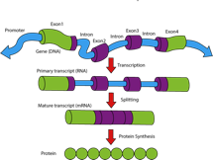
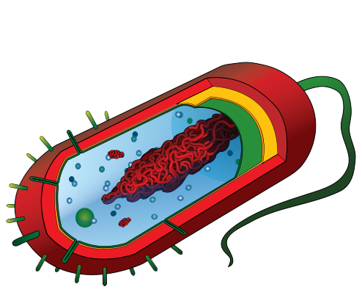
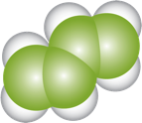
From Megabytes to Megabases
Building a Fab to Enable Synthetic Biology
Using Synthetic Genes…
to Program Cells to Become
Factories to Make…
Devices, Sensors, Pharmaceuticals, Renewable Chemicals & Fuels and Food
MIT Molecular Machines (Jacobson) Group
jacobson@media.mit.edu

Slide 2
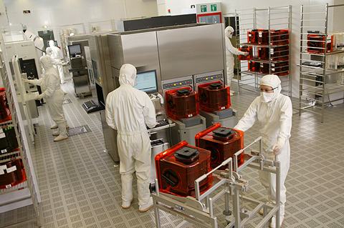
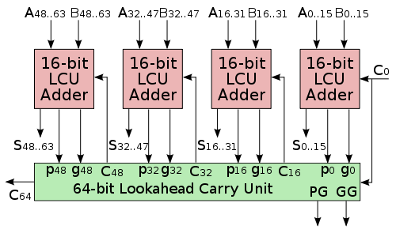
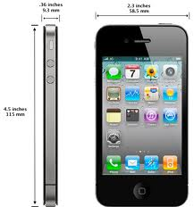
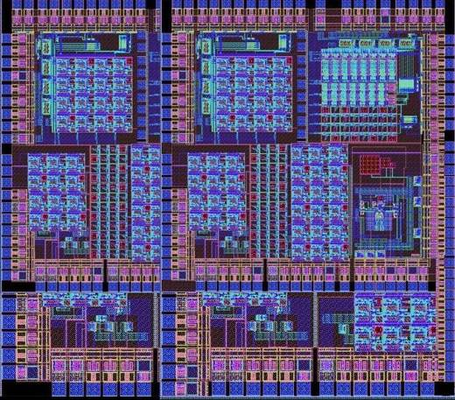
Moore’s Law for Silicon
From Schematic Design
To Fab
To Product
To Working Chip
http://www.national.com/company/pressroom/gallery/graphics/full_sized/06_rgb.jpg http://commons.wikimedia.org/wiki/File:InternalIntegratedCircuit2.JPG http://en.labs.wikimedia.org/wiki/File:64-bit_lookahead_carry_unit.svg
Notes:
2
2

Slide 3
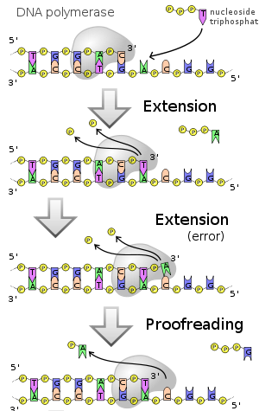
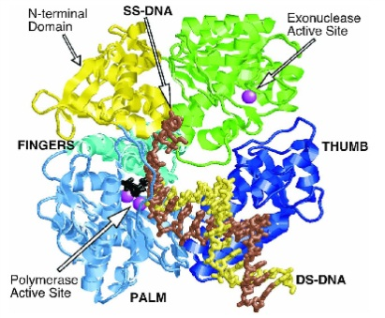
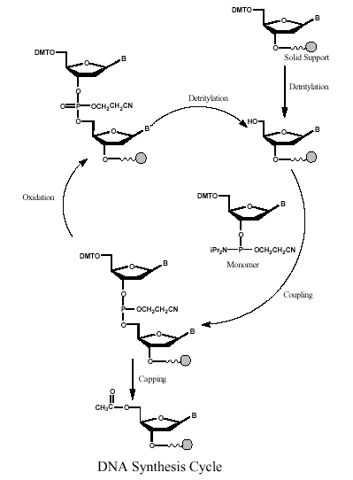
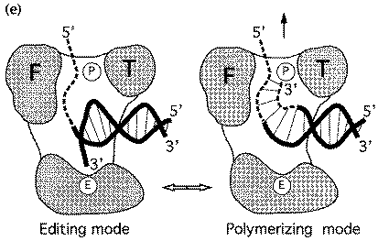
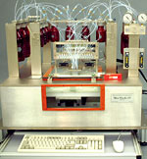
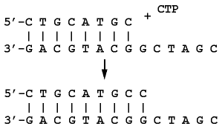
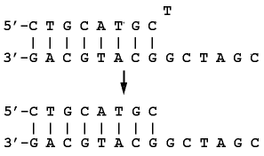
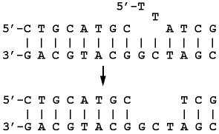
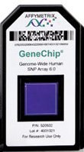
DNA Synthesis
Chemical Synthesis (Open Loop Protection Group) | Biological Synthesis (Error Correcting Polymerase)
Error Rate: 1:10² Throughput: 300 S per Base Addition http://www.med.upenn.edu/naf/services/catalog99.pdf
Throughput Error Rate Product Differential: ~10⁸
Error Rate: 1:10⁶
Throughput: 10 mS per
Base Addition
Beese et al. (1993), Science, 260, 352-355. http://www.biochem.ucl.ac.uk/bsm/xtal/teach/repl/klenow.html
template dependant 5'-3'
primer extension
3'-5' proofreading
exonuclease
5'-3' error-correcting
exonuclease
Example: [A] Synthesize 1500 Nucleotide Base Gene. Error Rate = 0.99
(0.99)¹⁵⁰⁰ ~ 10⁻⁷. [B] 3000 Nucleotide Base Gene. (0.99)³⁰⁰⁰ ~ 10⁻¹³.

Slide 4
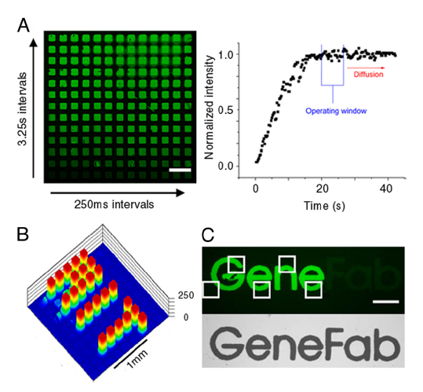
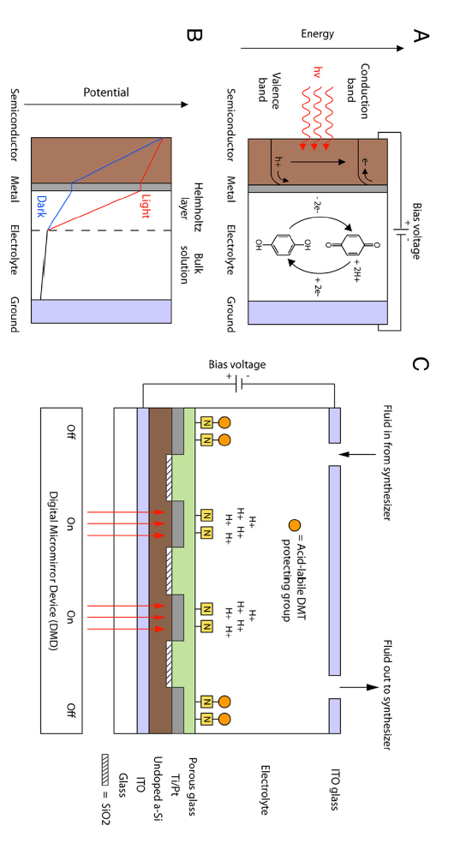
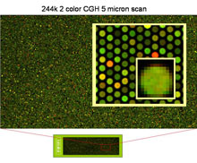
~ 1M Oligos/Chip
Chip Based Oligo Nucleotide Synthesis
~1000x Lower Oligonucleotide Cost
Chow, Brian Y., Christopher J. Emig, and Joseph M. Jacobson. "Photoelectrochemical synthesis of DNA microarrays." Proceedings of the National Academy of Sciences 106.36 (2009): 15219-15224.
http://www.technologyreview.com/biomedicine/20035/
http://learn.genetics.utah.edu/content/labs/microarray/analysis
Accurate multiplex gene synthesis from programmable DNA microchips
Jingdong Tian, Hui Gong, Nijing Sheng, Xiaochuan Zhou, Erdogan Gulari, Xiaolian Gao and George Church
Nature 432, 1050-1054(23 December 2004)
doi:10.1038/nature03151

Slide 5
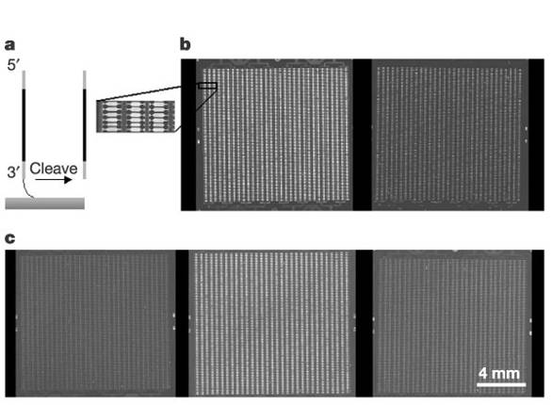
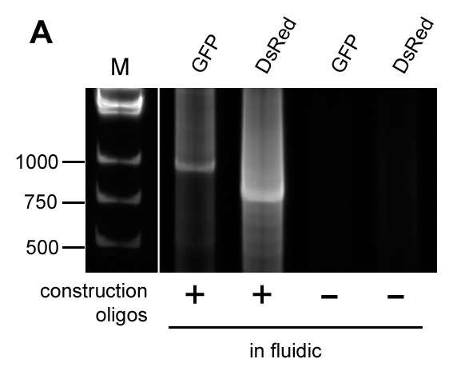
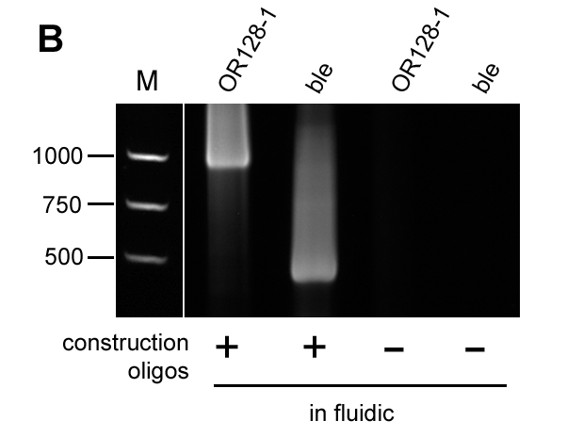
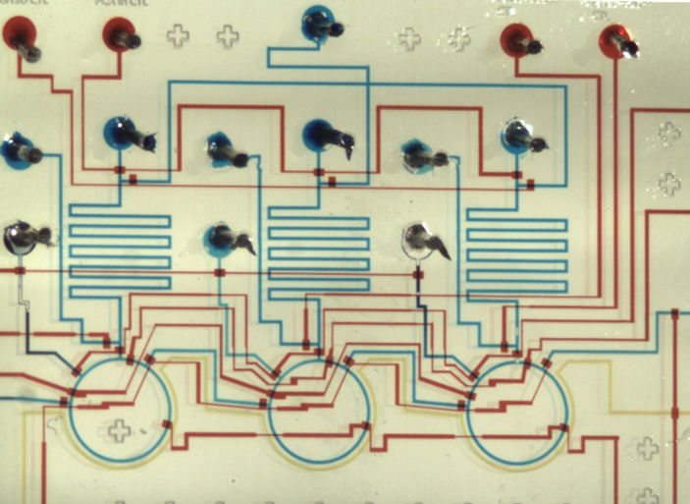
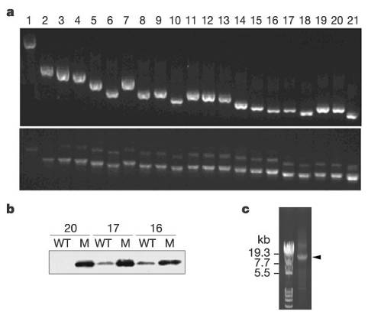
Chip Based Gene Synthesis
1
2
Accurate multiplex gene synthesis from programmable DNA microchips
Jingdong Tian, Hui Gong, Nijing Sheng, Xiaochuan Zhou, Erdogan Gulari, Xiaolian Gao and George Church
Nature 432, 1050-1054(23 December 2004)
doi:10.1038/nature03151
Parallel gene synthesis in a microfluidic device
D.S. Kong, P.A. Carr, L. Chen, S. Zhang, J.M. Jacobson Nucleic Acid Research , 2007, Vol. 35, No. 8 e61

Slide 6
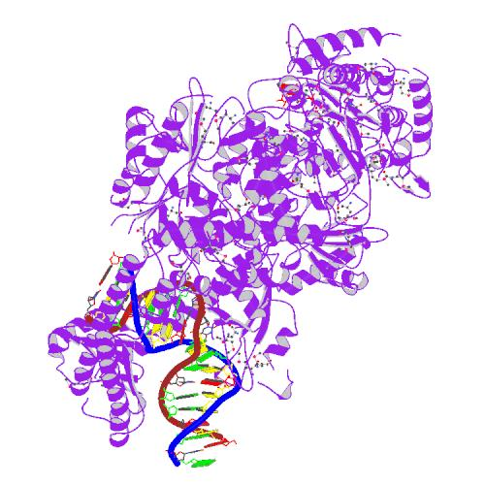
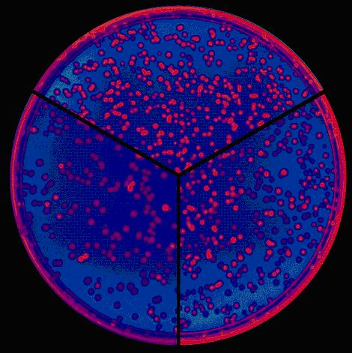
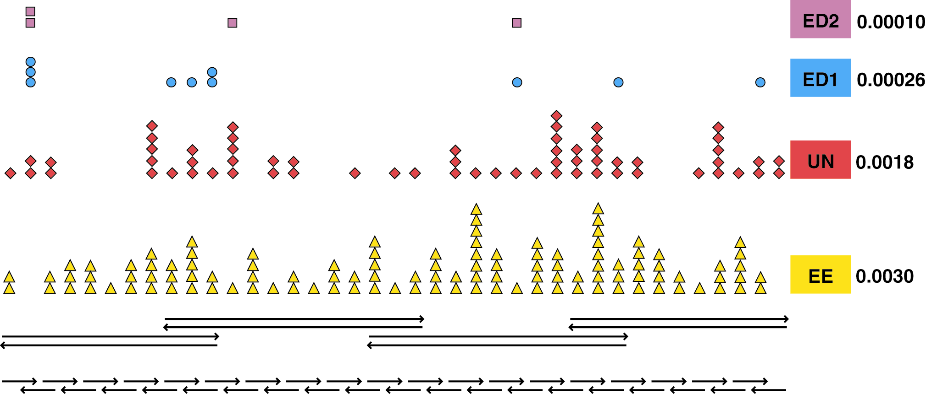
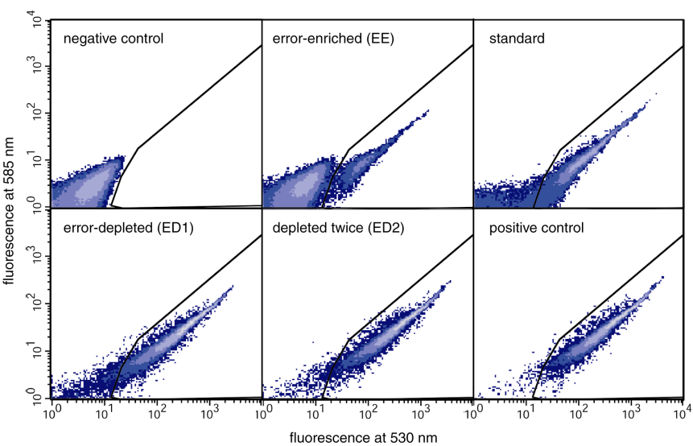
Error Correcting Gene Synthesis
X
X
X
Error Rate 1:10⁴
Lamers et al. Nature 407:711 (2000)
Nucleic Acids Research 2004 32(20):e162
Nucleic Acids Research 2004 32(20):e162

Slide 7
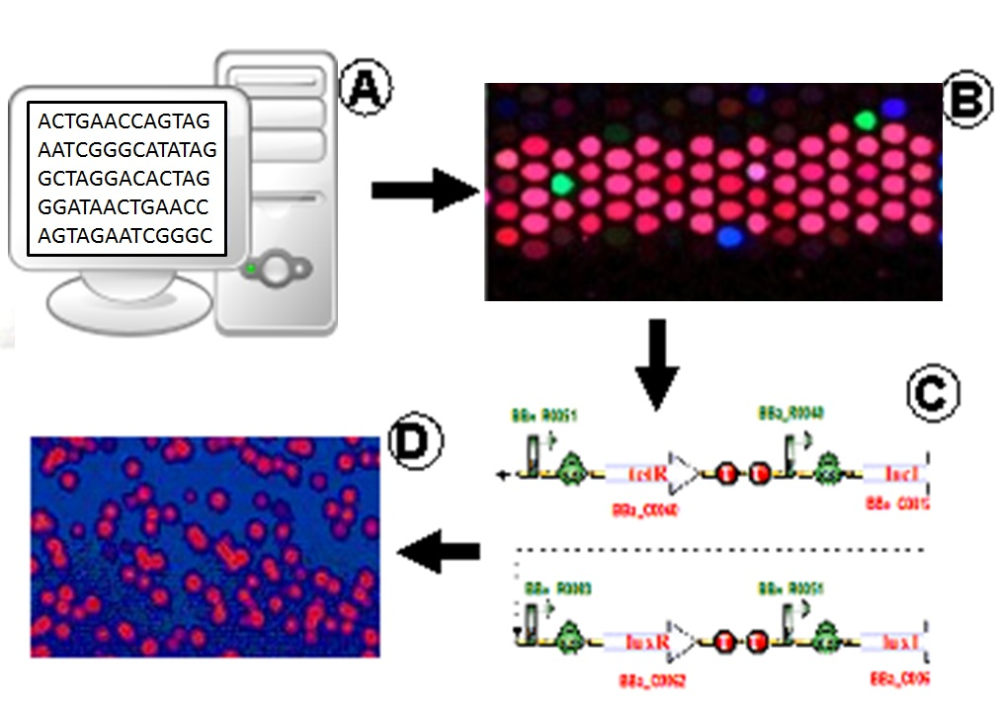
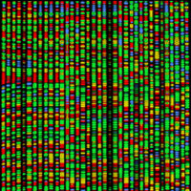
FAB: From Bits to Pathways

Slide 8
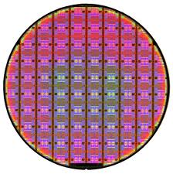
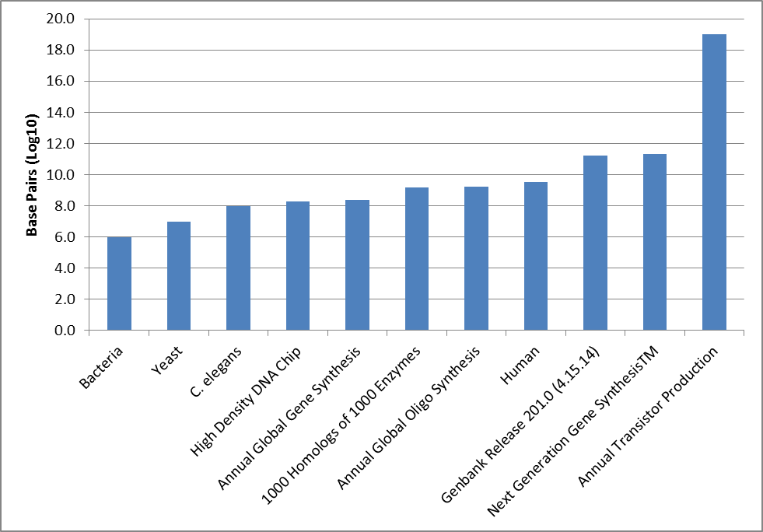
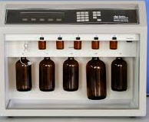
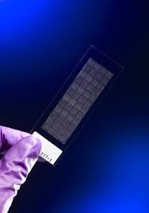
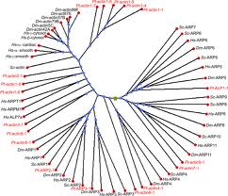
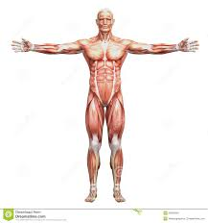
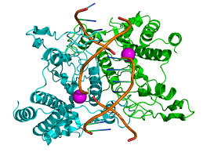
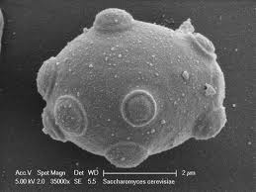
Scale Factors in DNA Synthesis & Applications
100T
1T
Base Pairs
10G
100M
10000000000 G Transistors
1M
97 Mbp
~ 200 Mbp
~ 250 Mbp
~ 1.5 Gbp
~ 1.6 Gbp
~ 3.2 Gbp
159.8 Gbp
~ 200 Gbp
12.2 Mbp
~1-13 Mbp
J. Jacobson – MIT CBA – 5.1.14

Slide 9
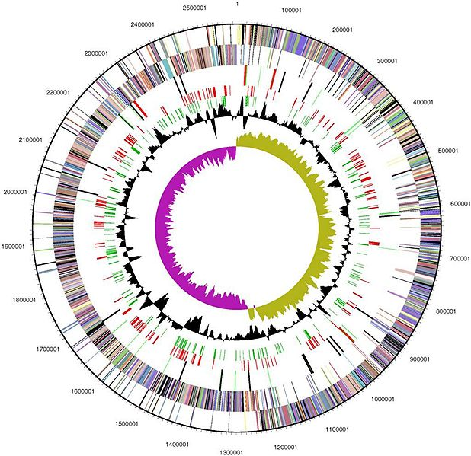
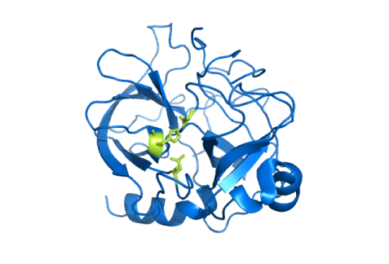
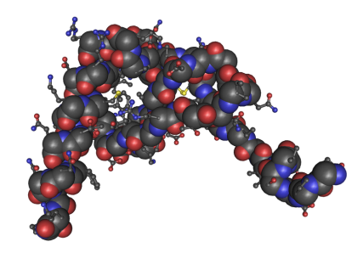
Synthesizing GenBank
GenBank Release 194 : 260,000 Organisms : >150 Billion Bp : > 25 B ESTs : Growing ~60% Per Year (18 Month Doubling)
Enzyme Homologs
Human Drug Targets
(Proteins)
1000 Enzymes * 1000 Homologs
= 1.5 Gb
100,000 Splice Variants *1.5 Kb
= 150 Mb
Synthetic Yeast 2.0 - Building the World's First Synthetic Eukaryotic Genome
Sources:
http://commons.wikimedia.org/wiki/File:CallystatinA-modular.jpg
http://commons.wikimedia.org/wiki/File:1ESR_Human_Monocyte_Chemotactic_Protein-2_01.png
http://commons.wikimedia.org/wiki/File:Chymotrypsin_enzyme.png
http://www.ncbi.nlm.nih.gov/pmc/articles/PMC2238942/
http://commons.wikimedia.org/wiki/File:Halo_genome.jpg

Slide 10
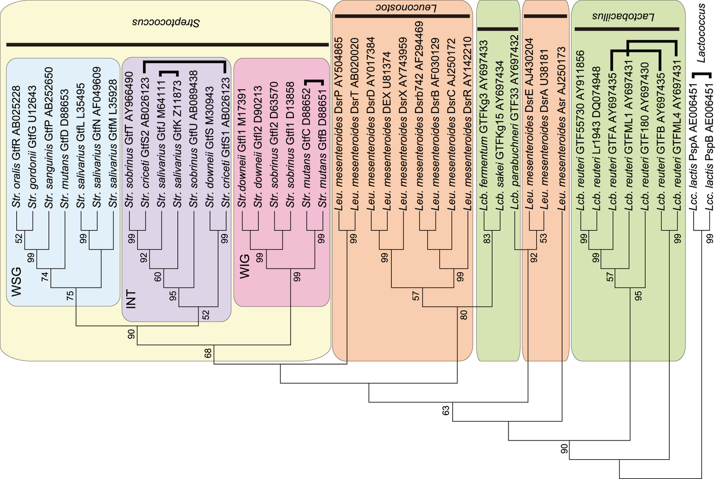
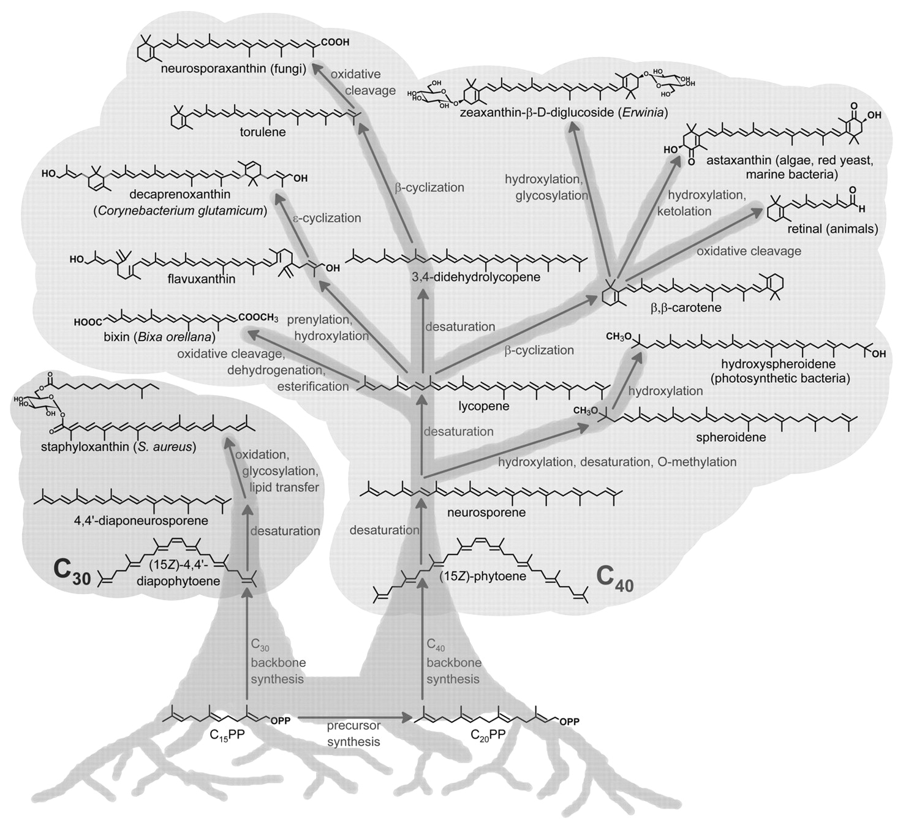
Synthesizing Phylogenetic Trees
Enzyme Homologs
1000 Enzymes * 1000 Homologs
= 1.5 Gb
http://mmbr.asm.org/content/69/1/51/F1.large.jpg
http://www.nature.com/srep/2012/120718/srep00518/images/srep00518-f1.jpg

Slide 11
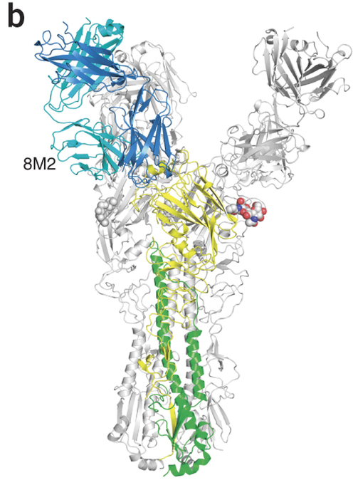
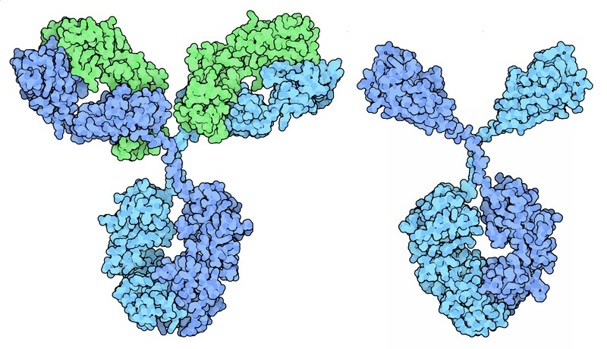
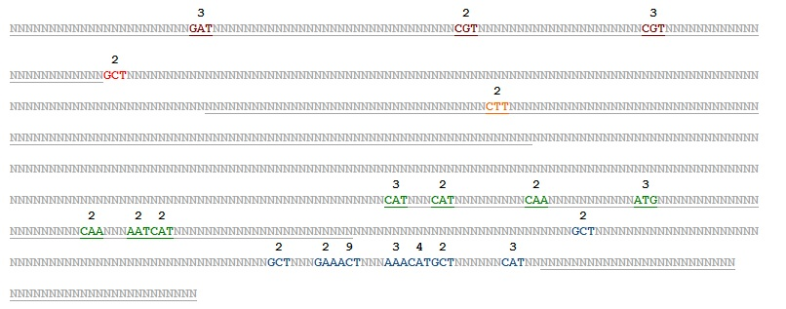
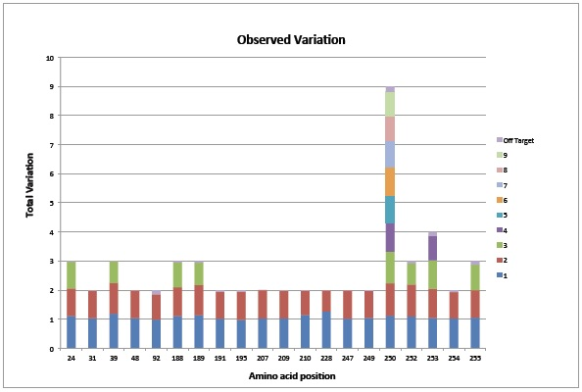
Antibody Engineering
Random Library: 20 Amino Acids: 20²⁰ = 10²⁶ Unscreenable
Next Gen Synthetic Library: No.of Variants=18*2*2*288*5184=107,495,424=10⁸ Screenable
http://www.nature.com/nsmb/journal/v20/n3/fig_tab/nsmb.2500_F1.html

Slide 12
Molecular Machines Group
Noah Jakimo
Lisa Nip
Divya Arcot
Jalena Mandic
Charles Fracchia

Slide 13
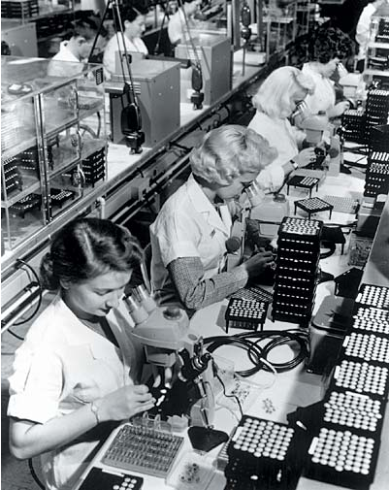
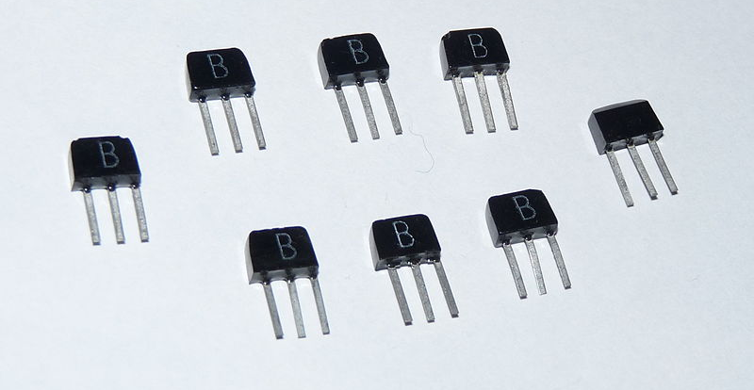
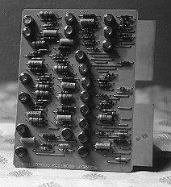
The Tyranny of Numbers
"For some time now, electronic man has known how 'in principle' to extend greatly his visual, tactile, and mental abilities through the digital transmission and processing of all kinds of information. However, all these functions suffer from what has been called 'the tyranny of numbers.' Such systems, because of their complex digital nature, require hundreds, thousands, and sometimes tens of thousands of electron devices." -J.A. Morton, Bell Laboratory 1957
http://www.webenweb.co.uk/museum/comps.htm
http://www.chipsetc.com/the-transistor.html

