Slide 1
How To Make Radically New Genomes D→B→A→D …1015-1030 AM 1-May-2014 CBA Cambridge MA
Thanks, contributions, disclosures:
ow.ly / wk5IB
Notes:
Thank you & conflict of interests reminder

Slide 2
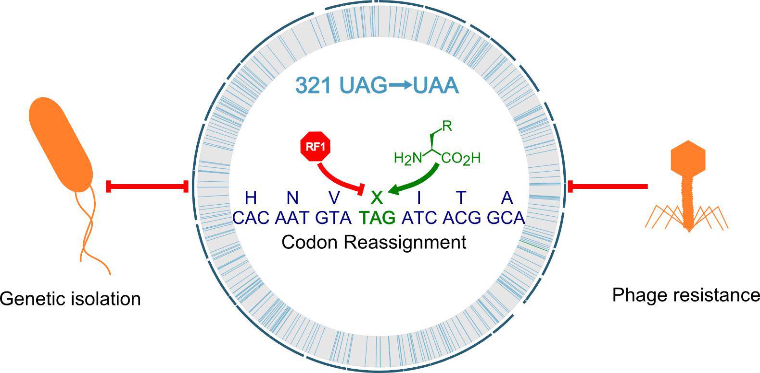
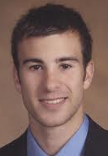
Why Radical Genome Recoding? 4 New functions
4.7 Mbp
3. New Chemistry
4. Virus Resistance
1. Genetic Isolation
2. Metabolic Isolation
Lajoie MJ, et al Genomically Recoded Organisms Impart New Biological Functions. Science 2013
Notes:
Some of the environmental components in red are genomic and epigenomics in green with costs dropping a million fold. Also medical records via Google Health

Slide 3
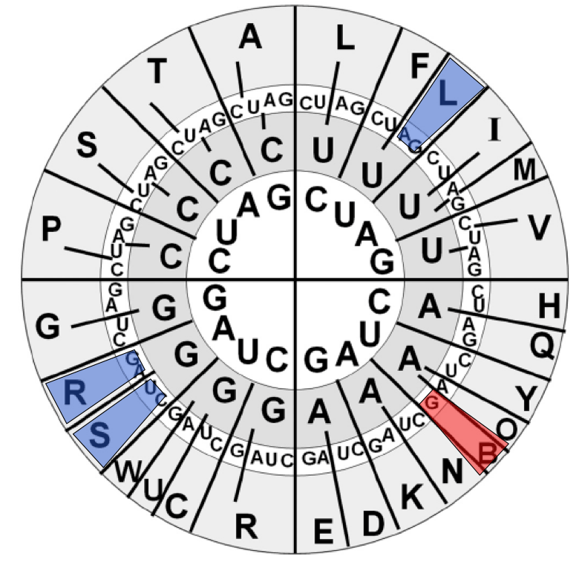
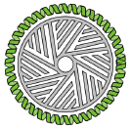
How To Make Radically New Genomes D→B→A→D …
Chip Synthesis
Genome CAD: new functions & codes
Genetic Isolation & Multi-virus resistance
Novel AAs & Metabolic Isolation
5. Sensor selectors
6. Human Genome Editing
Build
Design
Test
Analyze

Slide 4
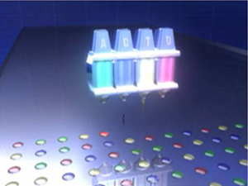
Next-Gen DNA Synthesis: 10kb/$
8*90K CustomArray Electrolytic
80K LCSci/Mycroarray Photo-Acid
55K Agilent Ink-jet
4M Roche Photo 5’ protection
Amplify pools with flanking universal primers
Paths to error correction
1.Hyb-Select: Tian et al. 2004 Nature
2. MutS: Carr & Jacobson 2004 NAR
3. MutHLS: Smith & Modrich 1997 PNAS
4. Endo/Exonuclease : Bang Nat Meth. 2008
5. Errase
6. Sequencing

Slide 5
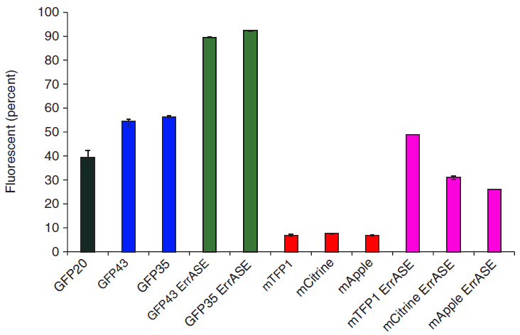
Chip DNA accuracy
Kosuri et al
Nature Biotech
200-mer 250
130-mer 1300
130+Errase 5940
5
Notes:
5
5940

Slide 6
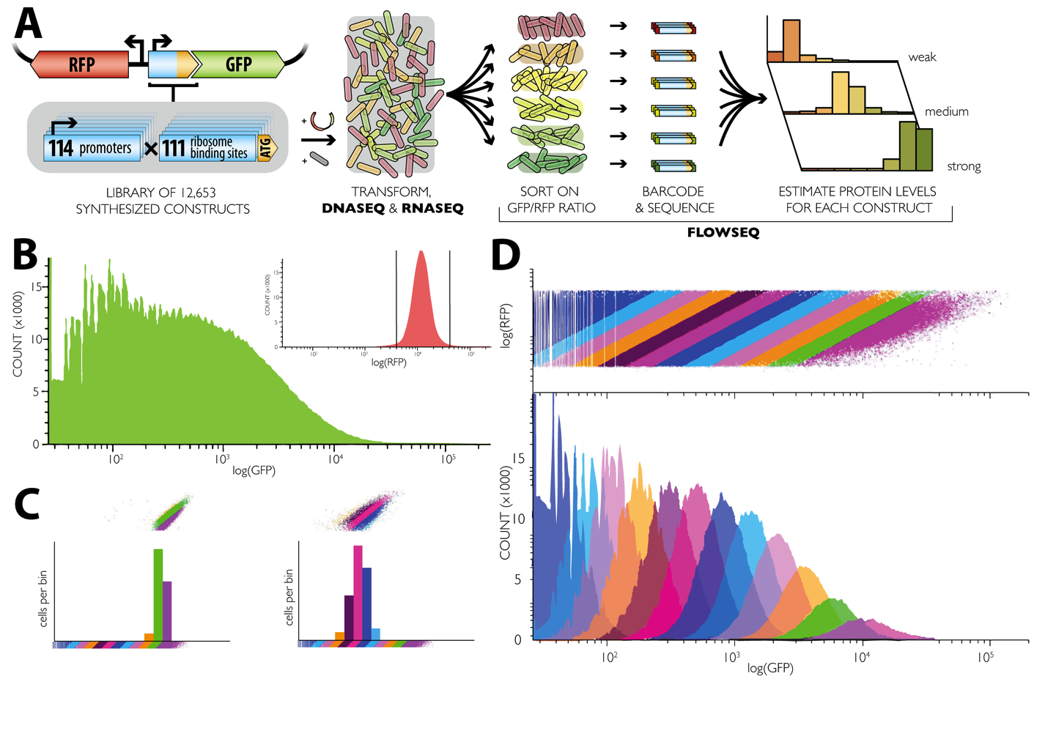
Cis Regulatory Interactions
Notes:
Import three DEBS polyketide synthase modules. Use yeast MAGE to generate diversity and sensor-selectors to enrich for strains generating desirable products.
Use MphR sensor selector currently functional in E.coli,
Use MphR sensor selector currently functional in E.colifo
Recoded debs tested successfully for expression and activity in E. coli
We are currently testing in yeast the expression/activity of the ketoreductase domain 1 of debs1 (it does not depend of PTMs), and of debs1 (it needs PTMs from 4'-phosphopantetheinyl transferase).

Slide 7
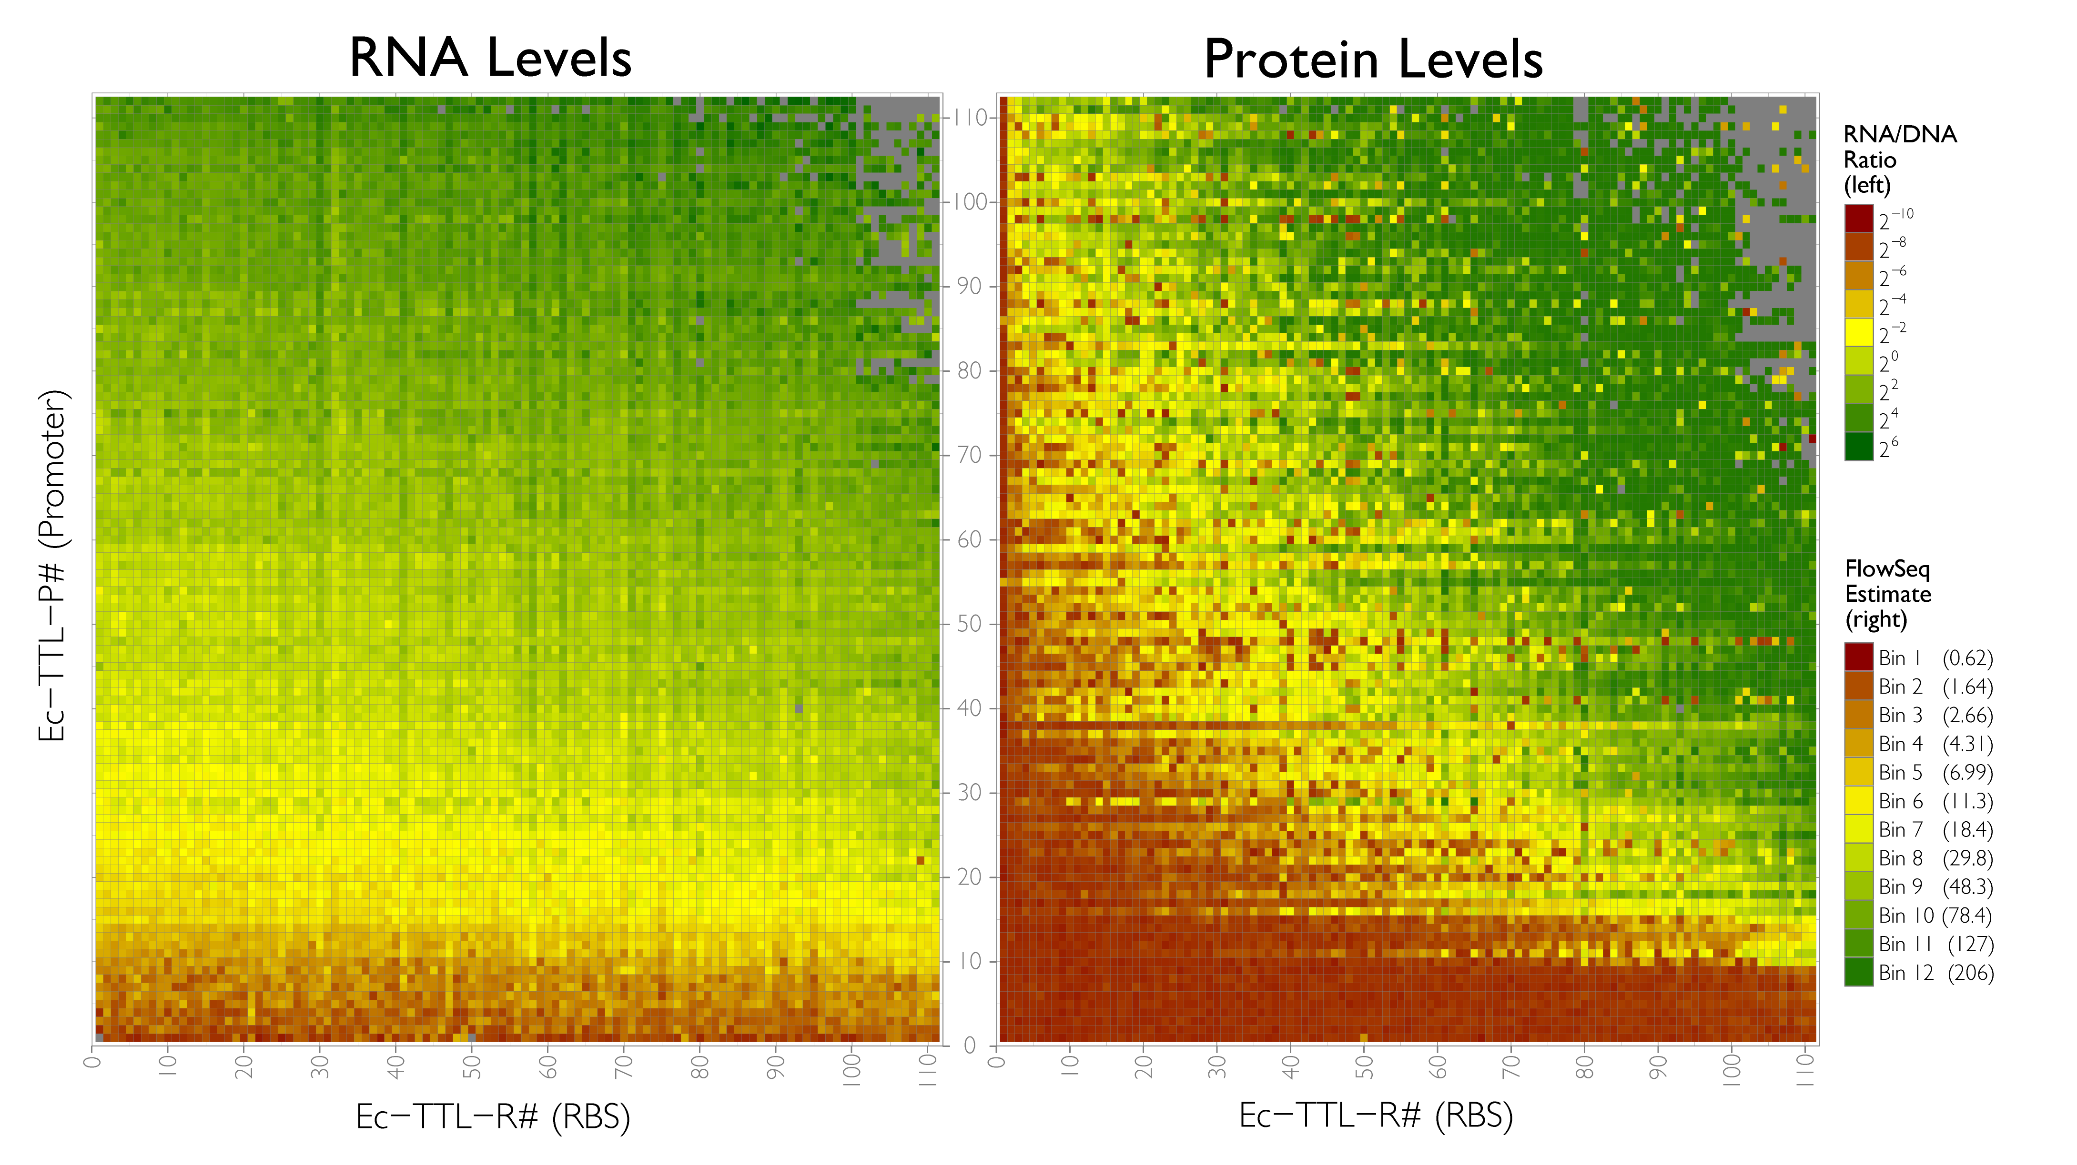
Kosuri, Goodman, et al.
Notes:
Import three DEBS polyketide synthase modules. Use yeast MAGE to generate diversity and sensor-selectors to enrich for strains generating desirable products.
Use MphR sensor selector currently functional in E.coli,
Use MphR sensor selector currently functional in E.colifo
Recoded debs tested successfully for expression and activity in E. coli
We are currently testing in yeast the expression/activity of the ketoreductase domain 1 of debs1 (it does not depend of PTMs), and of debs1 (it needs PTMs from 4'-phosphopantetheinyl transferase).

Slide 8
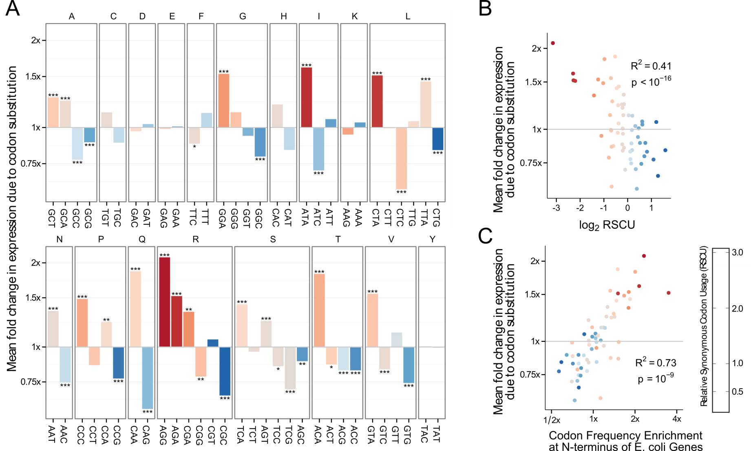
Causes & Effects of N-Terminal Codon Bias in Bacterial Genes
Freq. in genome
Freq. at N-term
Goodman, Church, Kosuri. Science 2013
Notes:
A: each codon affects expression
B: Mean effect on expression vs. relative synonymous codon usage
C: Mean effect on expression vs. codon frequency near N-terminus relative to rest of gene

Slide 9
How To Make Radically New Genomes
Chip Synthesis
Genome CAD: new functions & codes
Genetic Isolation & Multi-virus resistance
Novel AAs & Metabolic Isolation
5. Sensor selectors
6. Human Genome Editing
Build
Design
Test
Analyze

Slide 10
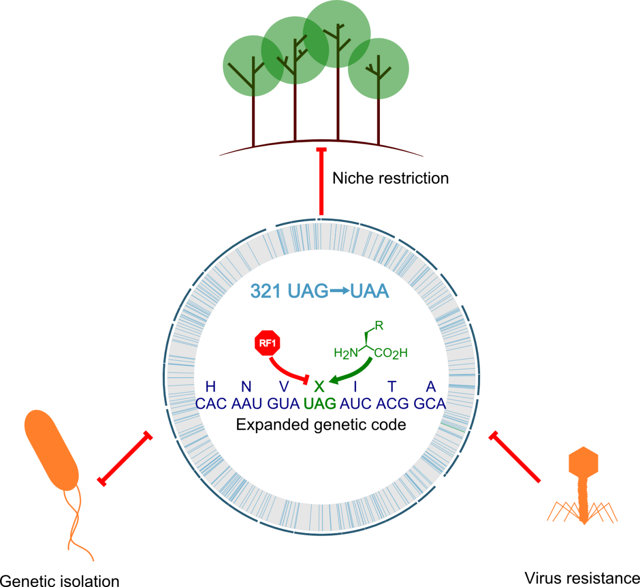
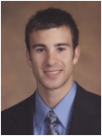
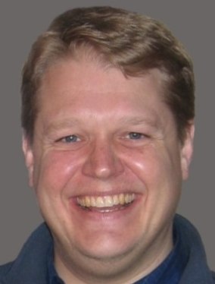
Generalizable strategy to reassign codon function
Science 2013: Lajoie, Rovner, Goodman, Aerni,
Haimovich, Kuznetsov, Mercer, Wang,
Carr, Mosberg, Rohland, Schultz,
Jacobson, Rinehart, Church, Isaacs

Slide 11
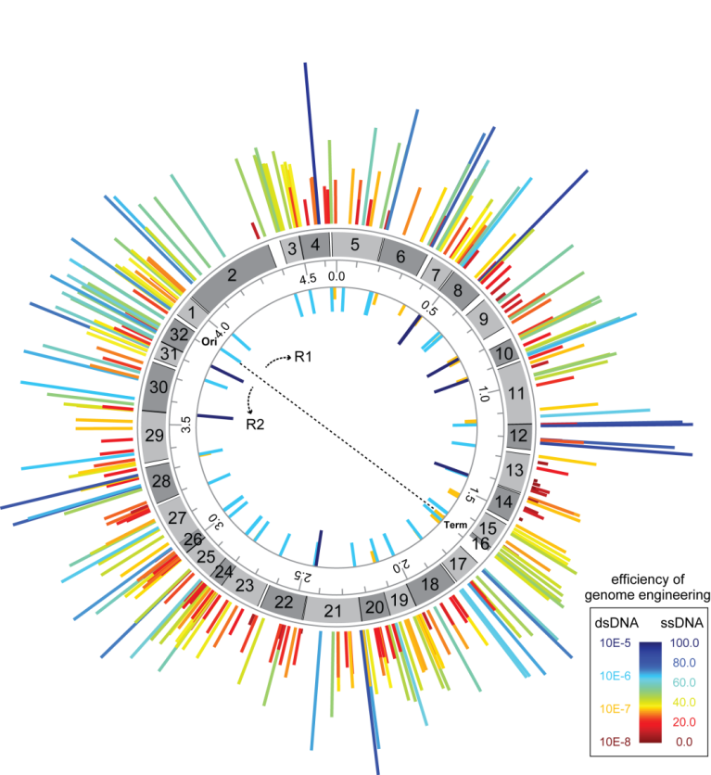
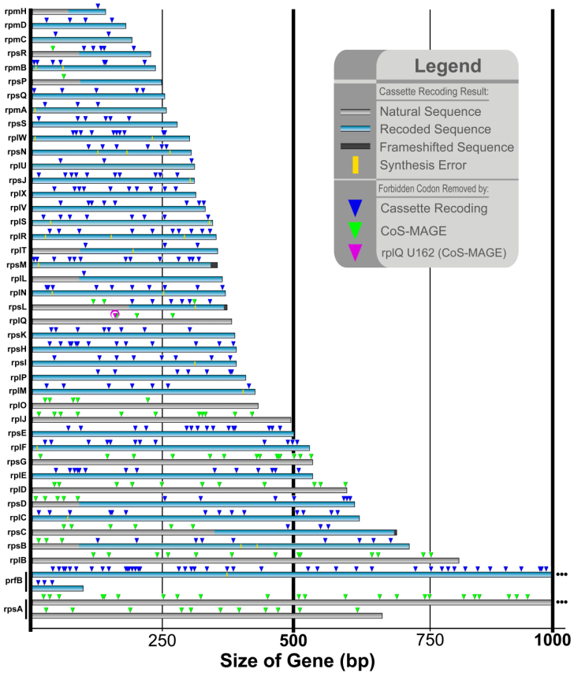
Combinatorial de-risking of whole genome design
LaJoie et al Probing the limits of genetic recoding in essential genes. Science 2013
Genome-wide UAG
reassignment
Recoding 13 codons in 42 ribosomal essential genes
Recoding AGG & AGA codons in all essential genes

Slide 12
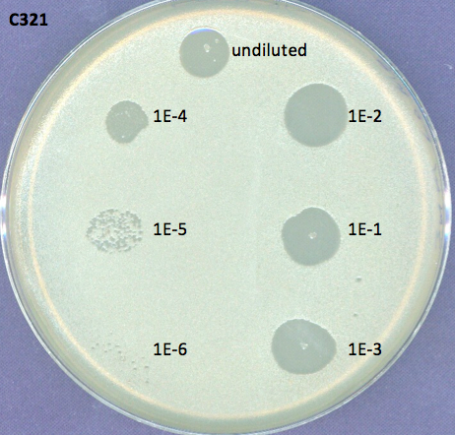
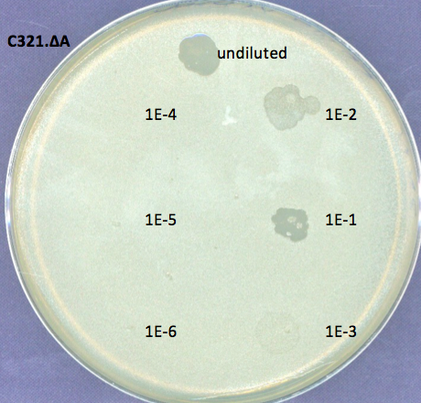
Non-functional UAG attenuates λvir infection
Lajoie unpublished
Notes:
T7 fitness: measures how fast a phage infection expands (function of infection efficiency, burst size, and lysis time)
Mean lysis time: measures how long it takes for half of the infected cells to lyse

Slide 13
Non-functional UAG attenuates T7 infection
Lajoie et al. Science 2013
Notes:
T7 fitness: measures how fast a phage infection expands (function of infection efficiency, burst size, and lysis time)
Mean lysis time: measures how long it takes for half of the infected cells to lyse

Slide 14
How To Make Radically New Genomes
Chip Synthesis
Genome CAD: new functions & codes
Genetic Isolation & Multi-virus resistance
Novel AAs & Metabolic Isolation
5. Sensor selectors
6. Human Genome Editing
Build
Design
Test
Analyze

Slide 15
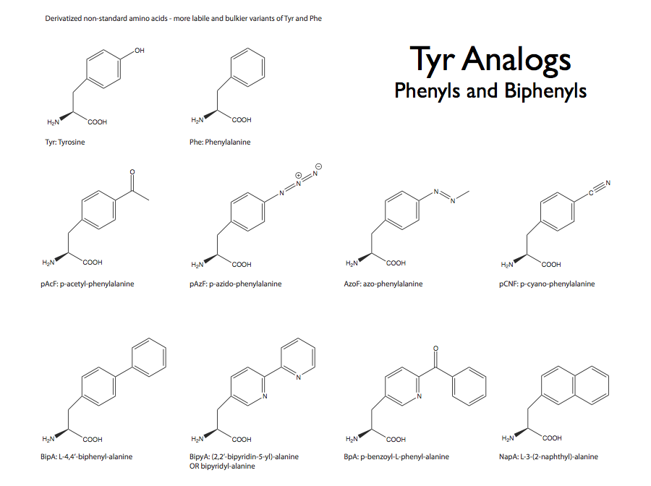
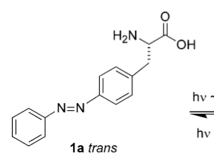
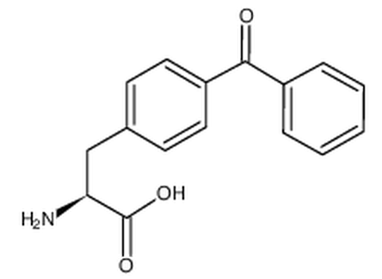
BipA

Slide 16
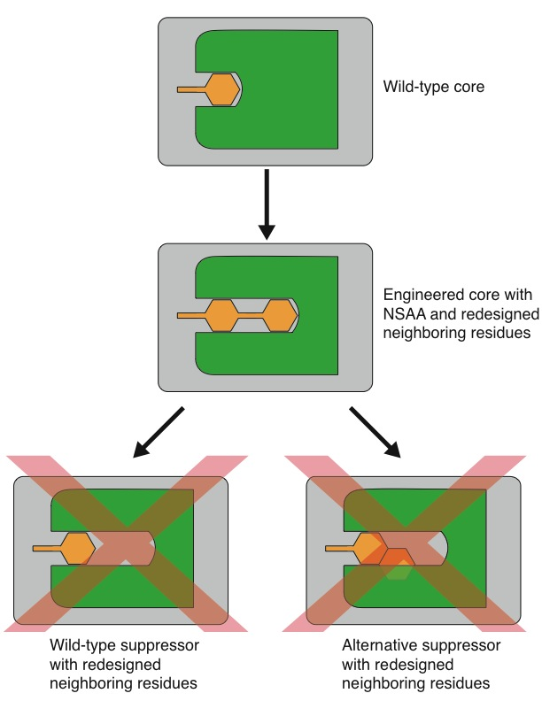
Computational “adjacent AA suppressor” strategy to rebuild essential protein cores for NSAAs
Starting with 120 known crystal structures
Failure modes:
Tolerance
Near-cognate suppression
Escape
tRNA anticodon mutations
UAG reversion
Solutions:
Exclude canonical amino acids
Require compensatory mutations
Reduce spontaneous mutation freq.
mutS⁻: 2x10⁻⁸
mutS⁺: 10⁻¹⁰

Slide 17
BipA (nsAA) vs asd & thy auxotrophs growth on cell lysates
4x10⁴ cells
10⁷ cells
 | Parent | ∆asd | ∆asd ∆thy |  | tyrS D10 mutS⁺
LB Lysate | ~1e4 | 0 | 0 |  | 0
M9 Lysate | ~1e4 | 0 | 1 |  | 0
M9 ∆K Lysate | ~1e4 | 459 | 309 |  | 0
M9∆K + insol Lysate | ~1e4 | ~1e4 | 429 |  | 6
~1e4 = lawn
Data from Mike Mee
Notes:
While we’re still determining DAP/thy escape rates / tuning plating parameters, our approach seems to provide additional safeguards over DAP/thy knockouts

Slide 18
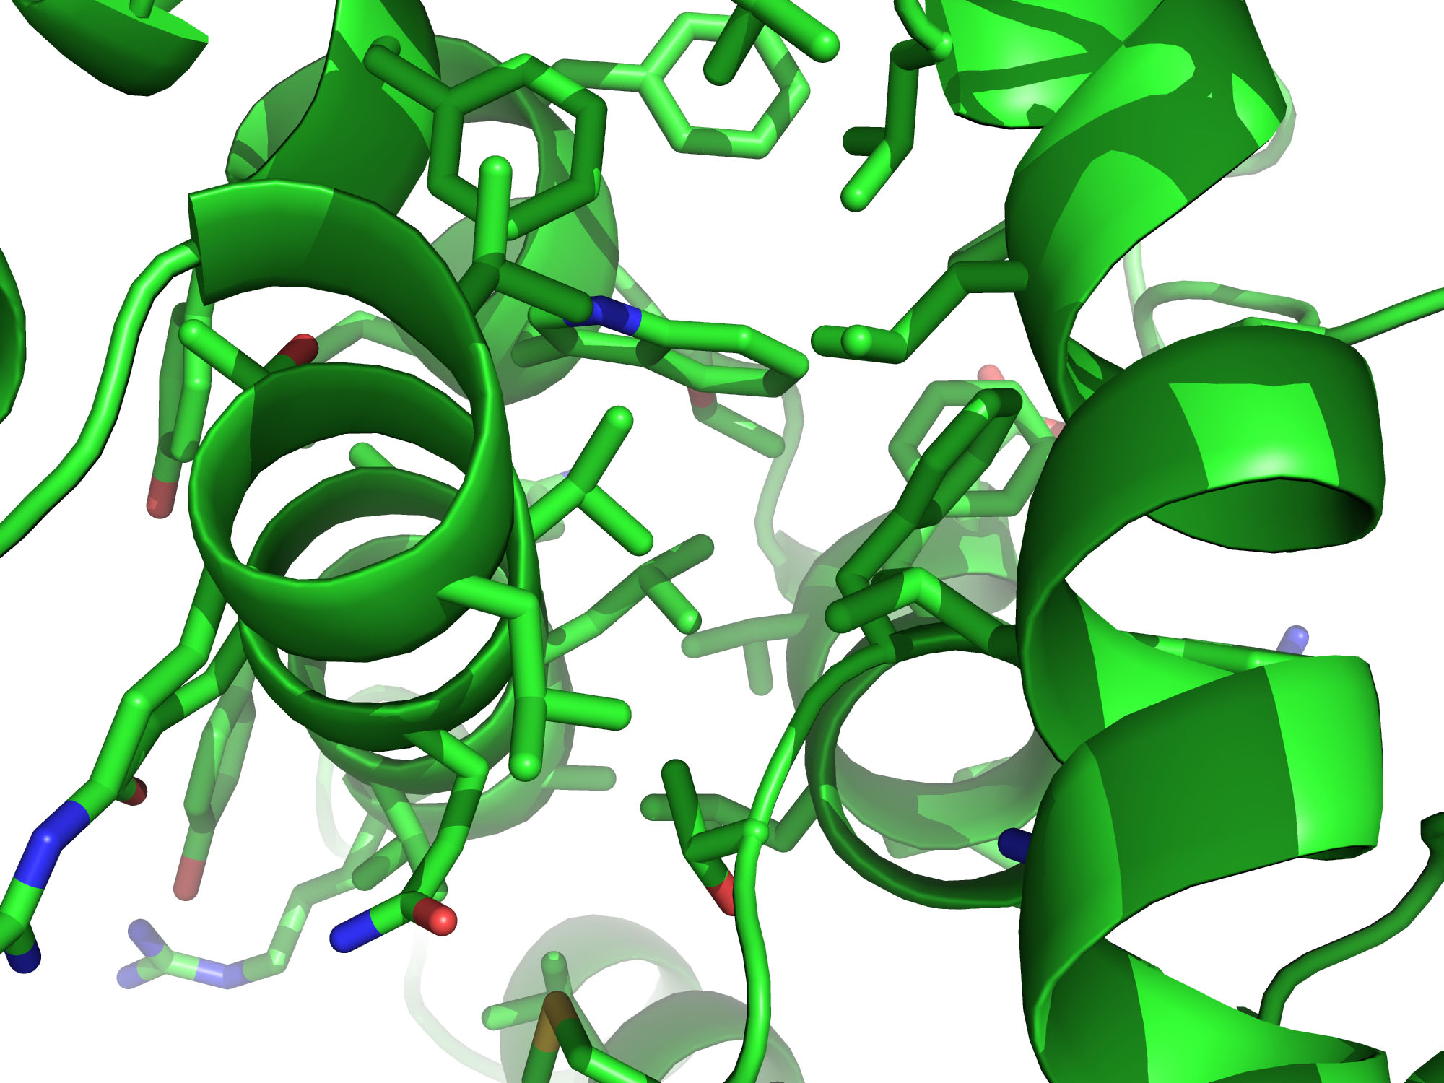
Notes:
Identified protein with suitable core to redesign
Identified residue to replace with bipA
bipA insertion
Identify shell of side chains in proximity of bipA
Initial compensation (automated)
Identify residues to keep, change back to wild type, and change to a different design (manual)
Optimized structure for bipA (this is the design that we want to engineer)
Mutate bipA back to wt residue, re-optimize, and observe hole in protein core

Slide 19
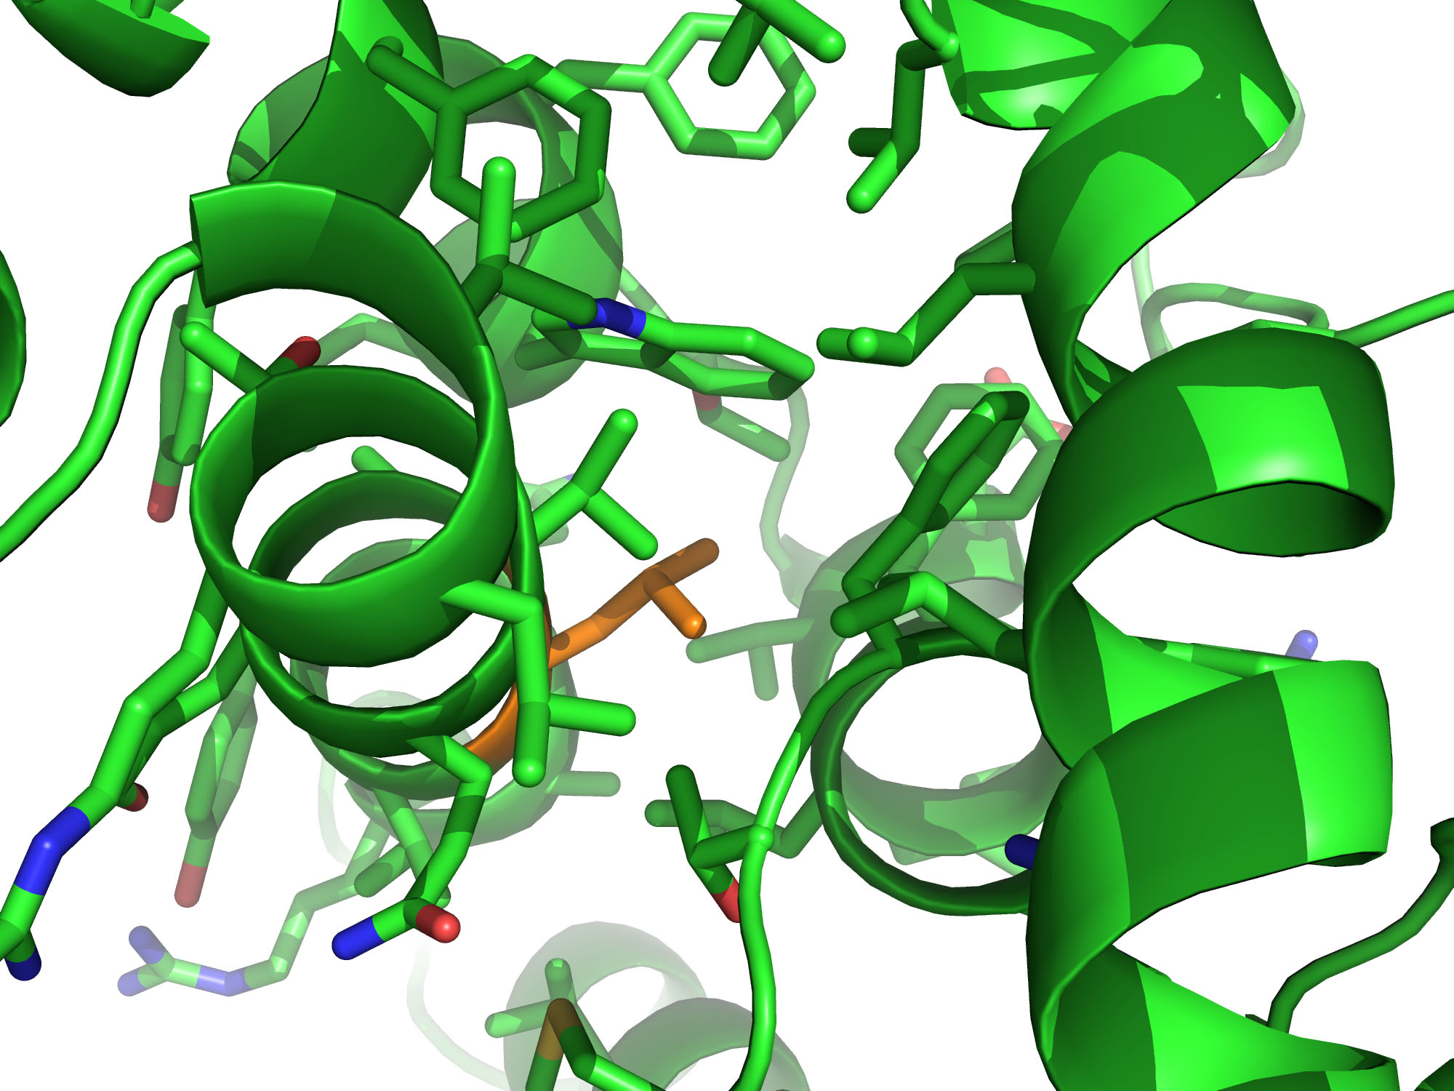
Notes:
Identified protein with suitable core to redesign
Identified residue to replace with bipA
bipA insertion
Identify shell of side chains in proximity of bipA
Initial compensation (automated)
Identify residues to keep, change back to wild type, and change to a different design (manual)
Optimized structure for bipA (this is the design that we want to engineer)
Mutate bipA back to wt residue, re-optimize, and observe hole in protein core

Slide 20
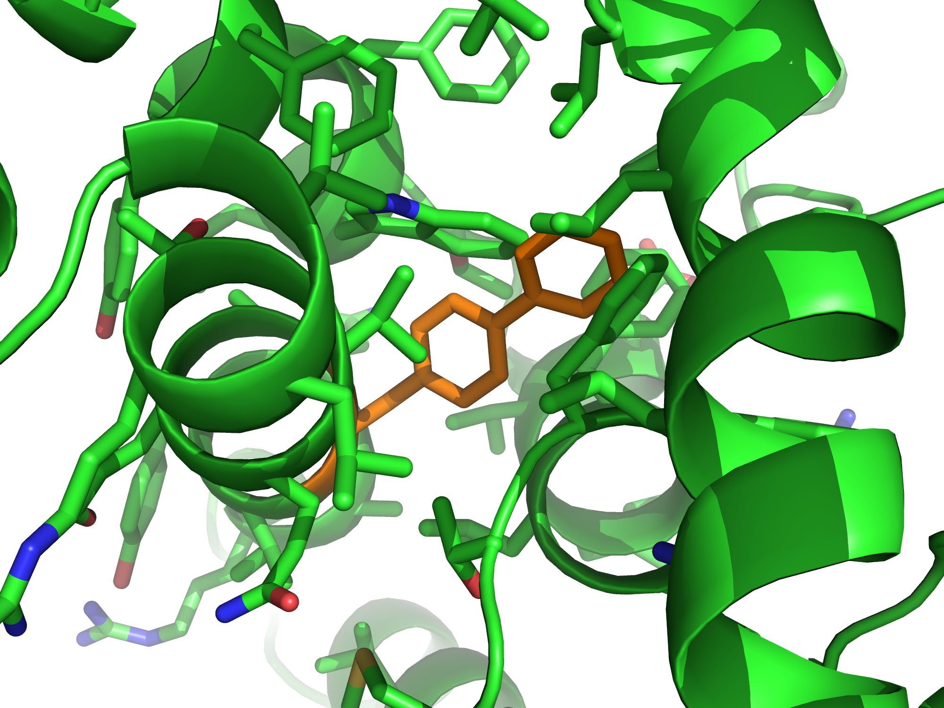
Notes:
Identified protein with suitable core to redesign
Identified residue to replace with bipA
bipA insertion
Identify shell of side chains in proximity of bipA
Initial compensation (automated)
Identify residues to keep, change back to wild type, and change to a different design (manual)
Optimized structure for bipA (this is the design that we want to engineer)
Mutate bipA back to wt residue, re-optimize, and observe hole in protein core

Slide 21
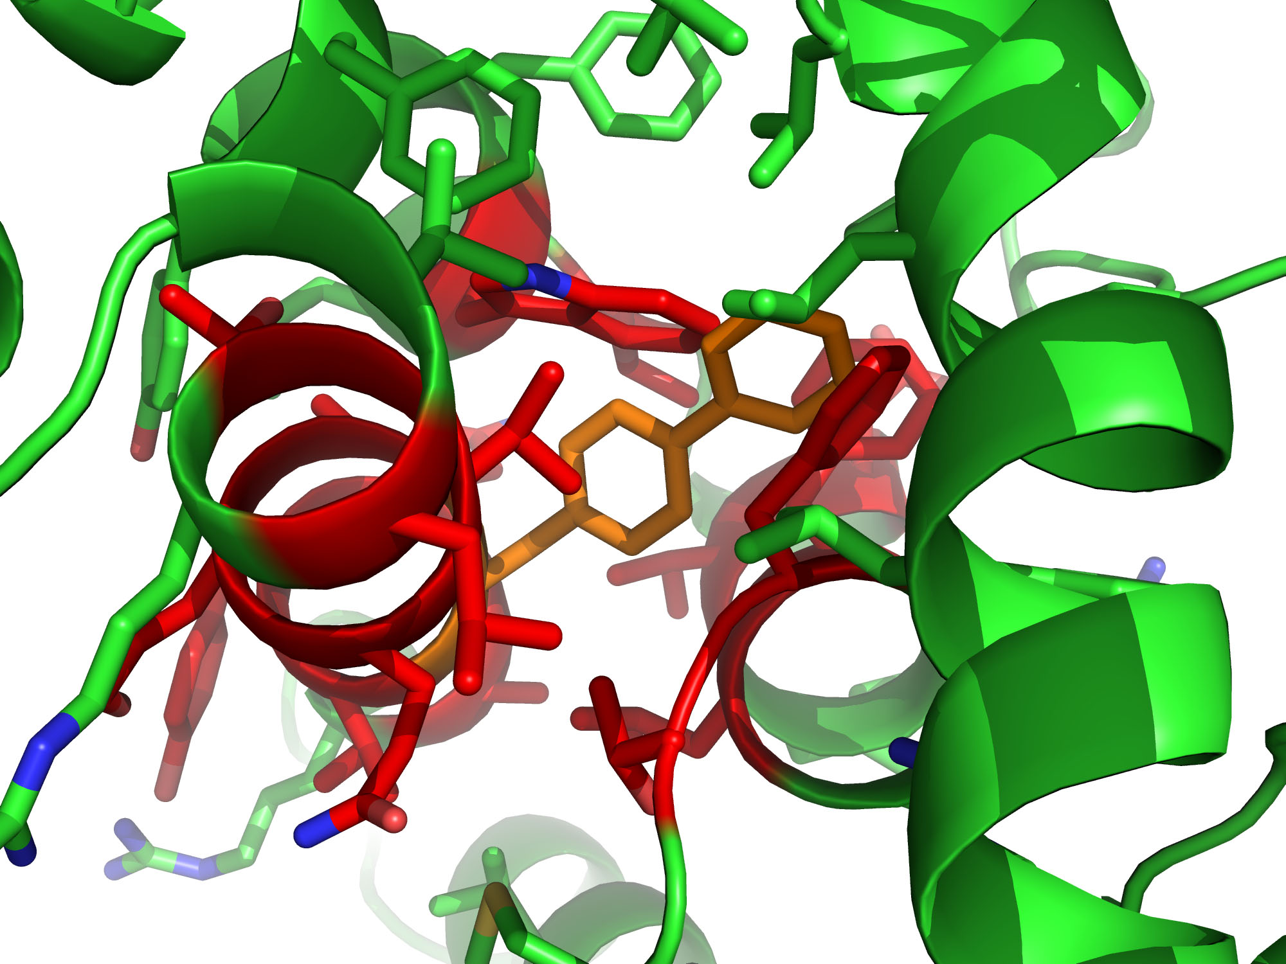
Notes:
Identified protein with suitable core to redesign
Identified residue to replace with bipA
bipA insertion
Identify shell of side chains in proximity of bipA
Initial compensation (automated)
Identify residues to keep, change back to wild type, and change to a different design (manual)
Optimized structure for bipA (this is the design that we want to engineer)
Mutate bipA back to wt residue, re-optimize, and observe hole in protein core

Slide 22
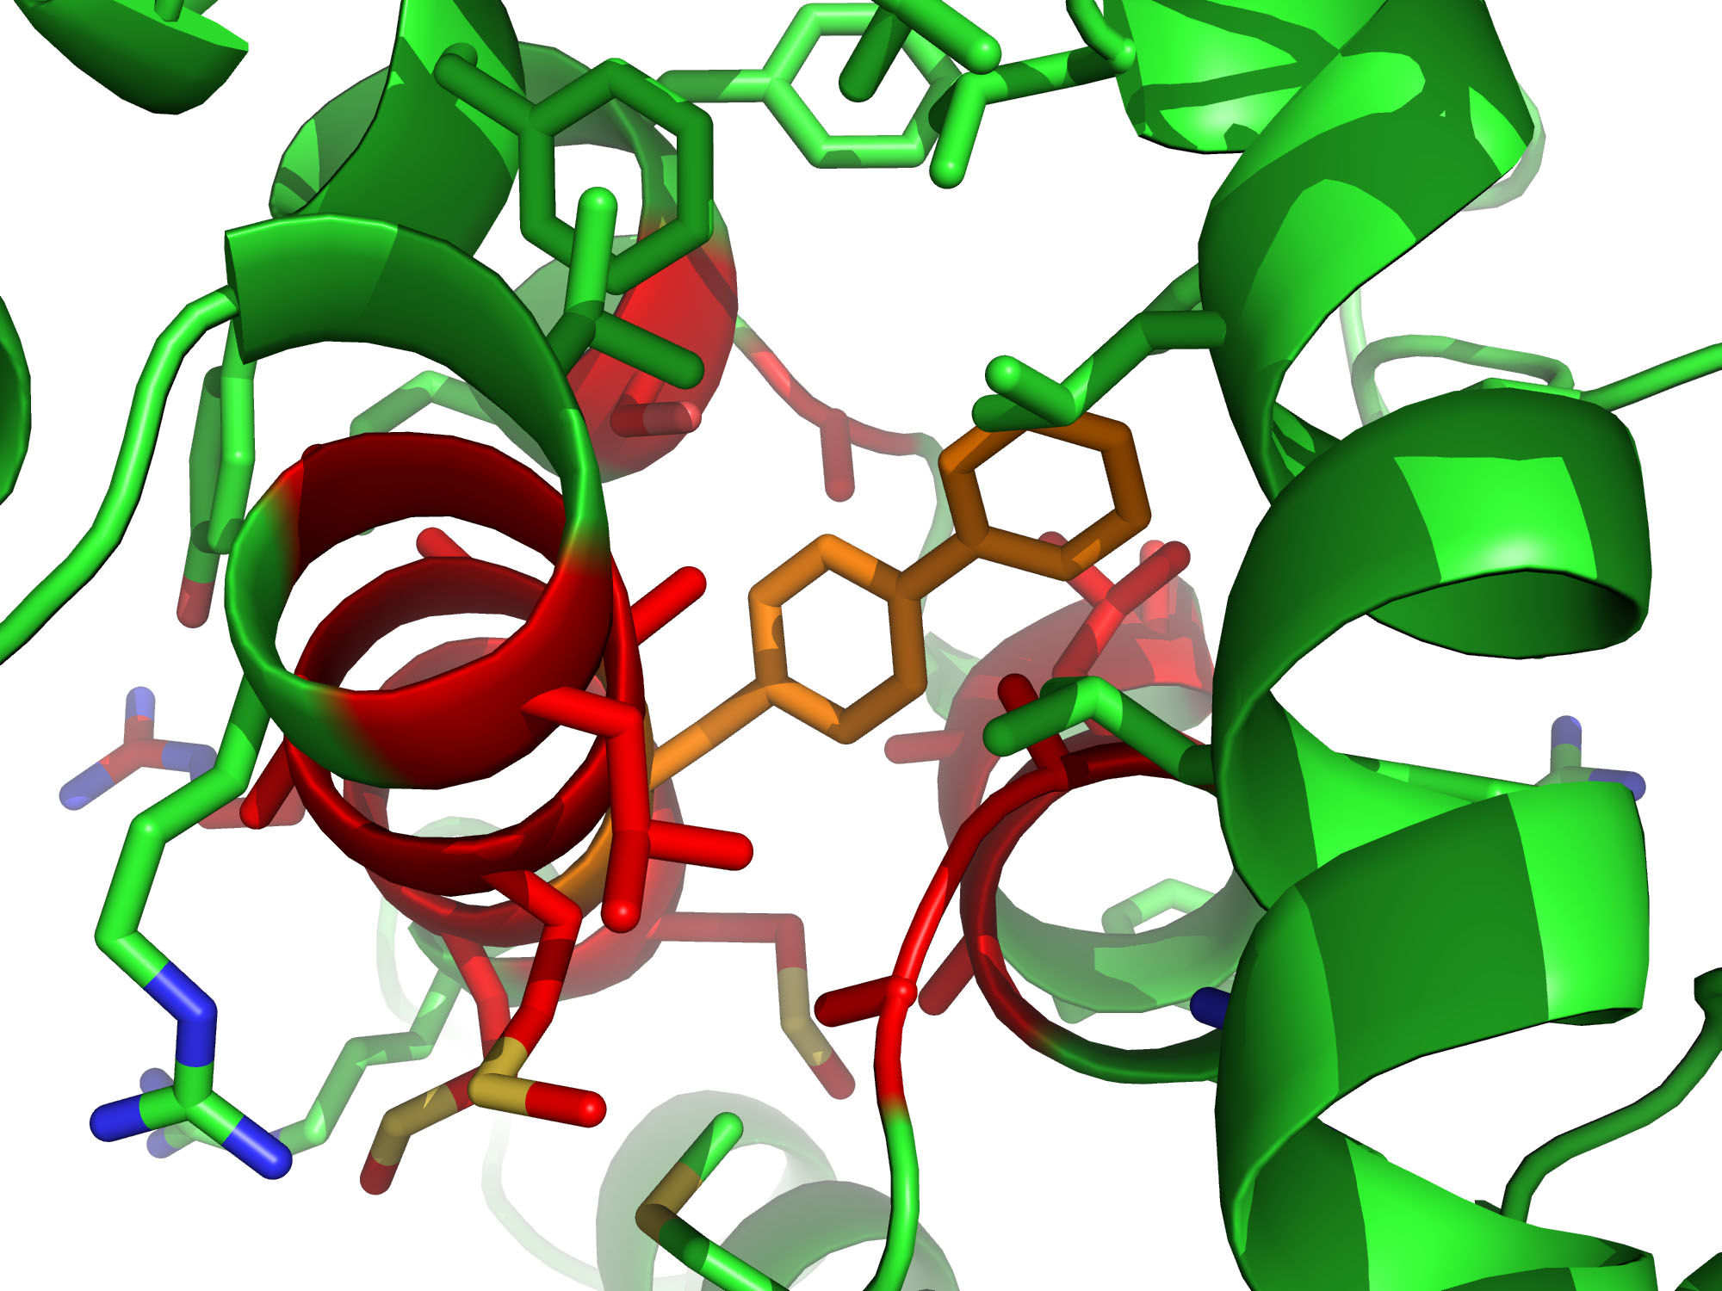
Notes:
Identified protein with suitable core to redesign
Identified residue to replace with bipA
bipA insertion
Identify shell of side chains in proximity of bipA
Initial compensation (automated)
Identify residues to keep, change back to wild type, and change to a different design (manual)
Optimized structure for bipA (this is the design that we want to engineer)
Mutate bipA back to wt residue, re-optimize, and observe hole in protein core

Slide 23
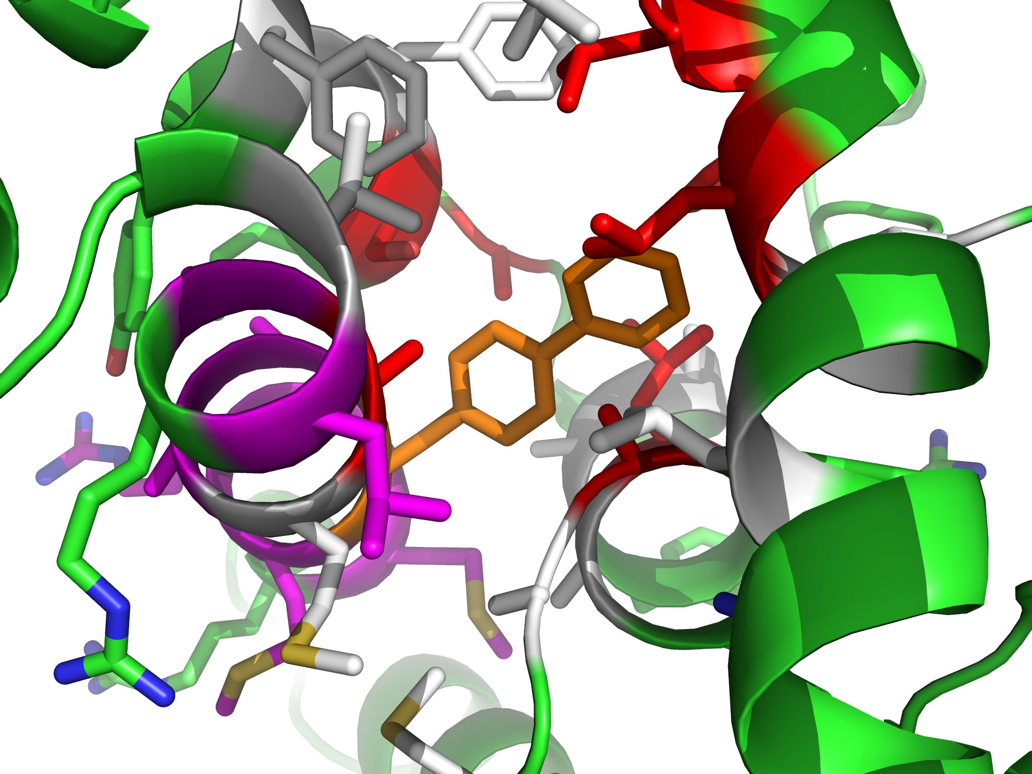
Notes:
Identified protein with suitable core to redesign
Identified residue to replace with bipA
bipA insertion
Identify shell of side chains in proximity of bipA
Initial compensation (automated)
Identify residues to keep, change back to wild type, and change to a different design (manual)
Optimized structure for bipA (this is the design that we want to engineer)
Mutate bipA back to wt residue, re-optimize, and observe hole in protein core

Slide 24
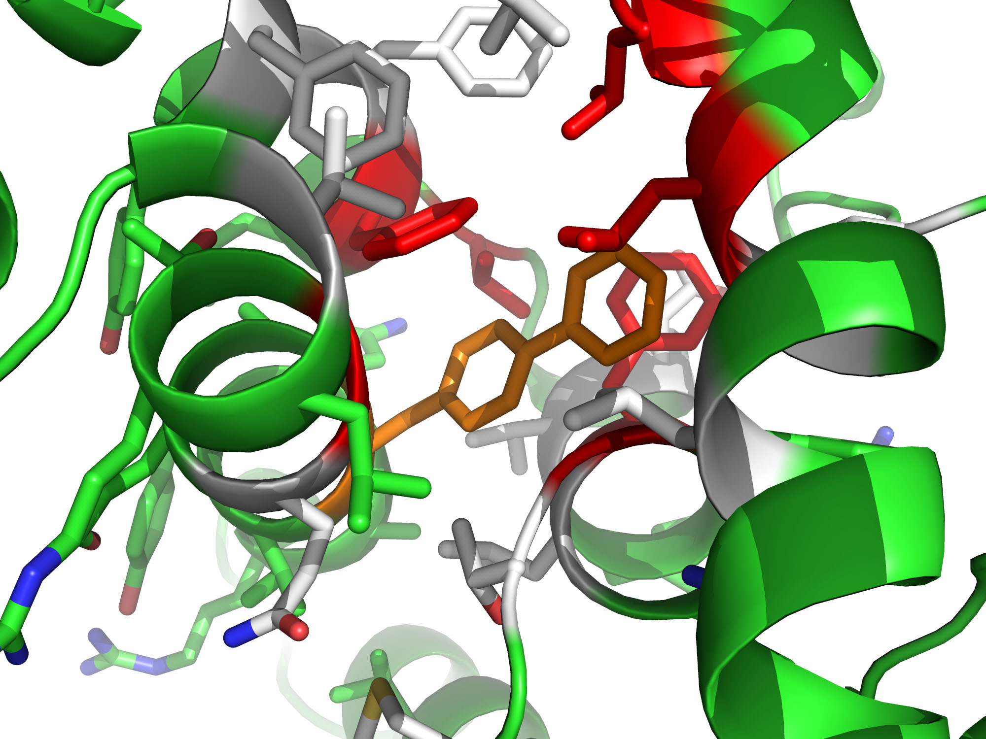
Notes:
Identified protein with suitable core to redesign
Identified residue to replace with bipA
bipA insertion
Identify shell of side chains in proximity of bipA
Initial compensation (automated)
Identify residues to keep, change back to wild type, and change to a different design (manual)
Optimized structure for bipA (this is the design that we want to engineer)
Mutate bipA back to wt residue, re-optimize, and observe hole in protein core

Slide 25
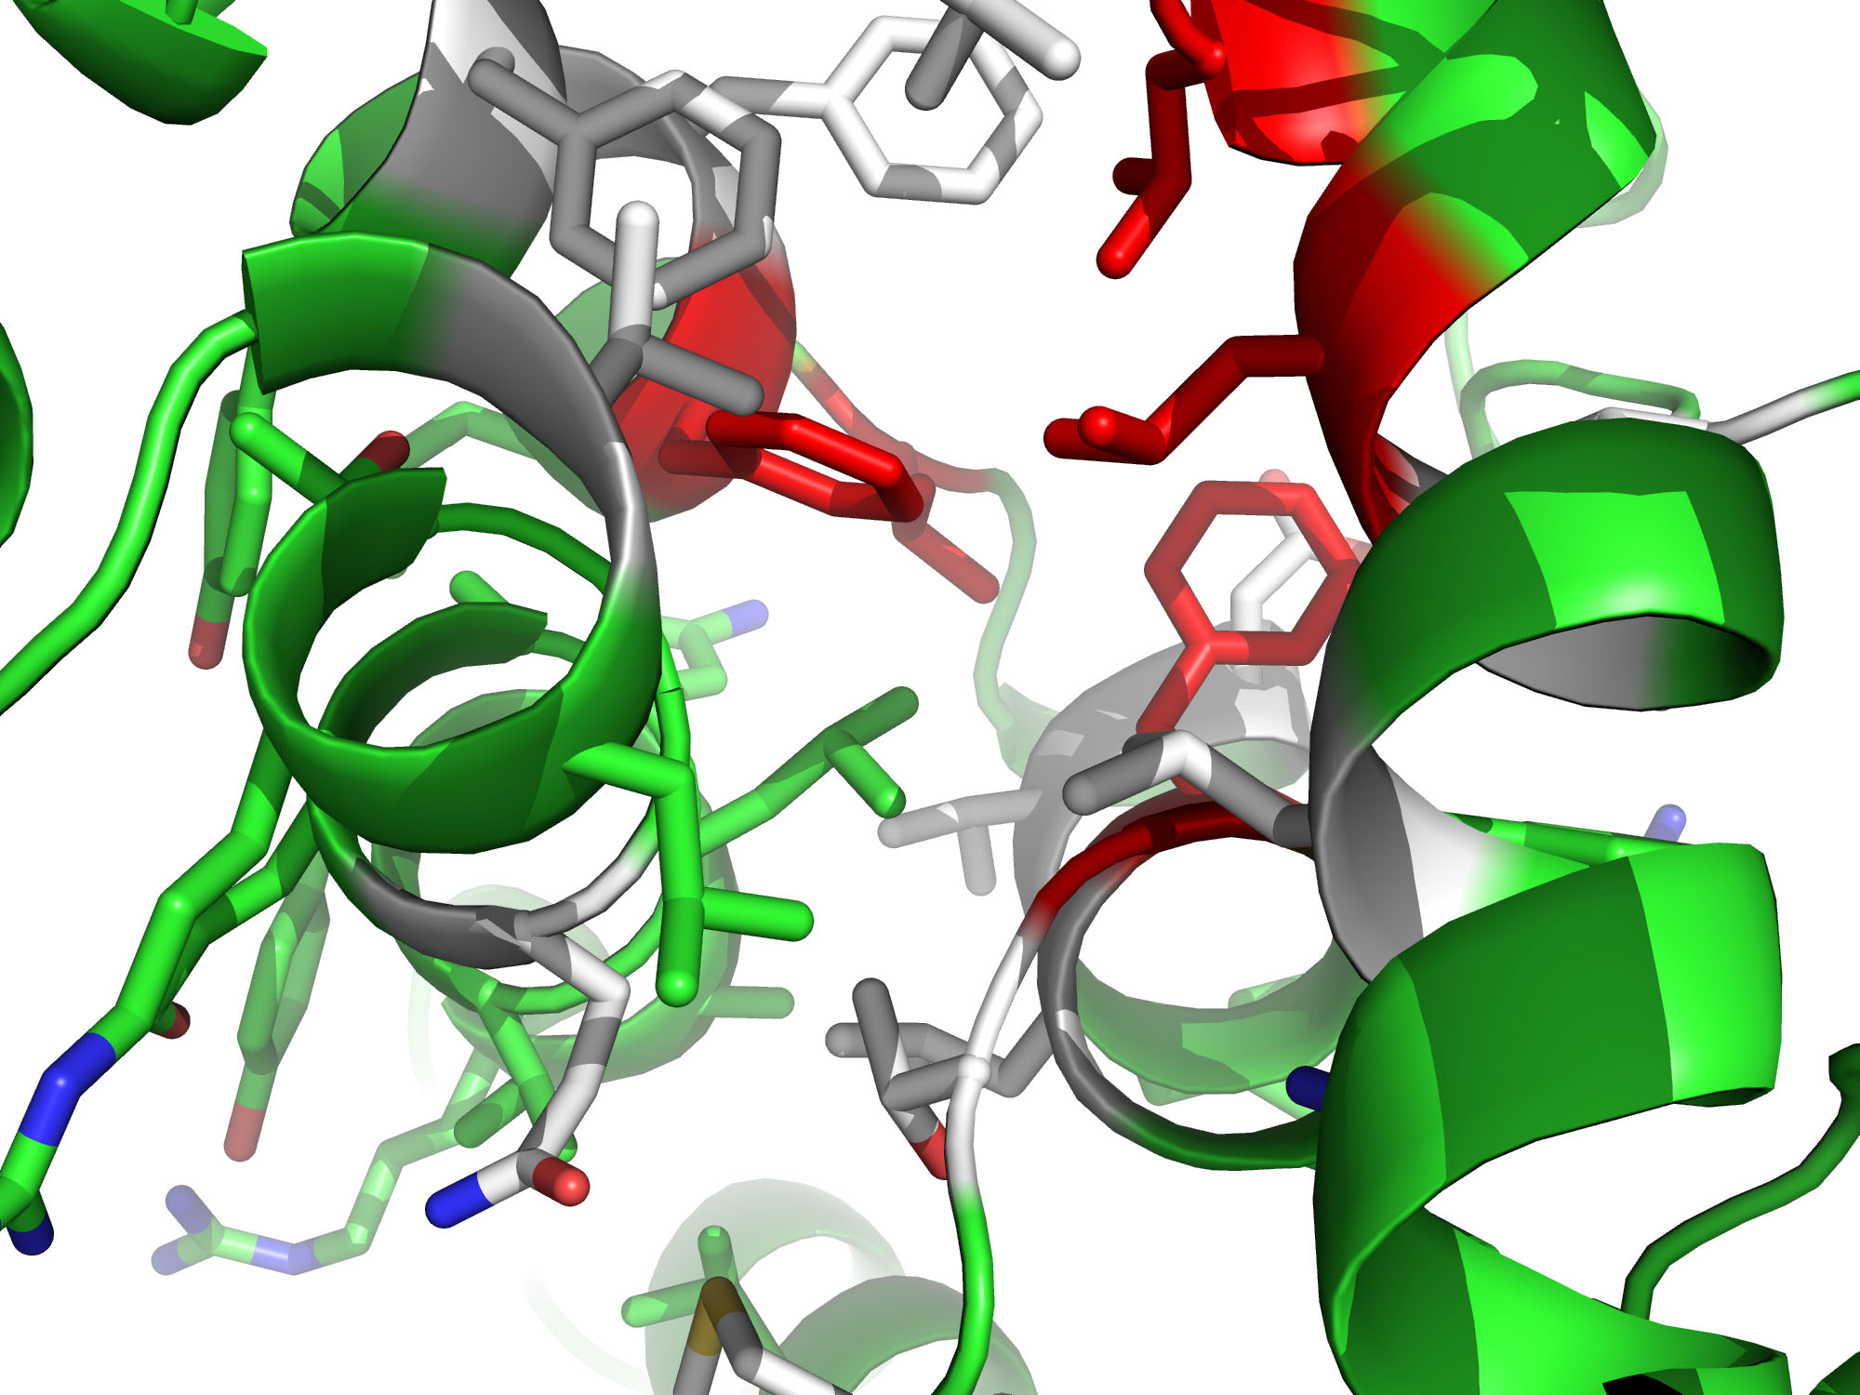
Notes:
Identified protein with suitable core to redesign
Identified residue to replace with bipA
bipA insertion
Identify shell of side chains in proximity of bipA
Initial compensation (automated)
Identify residues to keep, change back to wild type, and change to a different design (manual)
Optimized structure for bipA (this is the design that we want to engineer)
Mutate bipA back to wt residue, re-optimize, and observe hole in protein core

Slide 26
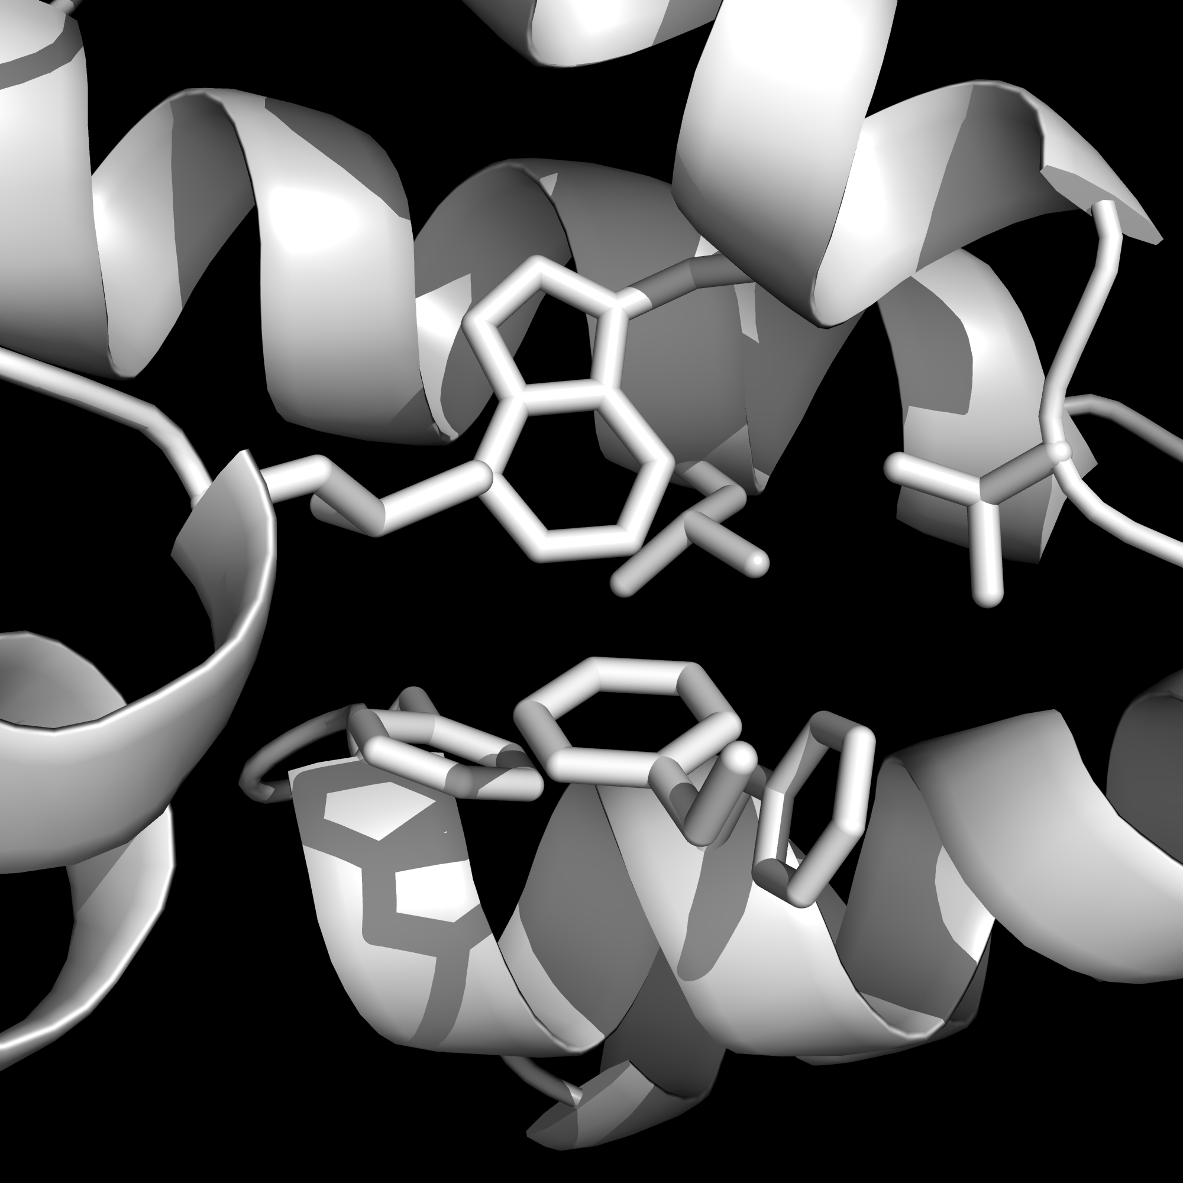
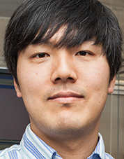
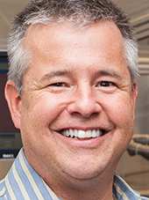
TyrS
WT only
Marc
Lajoie
Dan
Mandell
Ryo
Takeuchi
Barry
Stoddard
Notes:
tyrS WT site only

Slide 27
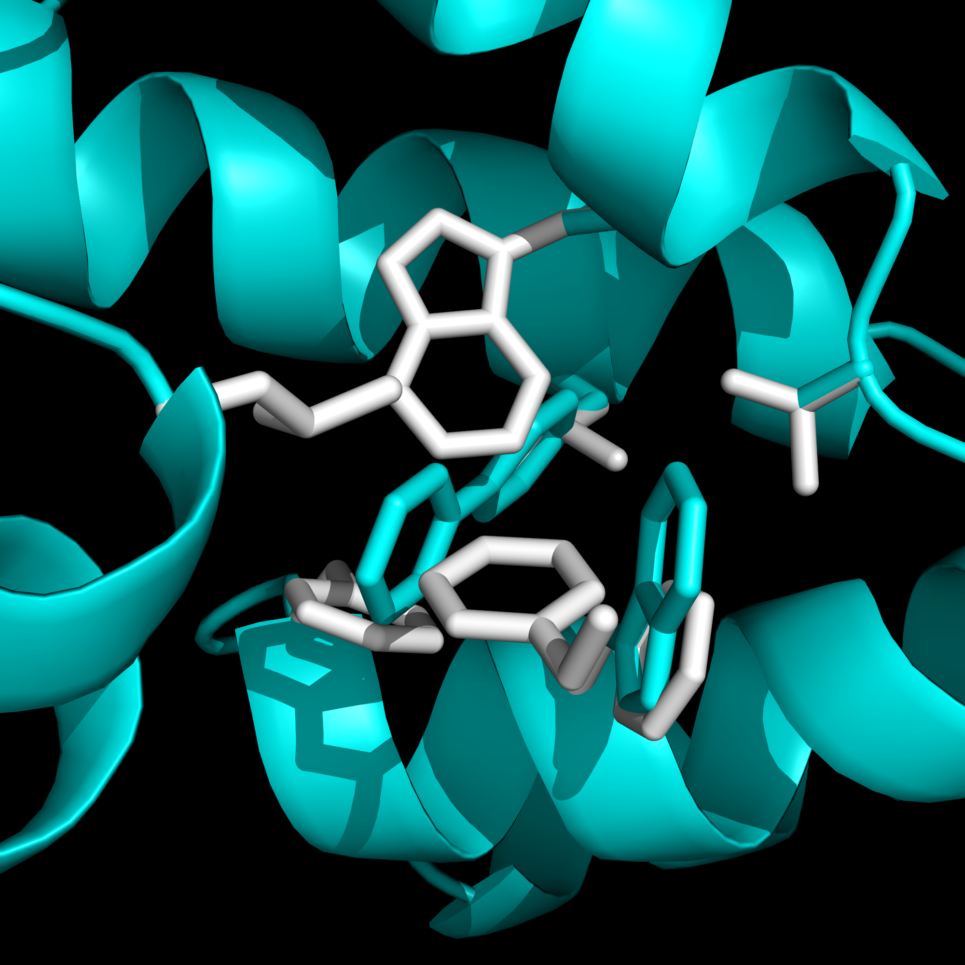
TyrS WT + TyrS-des7 design
(cyan)
Notes:
tyrS WT + tyrS-des7 design

Slide 28
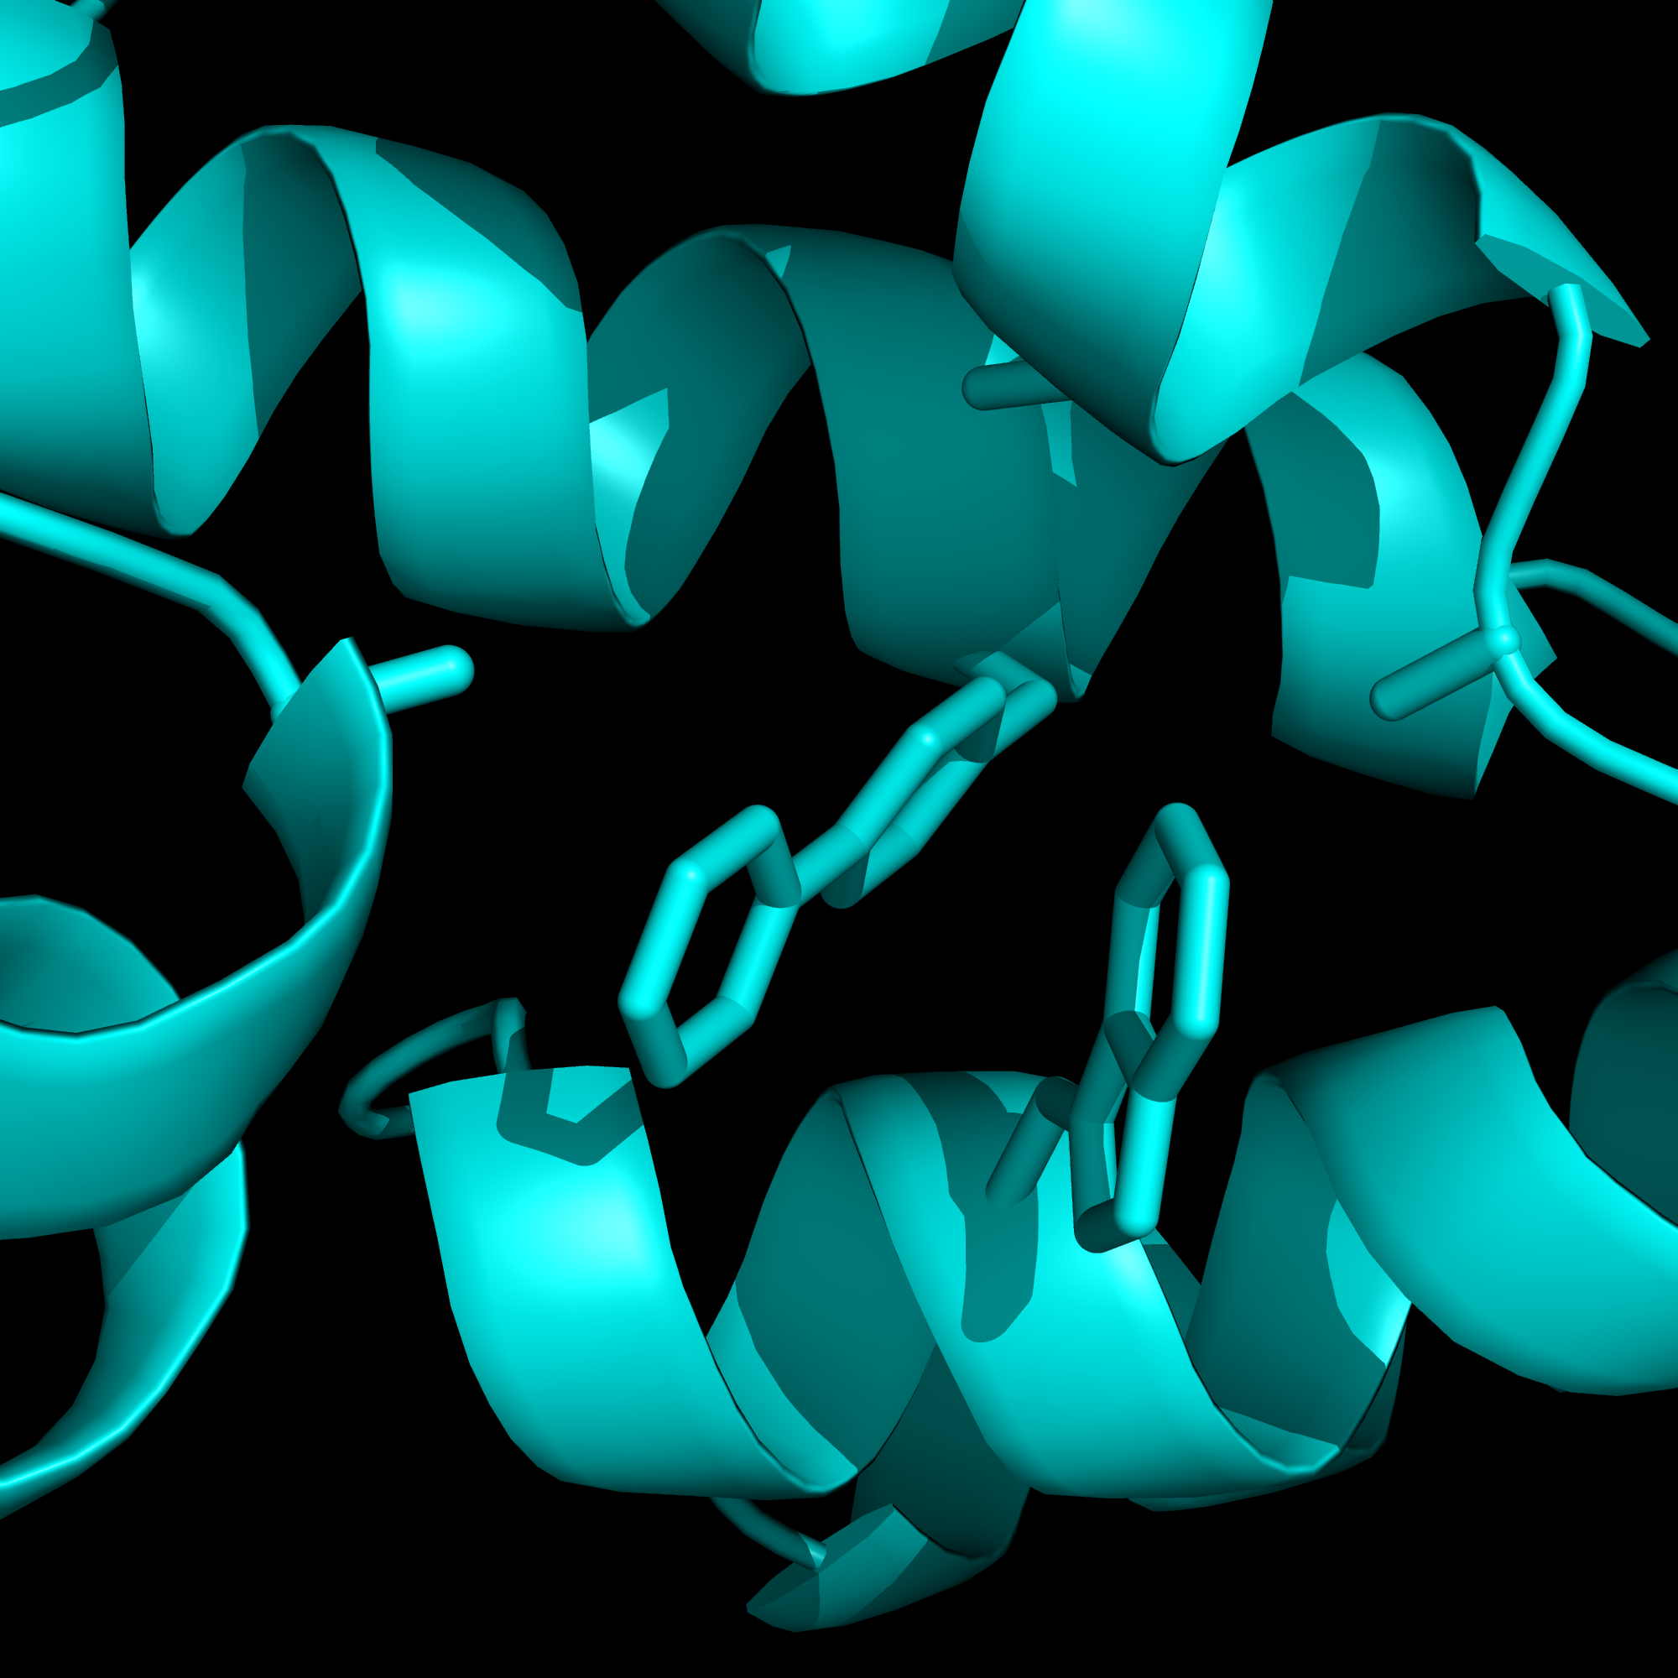
Design only
Notes:
Design only
(Phe->Ala isn’t visible; imagine Calpha/Cbeta of Phe still being there)

Slide 29
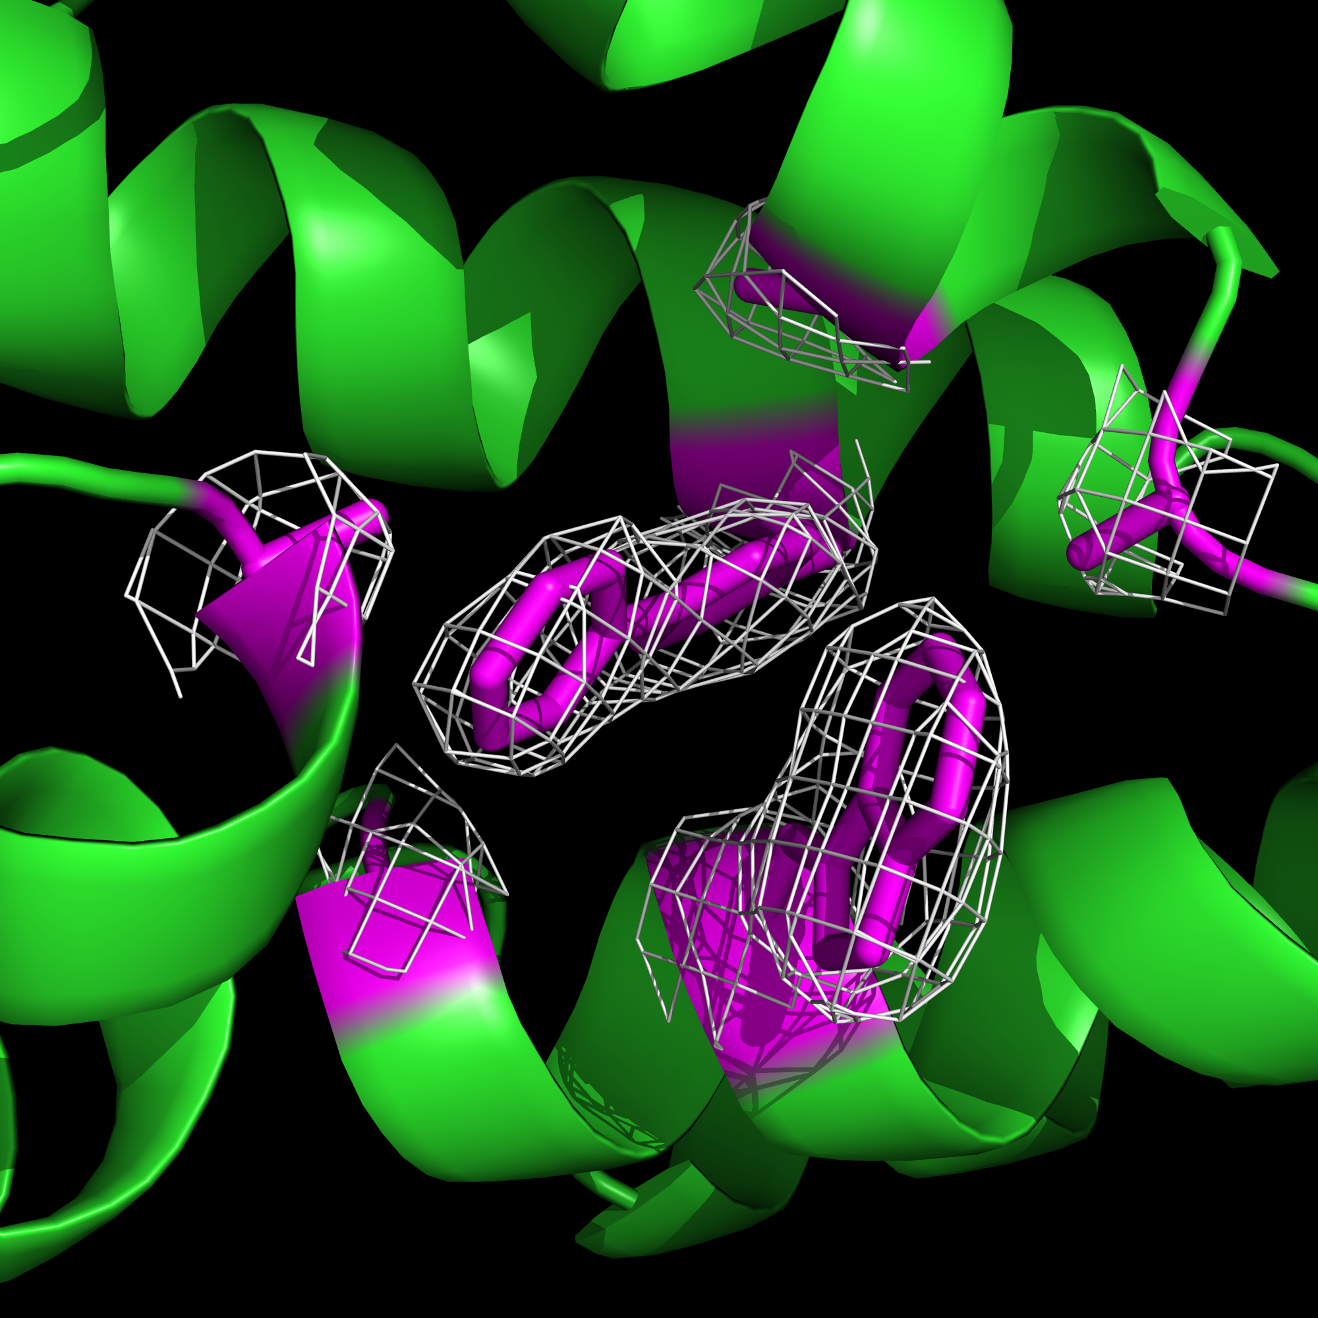
X-ray with electron density contoured
at 1.0σ
Notes:
X-ray with electron density contoured at 1.0σ

Slide 30
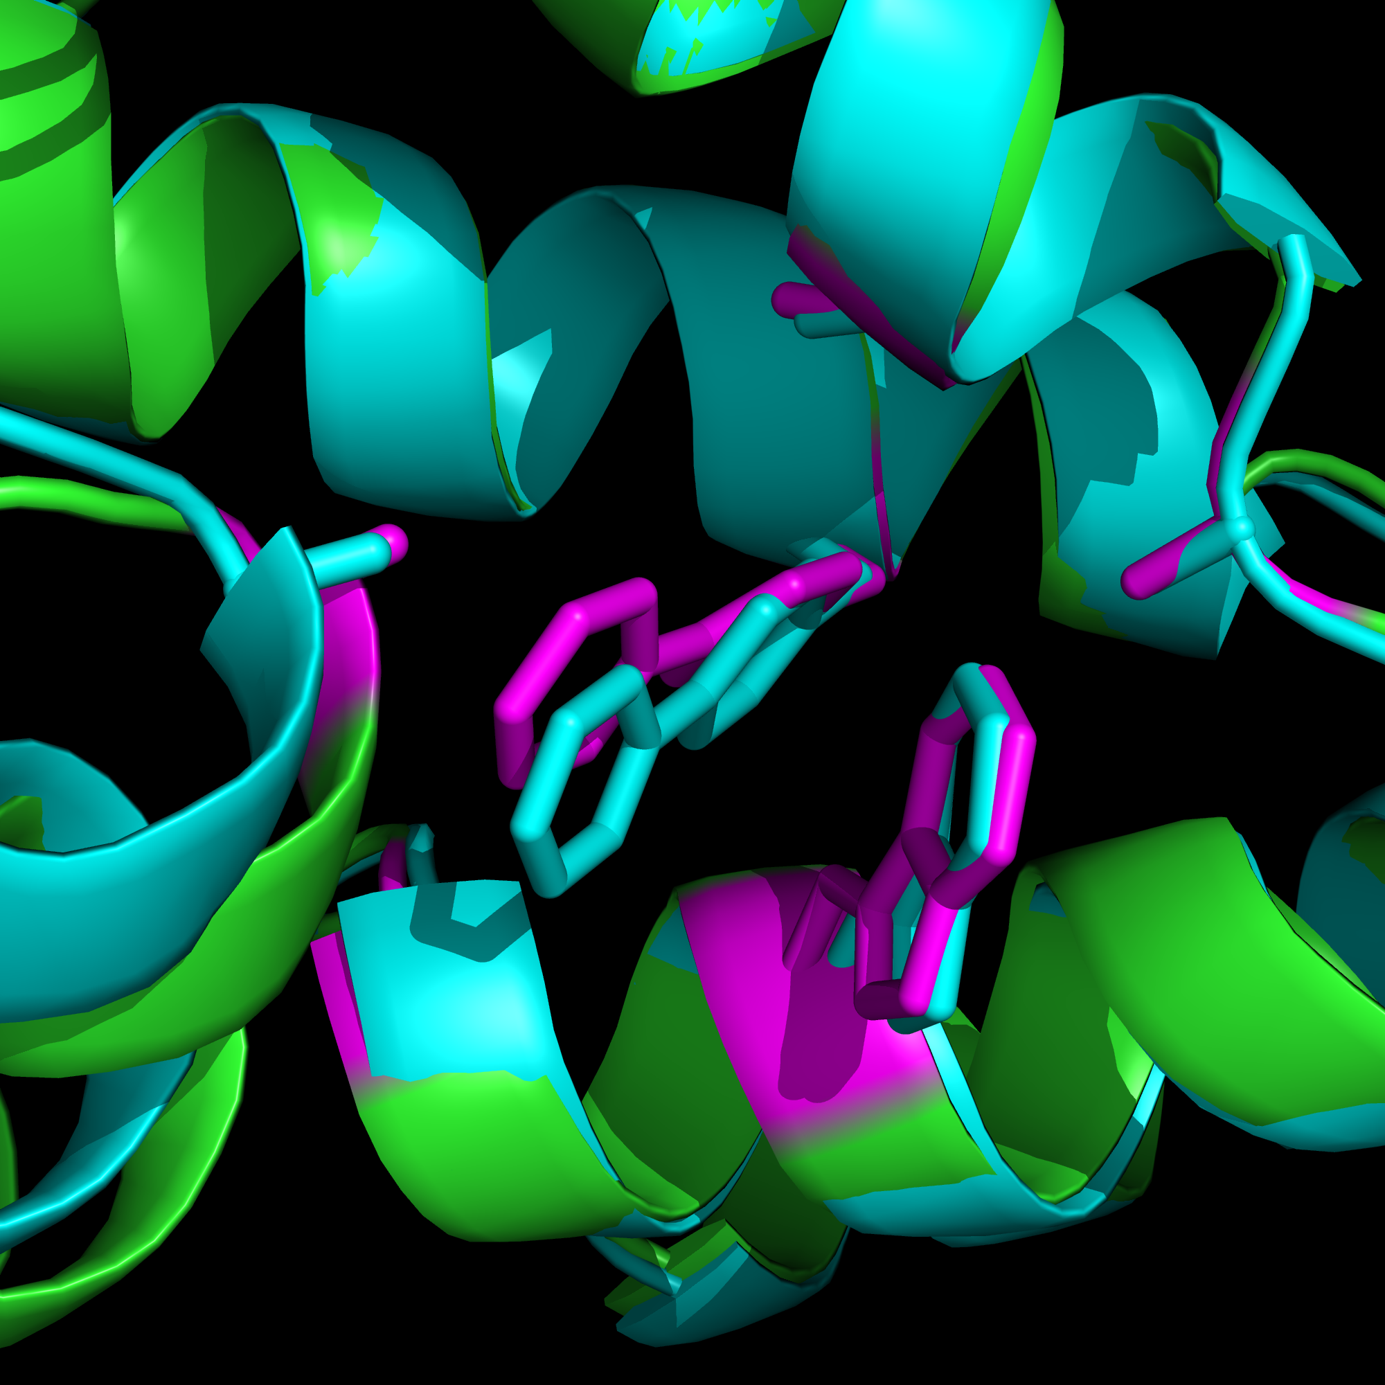
X-ray with design
(cyan)
Notes:
Ξ−ραψ ωιτη δεσιγν

Slide 31
How To Make Radically New Genomes
Chip Synthesis
Genome CAD: new functions & codes
Genetic Isolation & Multi-virus resistance
Novel AAs & Metabolic Isolation
5. Sensor selectors
6. Human Genome Editing
Build
Design
Test
Analyze

Slide 32
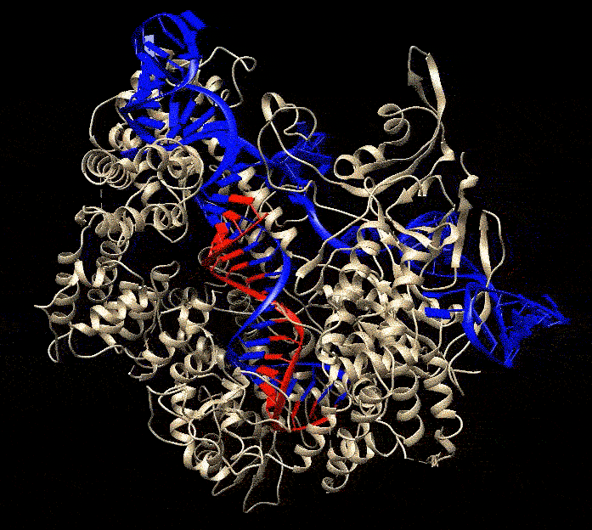
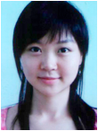
CRISPR 1987: Junk DNA → 2013 Technology >20 organisms today
Human | 3-Jan-13
Zebrafish | 29-Jan-13
Yeast | 4-Mar-13
C. elegans | 30-Jun-13
Drosophila | 5-Jul-13
Mouse | 8-Aug-13
Rat | 8-Aug-13
Wheat | 8-Aug-13
Arabidopsis | 20-Aug-13
Rice | 20-Aug-13
Sorghum | 2-Sep-13
Nicotiana | 2-Sep-13
Pig | 6-Sep-13
E. coli | 29-Sep-13
Silkworm | 29-Oct-13
Hamster | 7-Jan-14
Rabbit | 8-Jan-14
Xenopus | 8-Jan-14
Monkey | 30-Jan-14
Elephant | 4-Feb-14
Mali, Yang, et al.
& Cong, et al., Zhang Science 3-Jan-2013

Slide 33
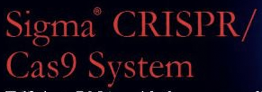
Improved Cas9 Specificity
100-fold: Theoretical & empirical searches
Mali et al. (Church lab) Science 3-Jan-2013
1000-fold: Paired nickases. Mali, et al. (Church lab).
Nat Biotechnol. 1-Aug-2013.
5,000-fold: Truncated guide RNAs. Fu, et al. (Joung lab).
Nat Biotechnol. 26-Jan-2014
?-fold: RNA-guided FokI nucleases (Joung & Liu labs)
Nat Biotechnol. 25-Apr-2014

Slide 34
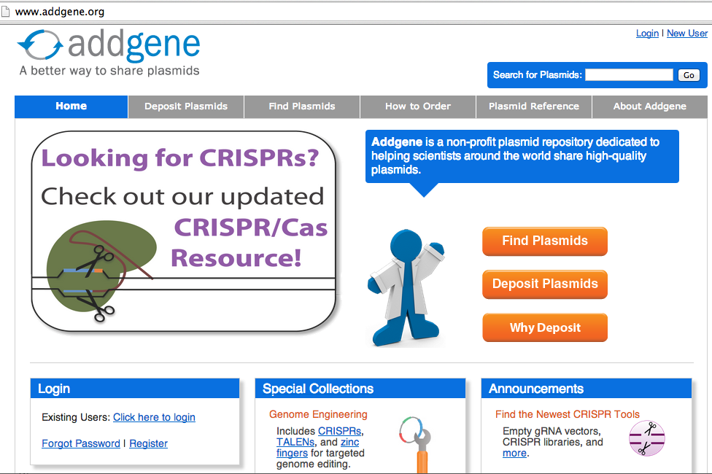
Non-Profit Genome Editing

Slide 35
How To Make Radically New Genomes
Chip Synthesis
Genome CAD: new functions & codes
Genetic Isolation & Multi-virus resistance
Novel AAs & Metabolic Isolation
5. Sensor selectors
6. Human Genome Editing
Build
Design
Test
Analyze

