Slide 1
Simulation and Optimization for Digital Fabrication
Wojciech Matusik
CSAIL & EECS MIT

Slide 2
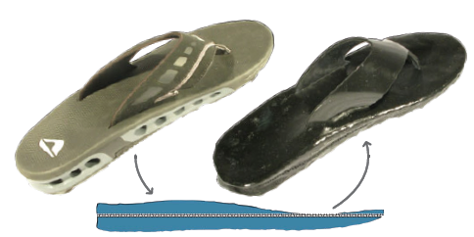
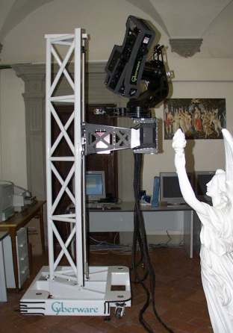
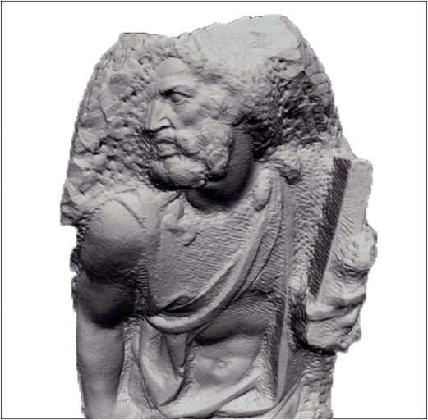
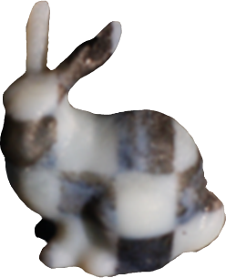
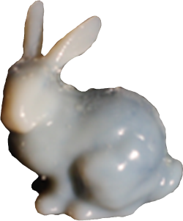
Digital Fabrication at ACM SIGGRAPH
Special Interest Group on Computer Graphics and Interactive Techniques
Traditional research in computer graphics
Physically-based simulation
Geometry acquisition and modeling
Interactive content creation tools
Material modeling
SIGGRAPH community is also excited about digital fabrication
Notes:
Both appearance and mechanical properties

Slide 3
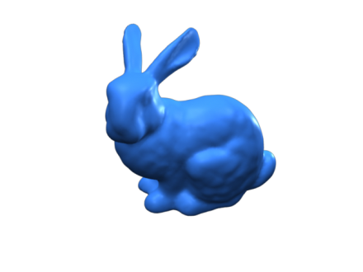
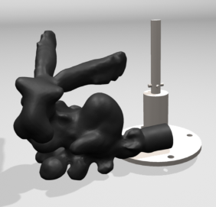
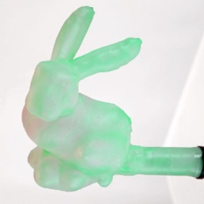
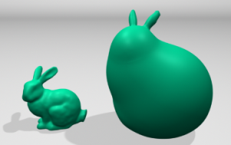
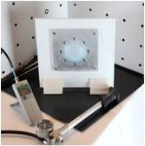
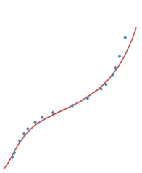
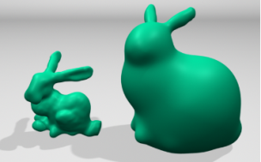
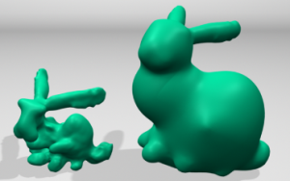
Typical Processing Pipeline
Editing and User Input
Target
Optimization
Fabrication
Simulation
Material Modeling
Mold
3D-printing
Material Parameters

Slide 4
Computational Design of Rubber Balloons
Skouras et al. 2012

Slide 5
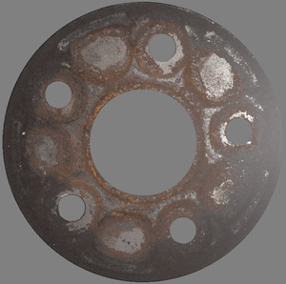
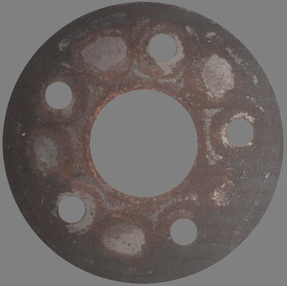
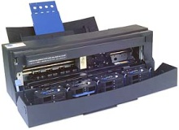
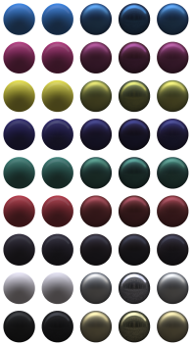
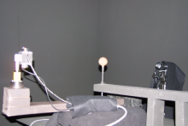
Reflectance Capture, Modeling, and Fabrication
Matusik et al. 2009
Editing and User Input
Target
Optimization
Fabrication
Simulation
Material Modeling
Mold
3D-printing

Slide 6
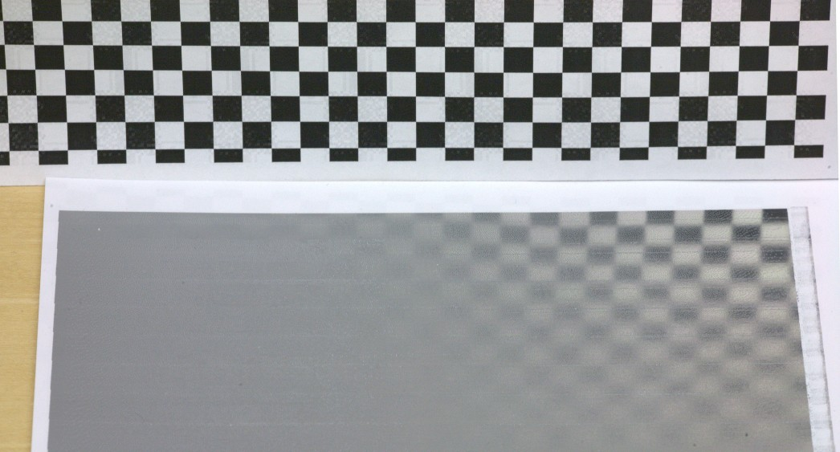
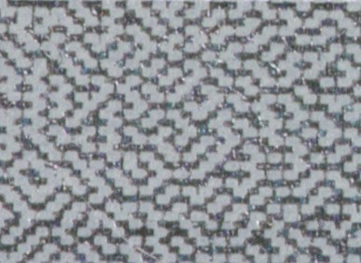
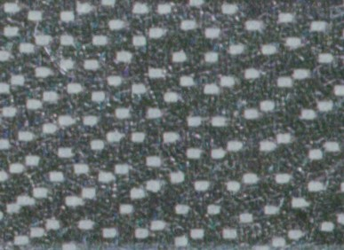
Printed Gradient Reflectance
Matusik et al. 2009
Reflector
Printed
Gradient
BRDF
Surface
Close-ups
Notes:
This process allows us to interpolate between different material properties.
For example we can print a material that smoothly varies between a diffuse and specular surface.
When you zoom up on the surface you can see that we obtain this effect by varying the ratio of specular vs diffuse surface elements.

Slide 7
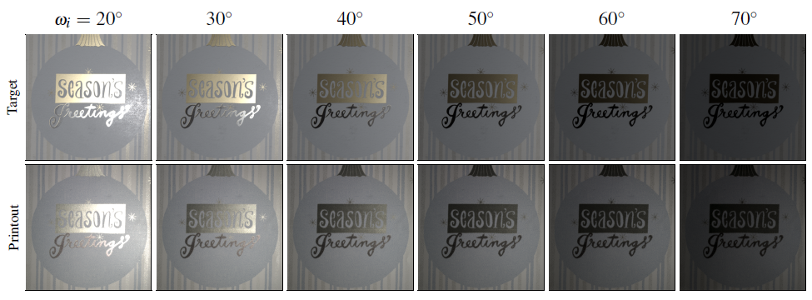
Printed Rusty Flange
Matusik et al. 2009
Notes:
And this is another example, a reproduction of rusty wheel.
The top row shows photographs of the real wheel.
The bottom row shows the reproduction.
You can see its appearance is very different depending on the illumination direction.

Slide 8
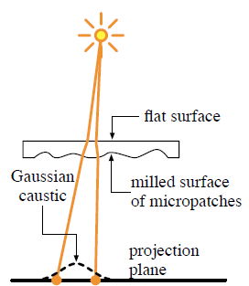
Fabricating Refractive Materials
Papas et al. 2011
Caustics

Slide 9
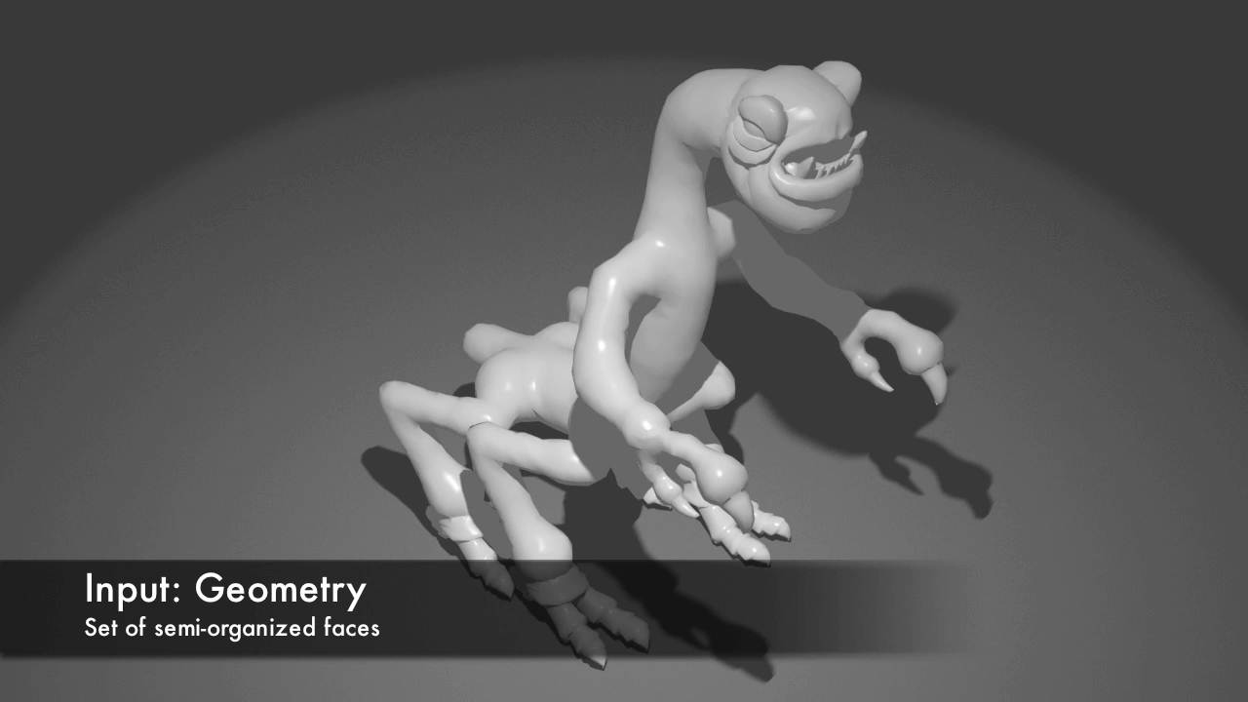
Fabricating Articulated Characters
Baecher et al. 2012

Slide 10
Fabricating Articulated Characters
Baecher et al. 2012

Slide 11
Fabricating Articulated Characters
Baecher et al. 2012

Slide 12
Physical Face Cloning
Bickel et al. 2012

Slide 13
Mechanical Assemblies
Zhu et al. 2012
Input
Mechanical Assembly
Manufactured Assembly

Slide 14
Mechanical Assemblies
Zhu et al. 2012

Slide 15
Interactive Furniture Design
Umetani et al. 2012

Slide 16
Challenges
Combinatorial explosion of material and structure optimization
Fast and accurate simulation methods
Perceptually-based material metrics
Fabrication-aware content creation tools
Notes:
For many applications, material similarity metrics based on user studies are desired.

