Slide 1
The Science of Digital Fabrication
March 7, 2013
MIT
From Fab Labs to Fab City
Vicente Guallart
Chief Architect
Barcelona City Council
Hàbitat Urbà

Slide 2
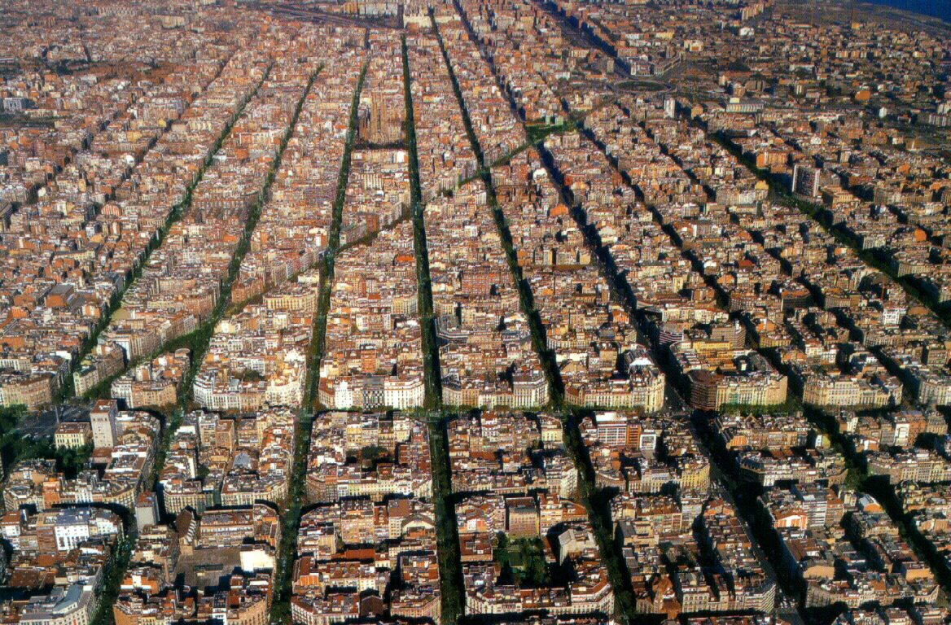
Cities: the biggest inhabitable structures ever made

Slide 3
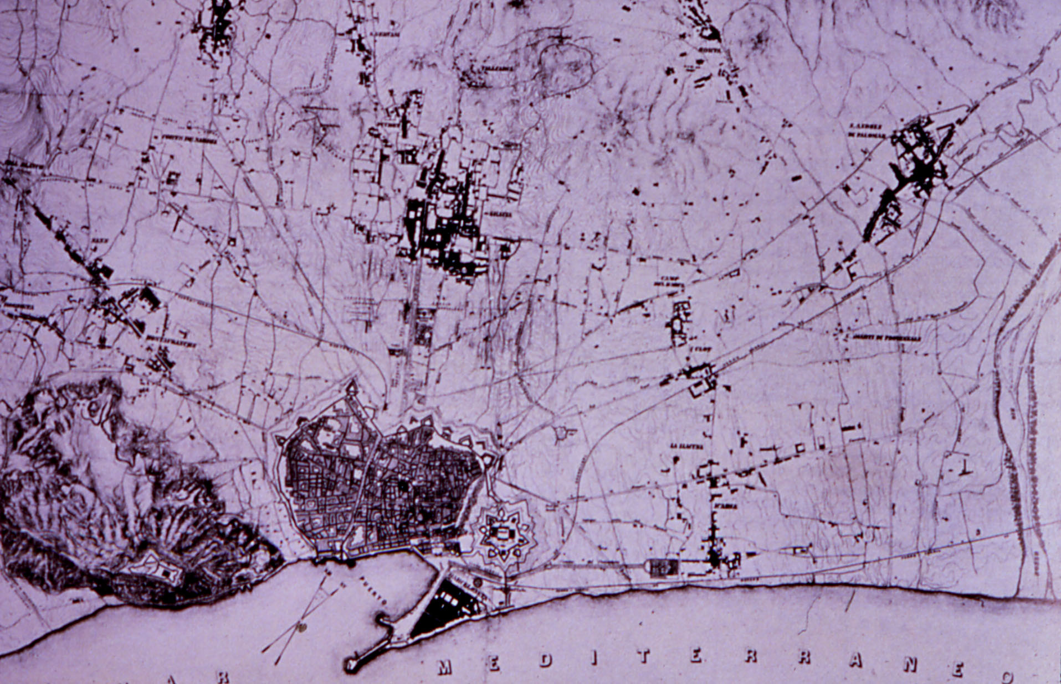
1850. Barcelona surrounded by walls....

Slide 4
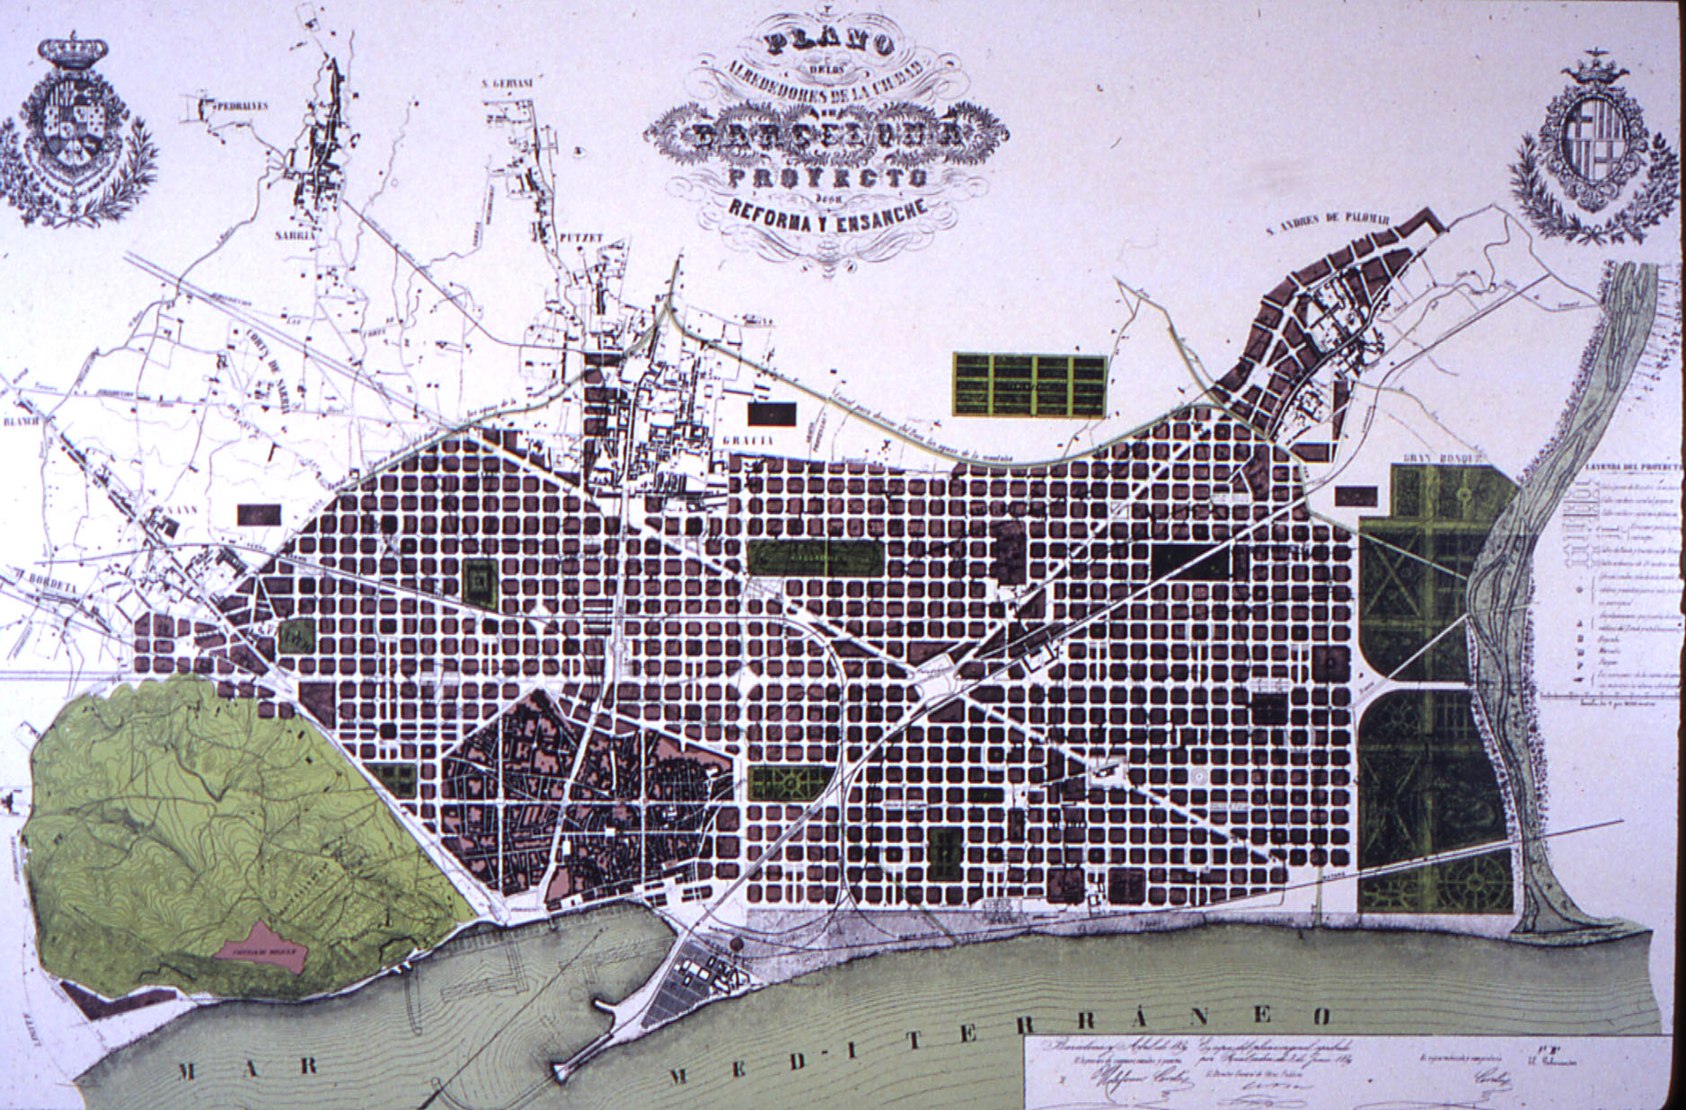
1859 Barcelona invented the science of Urbanism

Slide 5
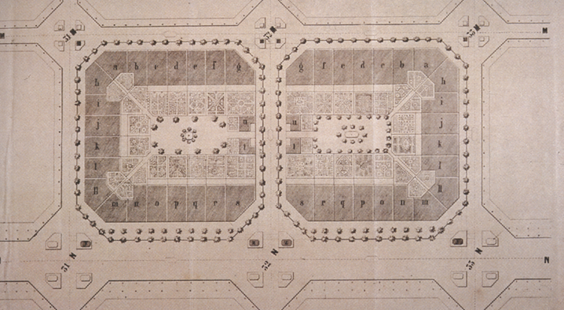
Urbanism is an science devoted to add value to the territory

Slide 6
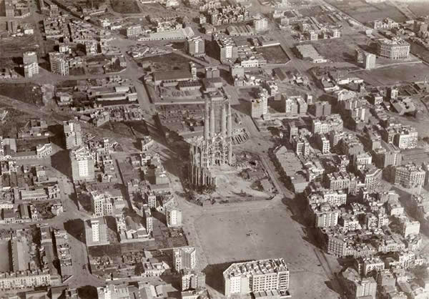
1920. Building the city....

Slide 7
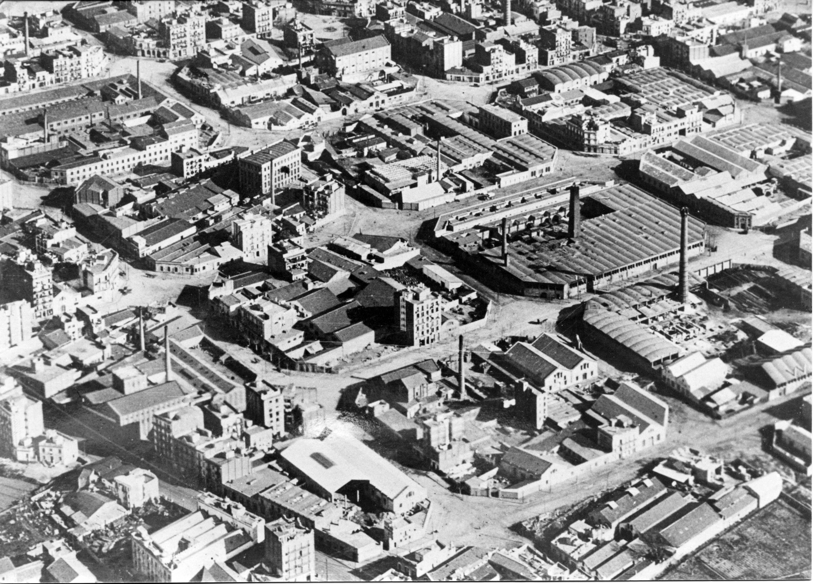
Industrialization generates urbanization

Slide 8
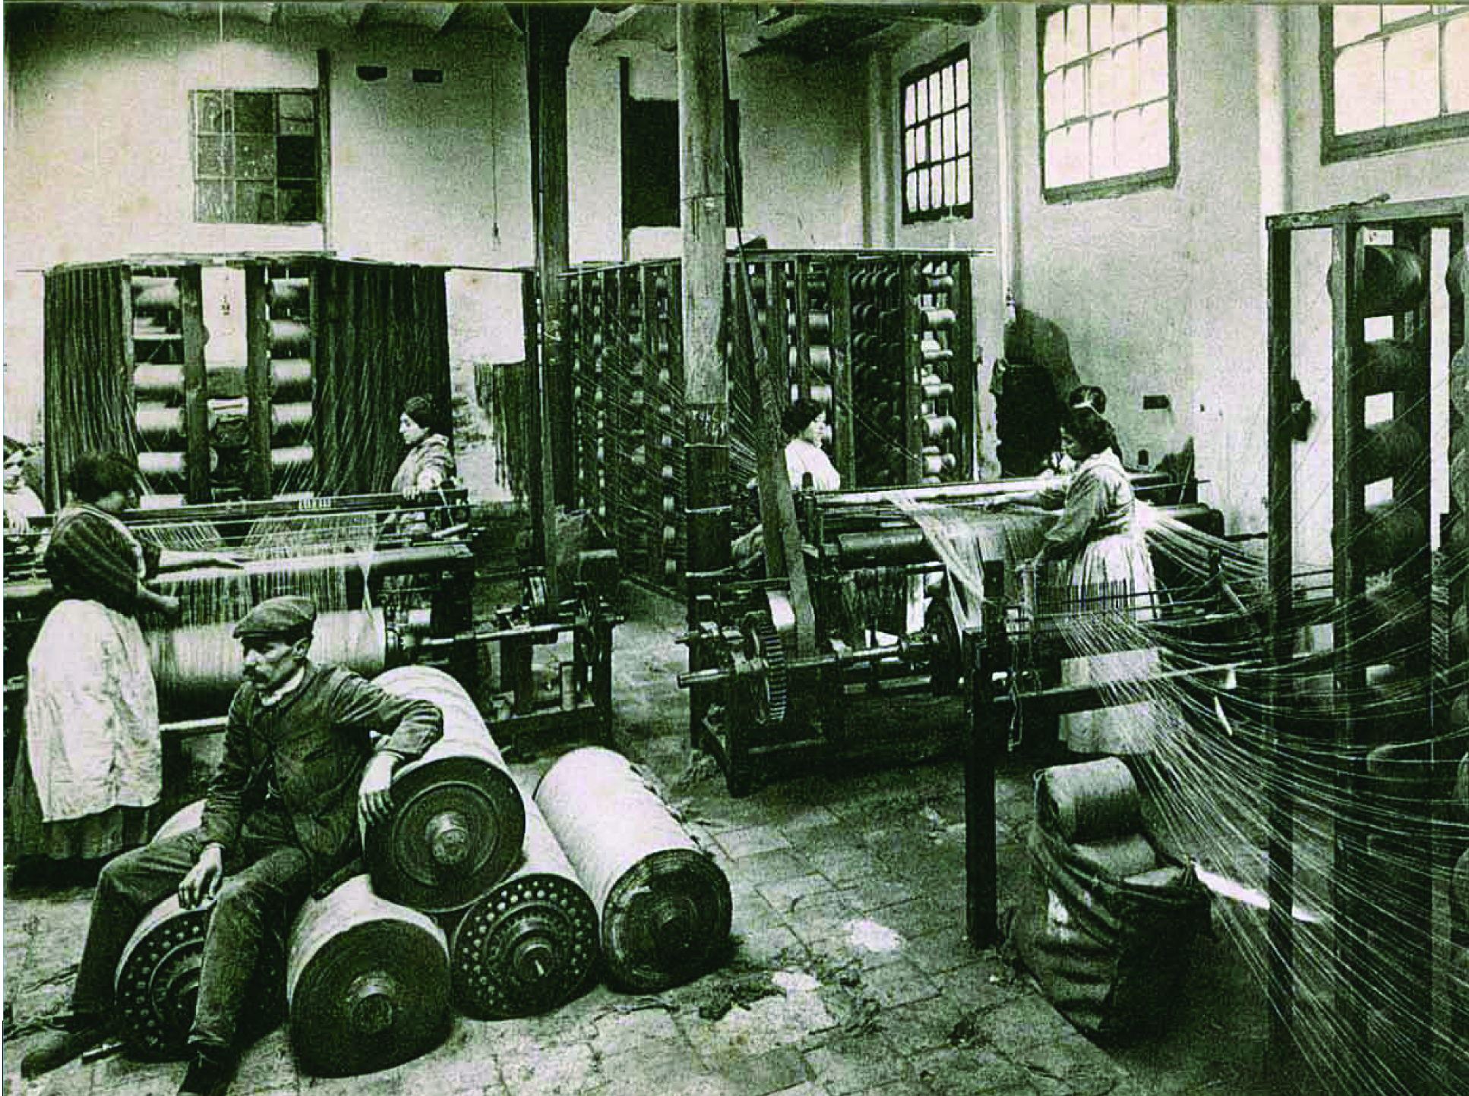
1920 Industry inside the city

Slide 9
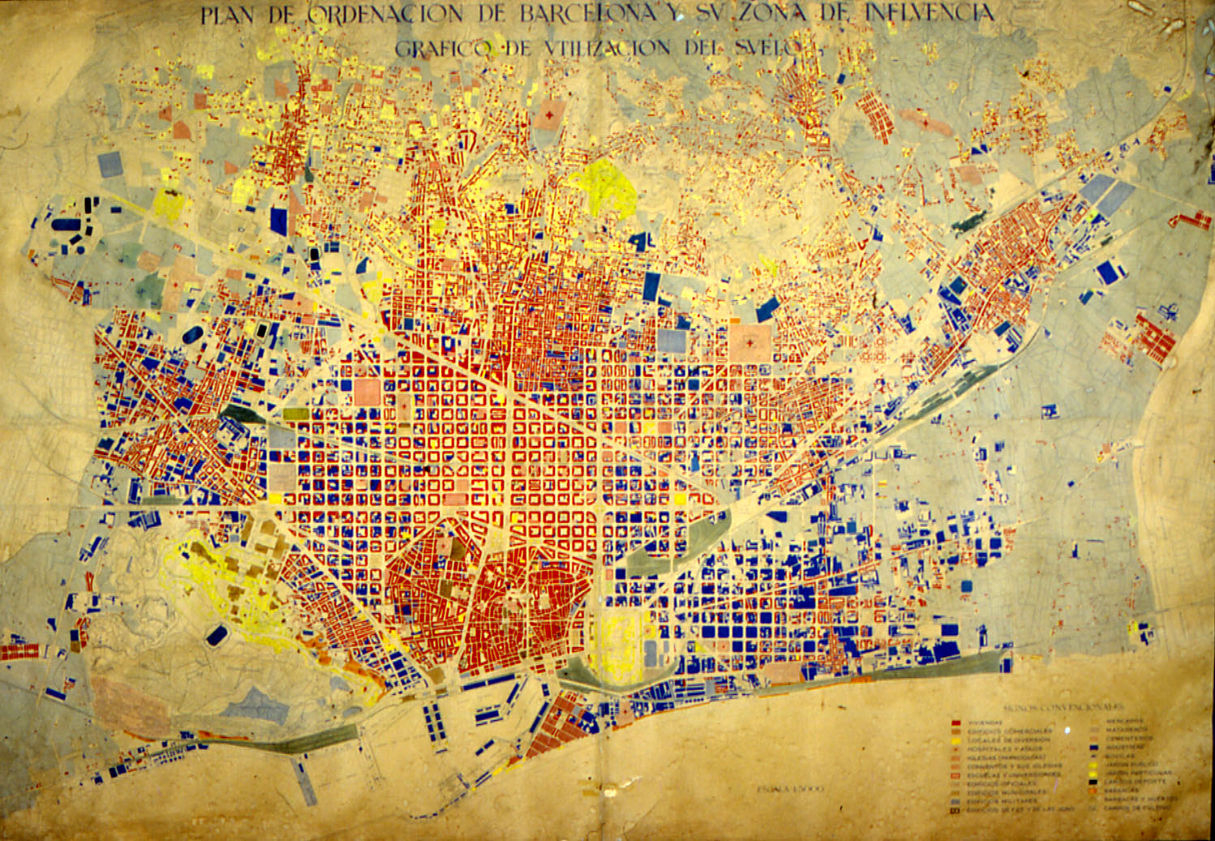
1950 Housing and Industry mixed up in the city

Slide 10
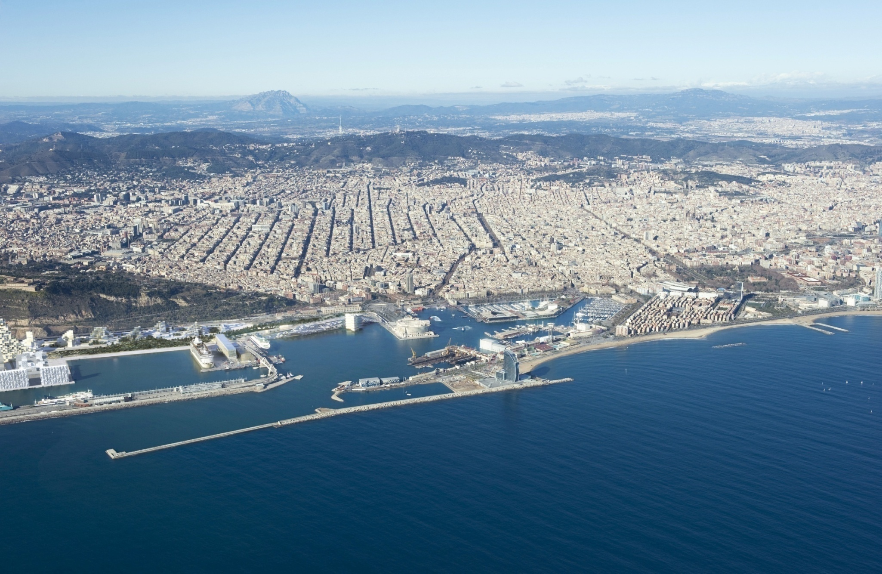
2013 Barcelona a healthy city

Slide 11
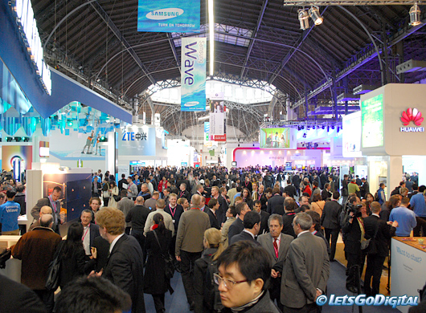
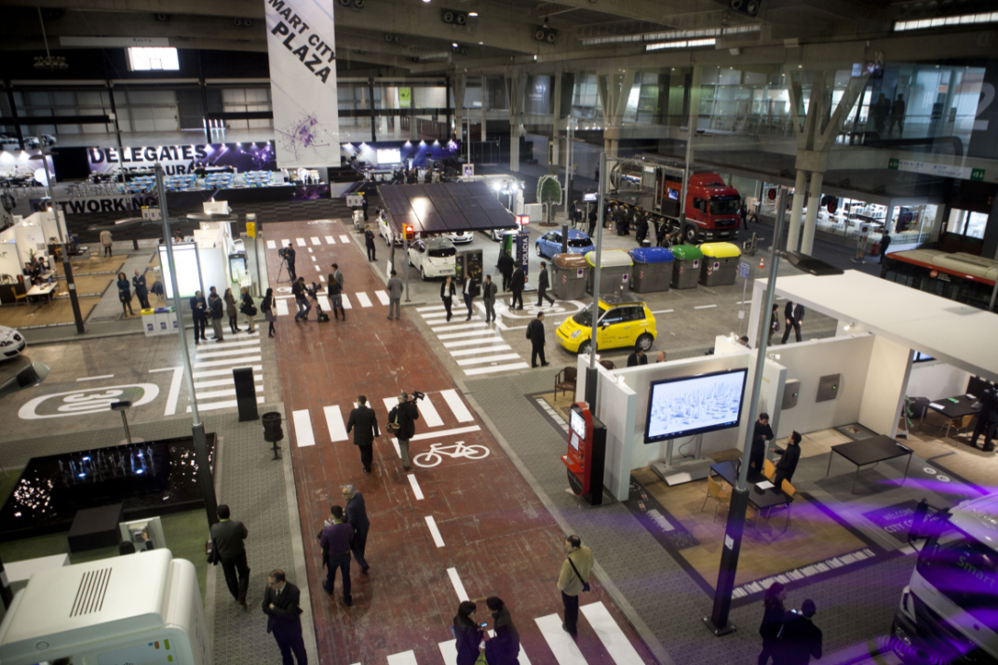
Barcelona host World Wide IT events

Slide 12
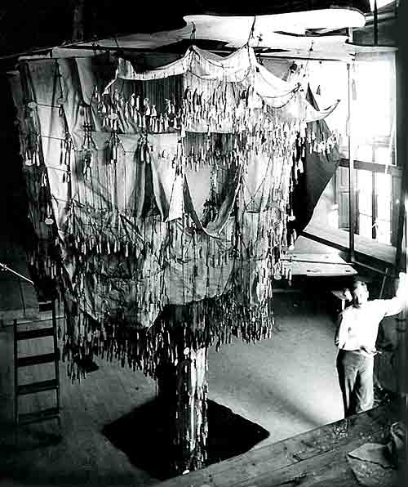
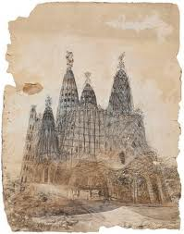
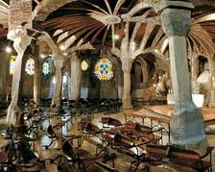
Gaudi: How information produces form

Slide 13
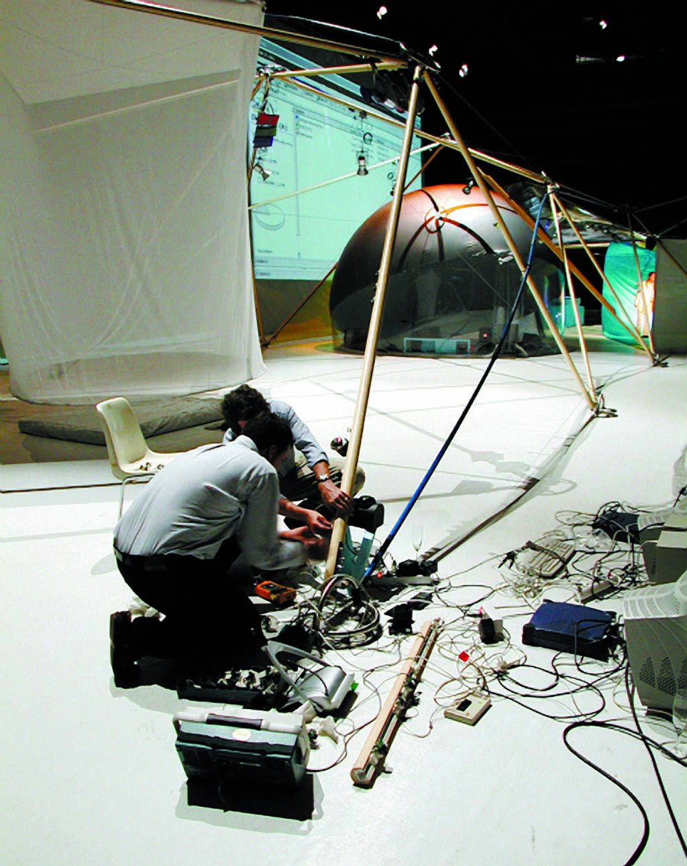
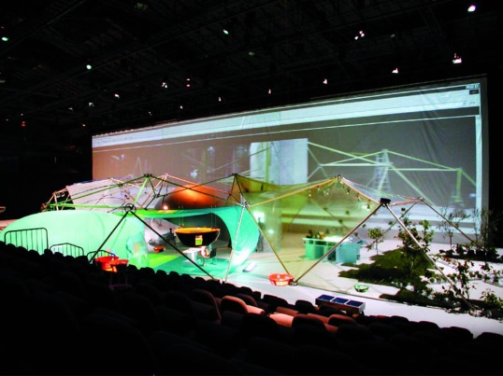
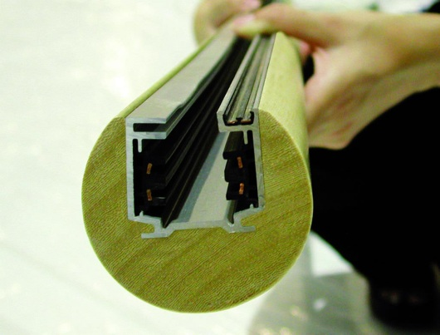
Media House Project. Information embedded into things
Sept 2011. Defining Internet 0.

Slide 14
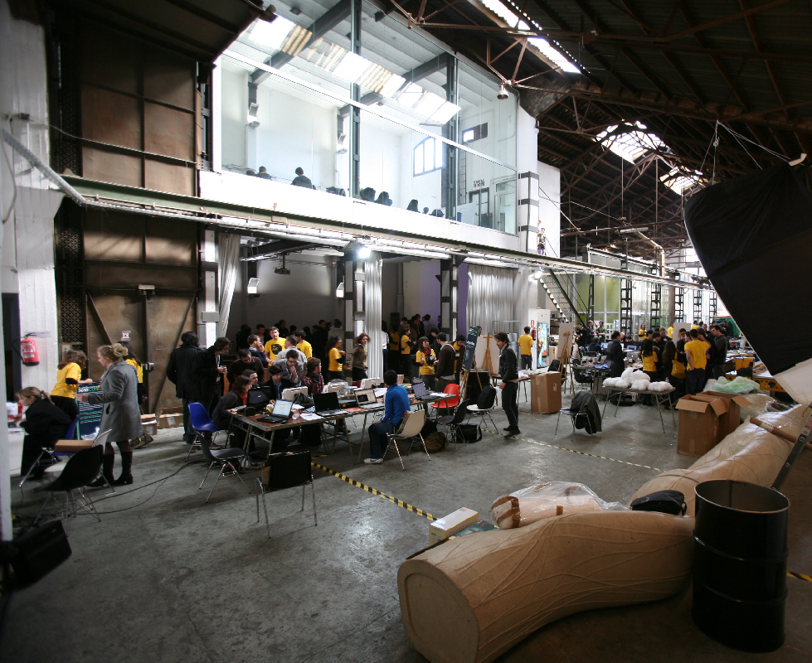
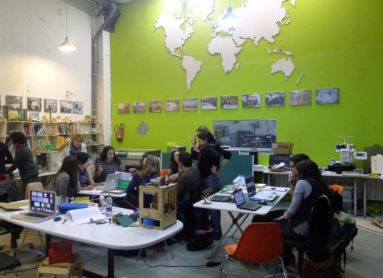
Fab Lab Barcelona. An open factory

Slide 15
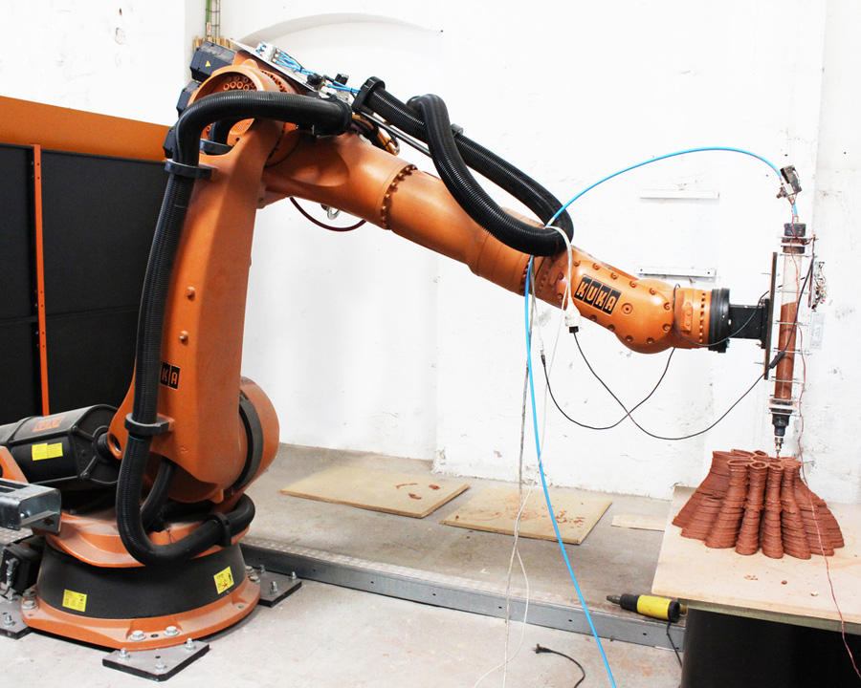
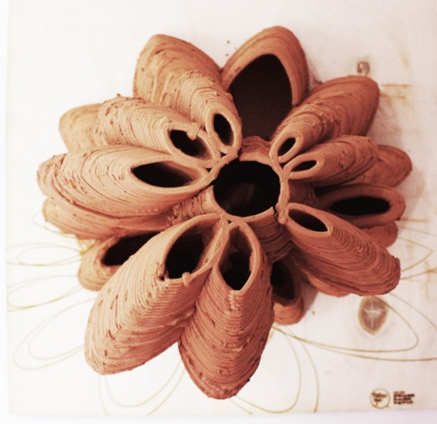
IAAC Barcelona. How information produces form
Sasha Jokic, Starsk Lara and Nasim Fashami. Professor Marta Male-Alemany

Slide 16
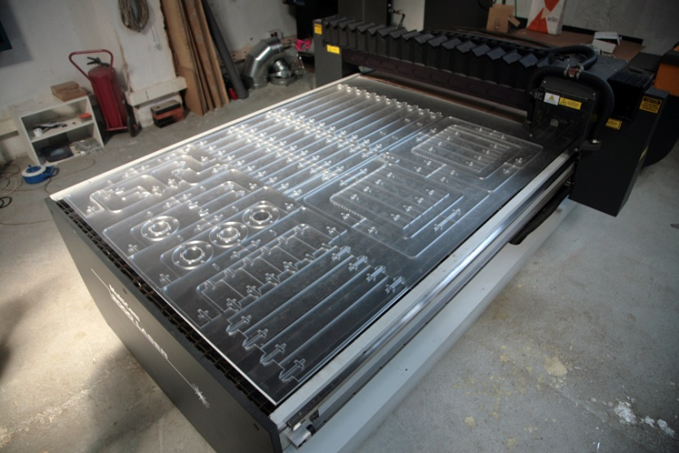
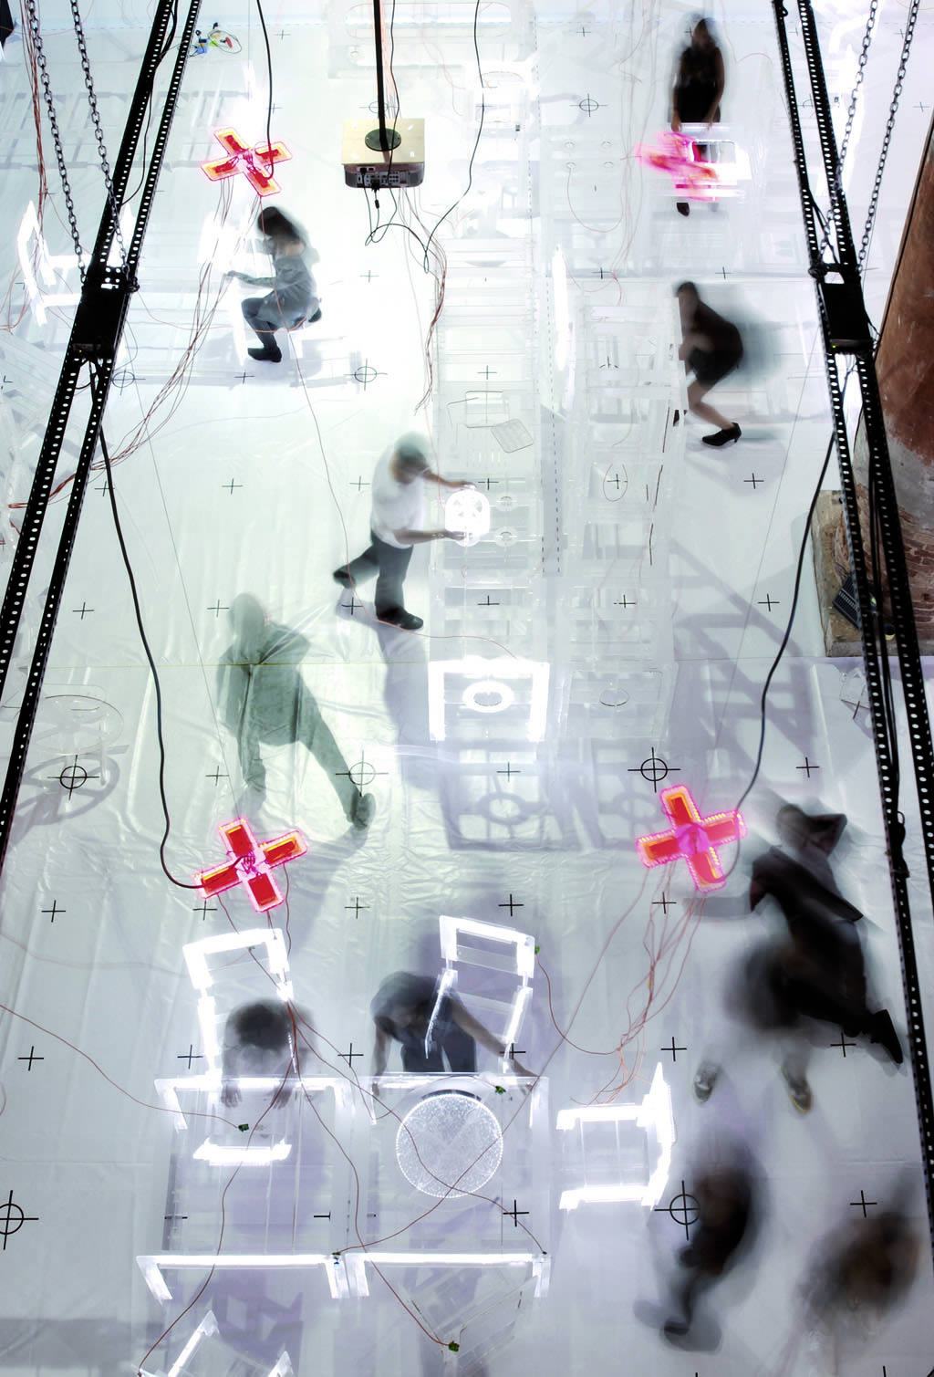
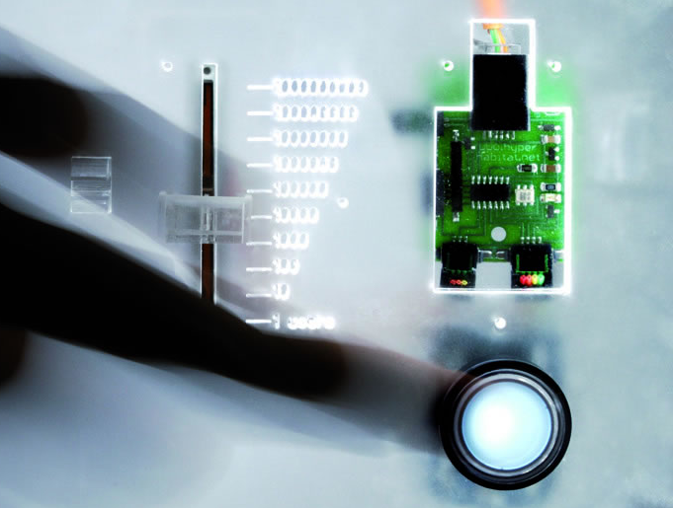
Hyperhabitat. The Internet of Things
La Biennale di Venezia 2008

Slide 17
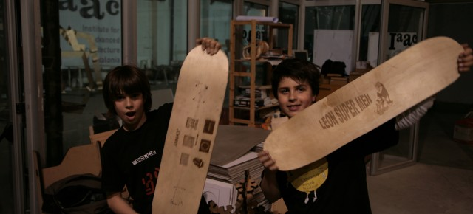
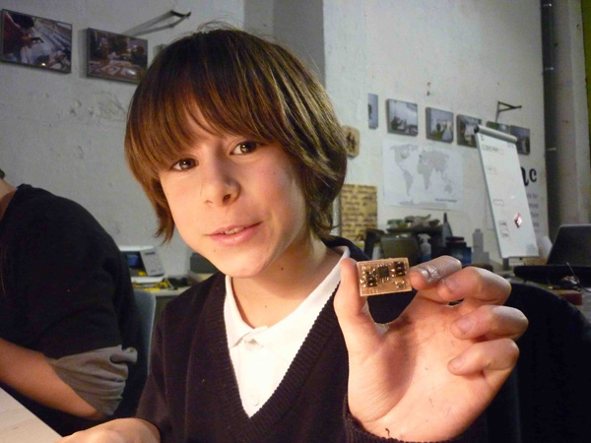
Fab Lab Kids

Slide 18
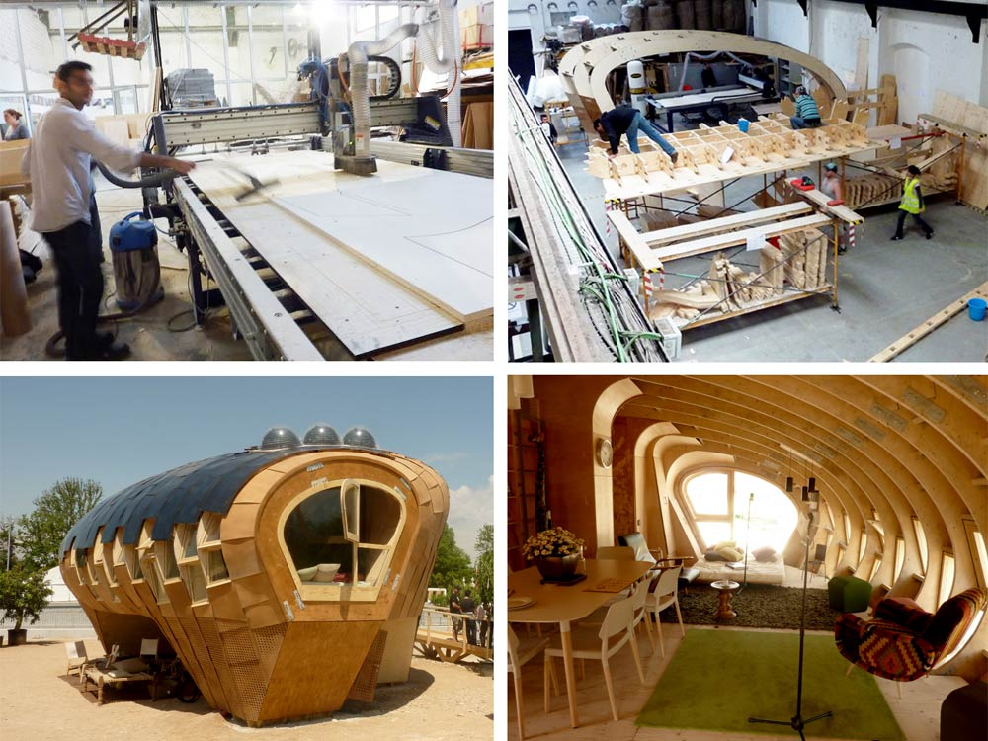
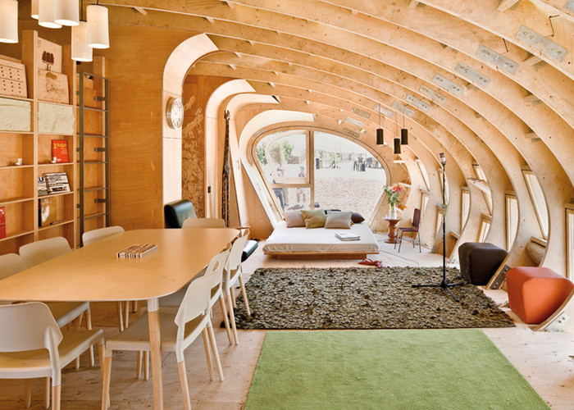
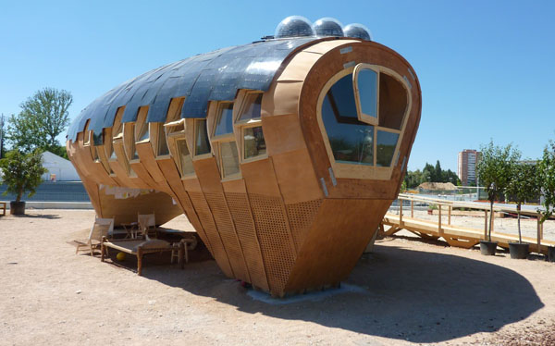
Fab Lab House. Form follows Energy
Solar Decathlon 2010

Slide 19
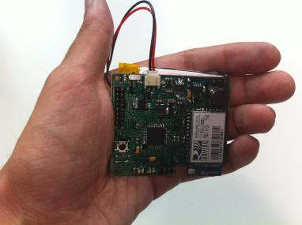
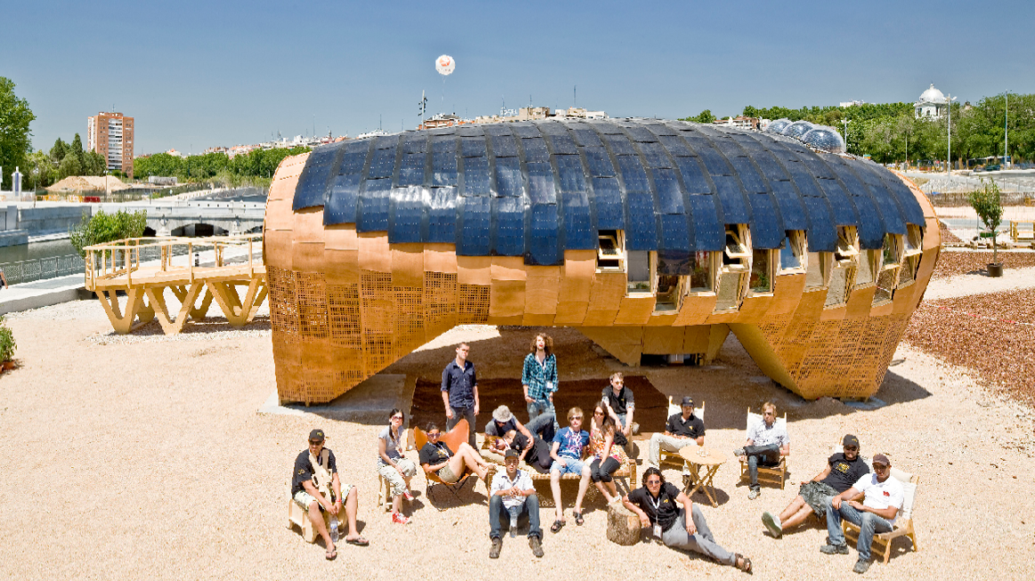
Fab Lab Barcelona
From a computer to a House

Slide 20
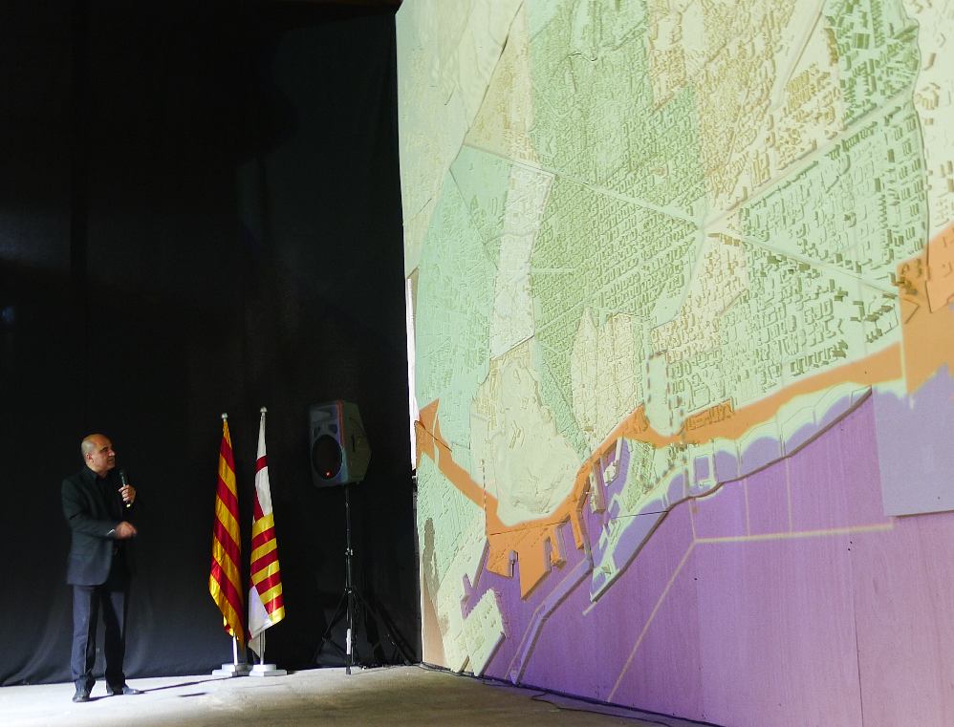
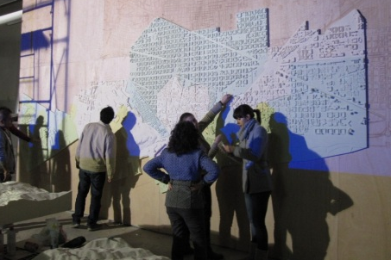
2011 Project for the Regeneration of Barcelona

Slide 21
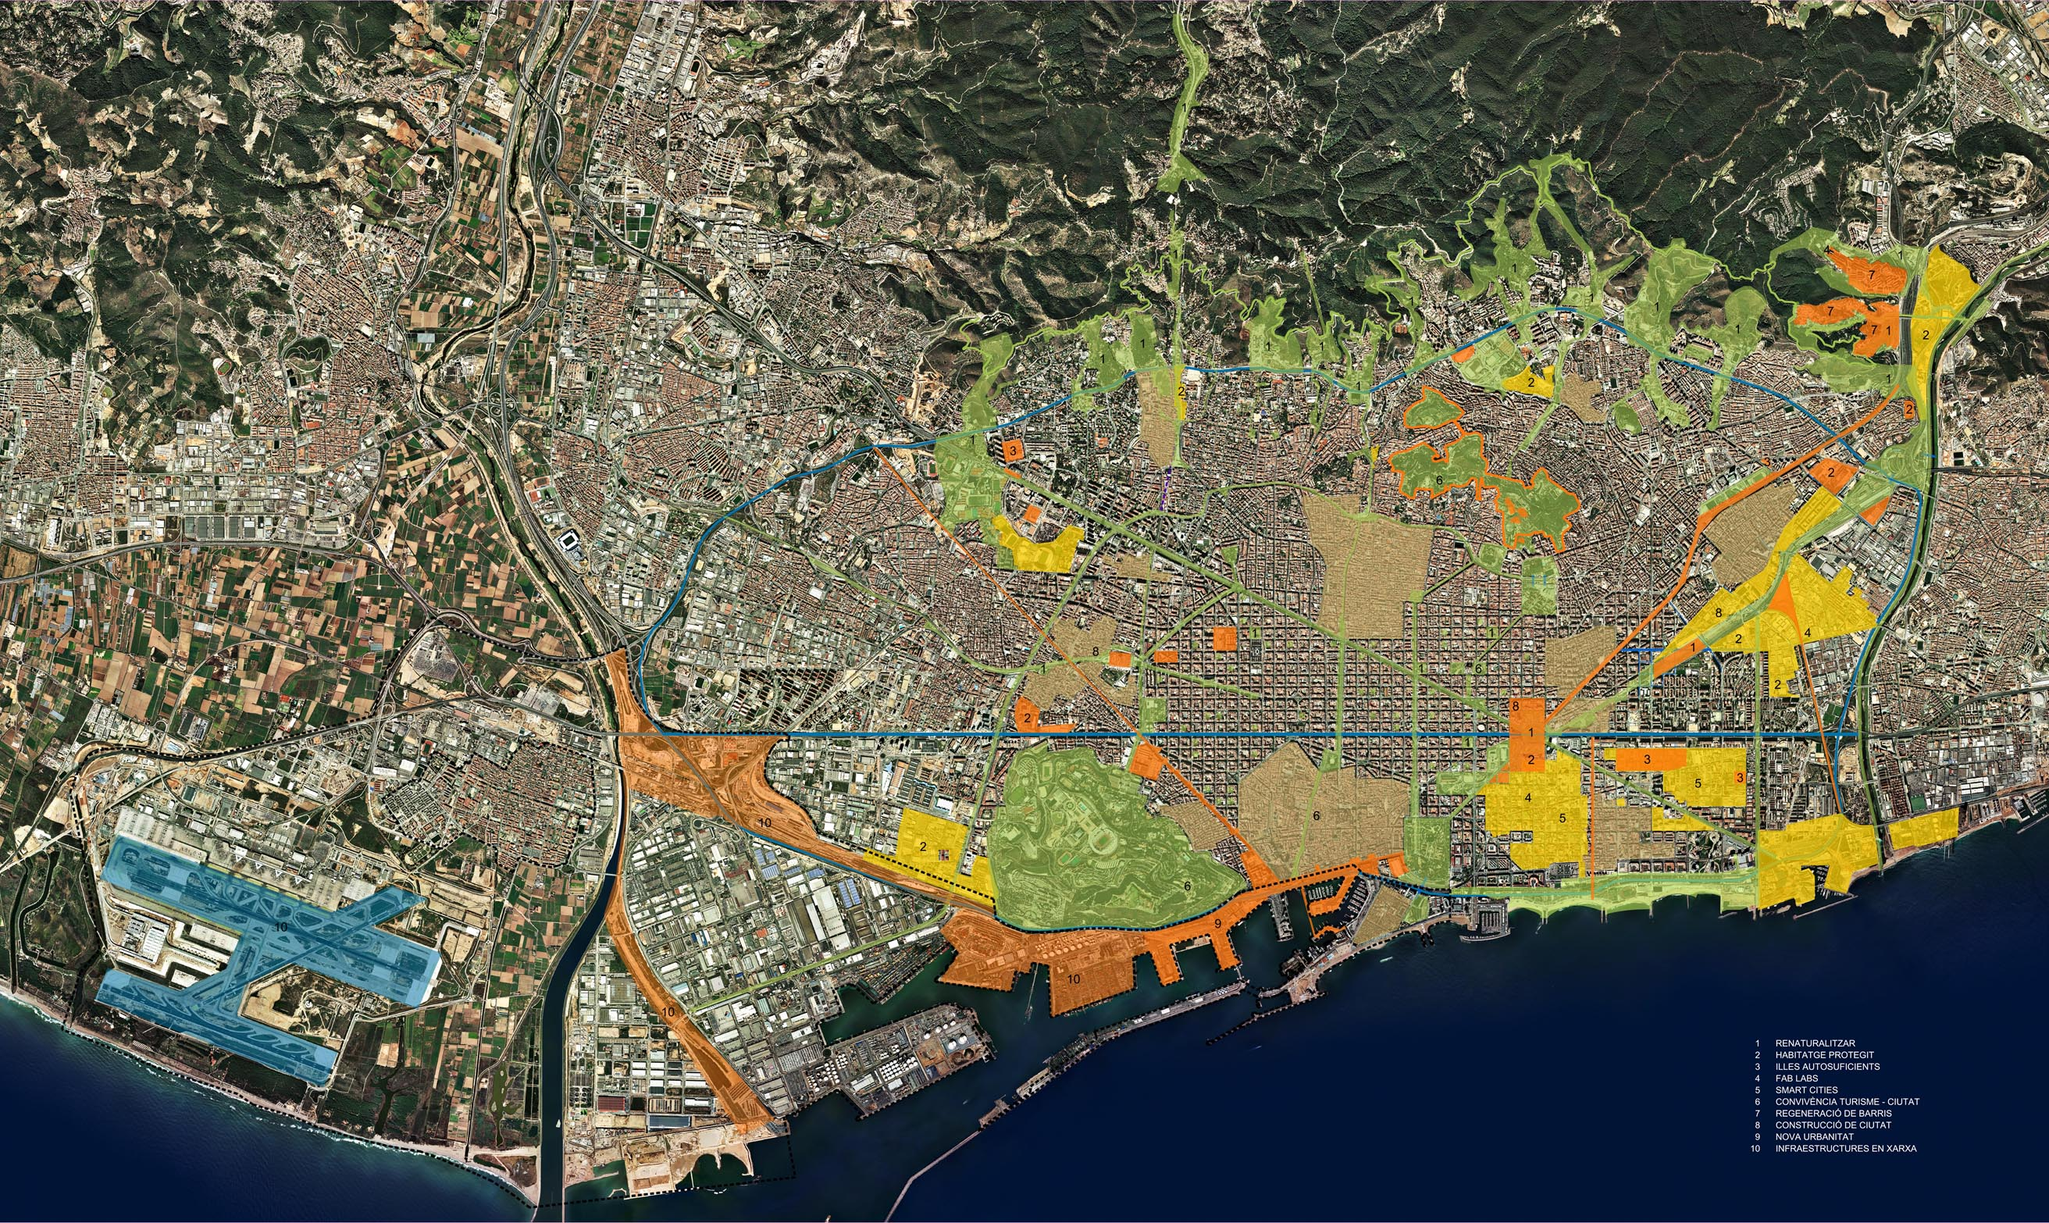
Barcelona 2011-2041: Inventing the future of cities

Slide 22
BARCELONA SELF-SUFFICIENT CITY
“Productive neighborhoods at human speed, inside a hyperconnected zero emissions metropolis”
“Many slow cities inside a smart city”
Hàbitat Urbà
Notes:
BANISM

Slide 23
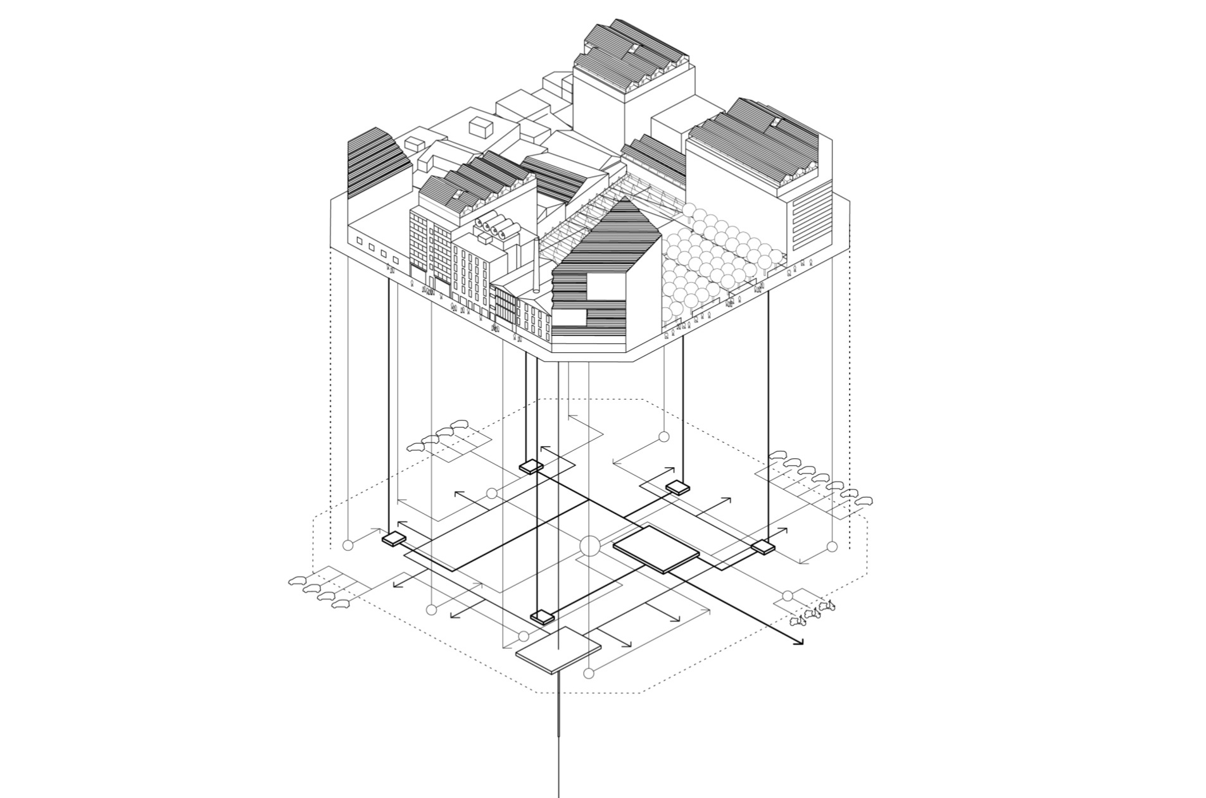
Self-sufficient blocks: producing locally
Energy, Food, and Things
SELF SUFFICENT BLOCKS
ENERGY WISE
SOLAR ROOF
MIXED USES
DISTRICT HEATING
WASTE RECICLING
ELECTRIC CAR
ELECTRIC BIKE

Slide 24
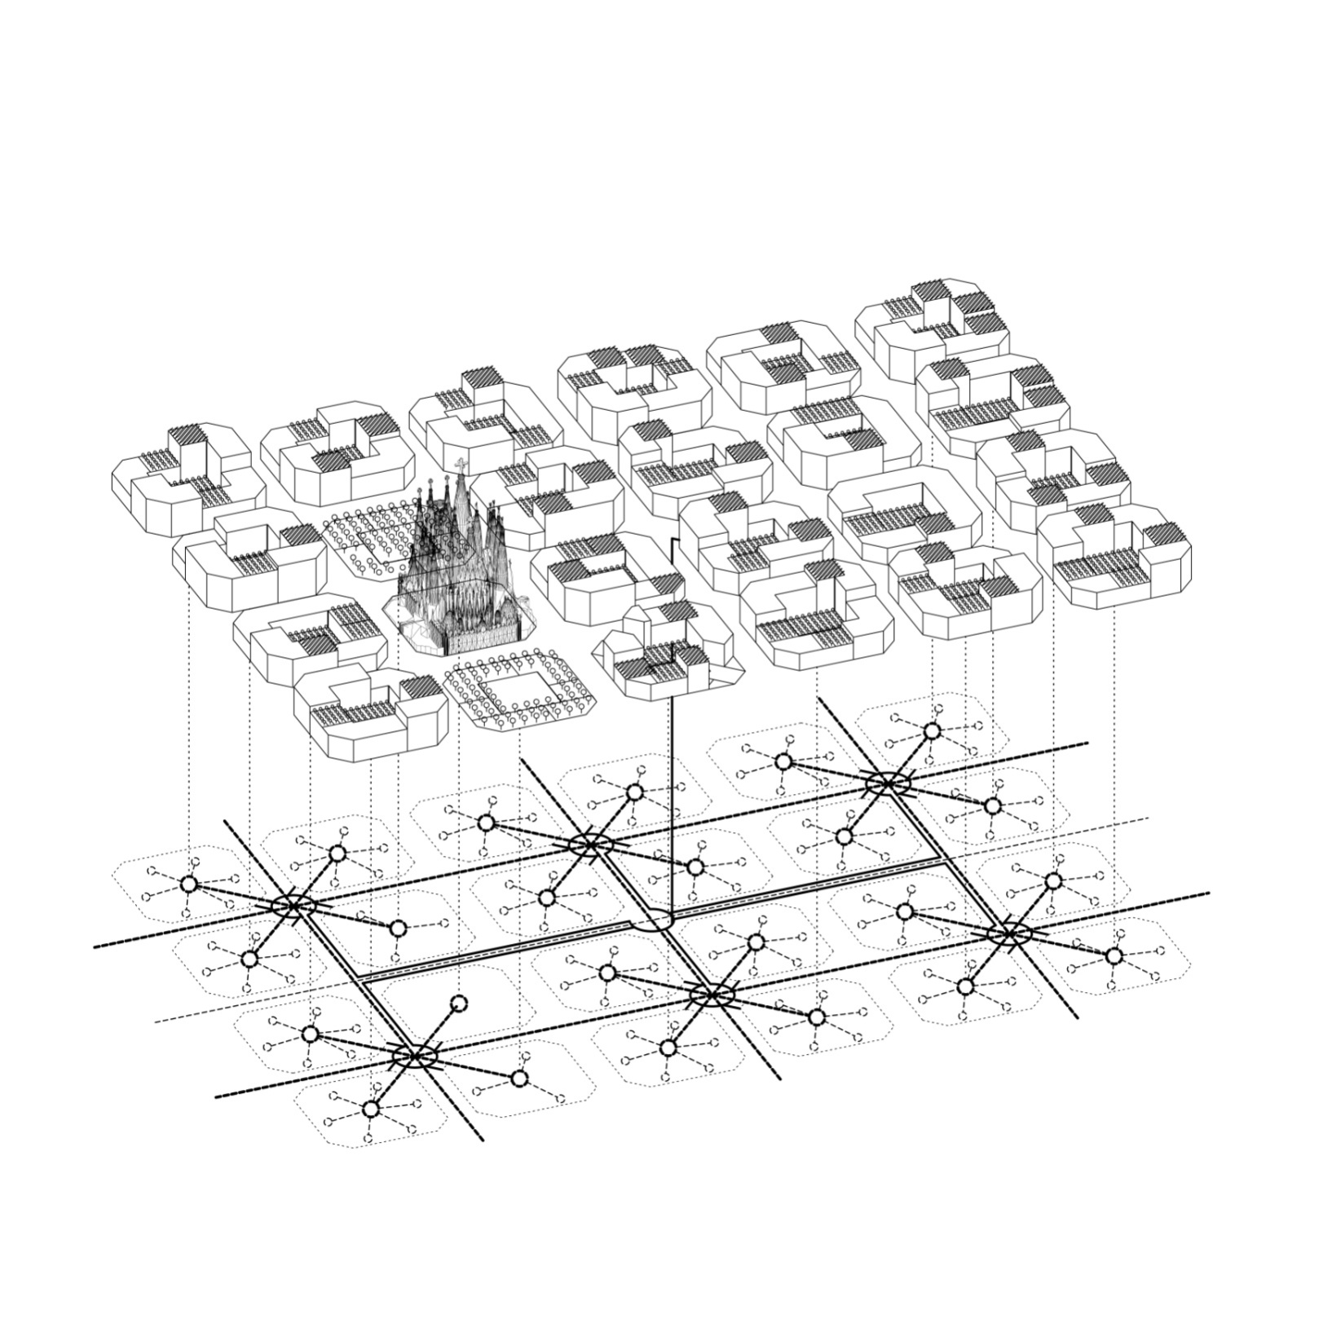
THE CITY AS A NETWORK OF NETWORKS
The city as a network of networks

Slide 25
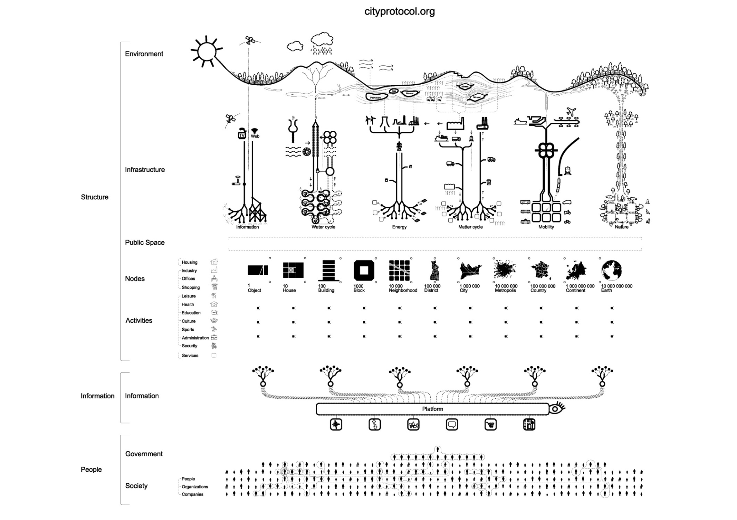
City Protocol: defining standards for cities
Cities, Universities, Industry and Organizations working togheter

Slide 26
Launching Fab City
Mr Antoni Vives. Deputy Mayor Urban Habitat. Fab 7- Peru 2011

Slide 27
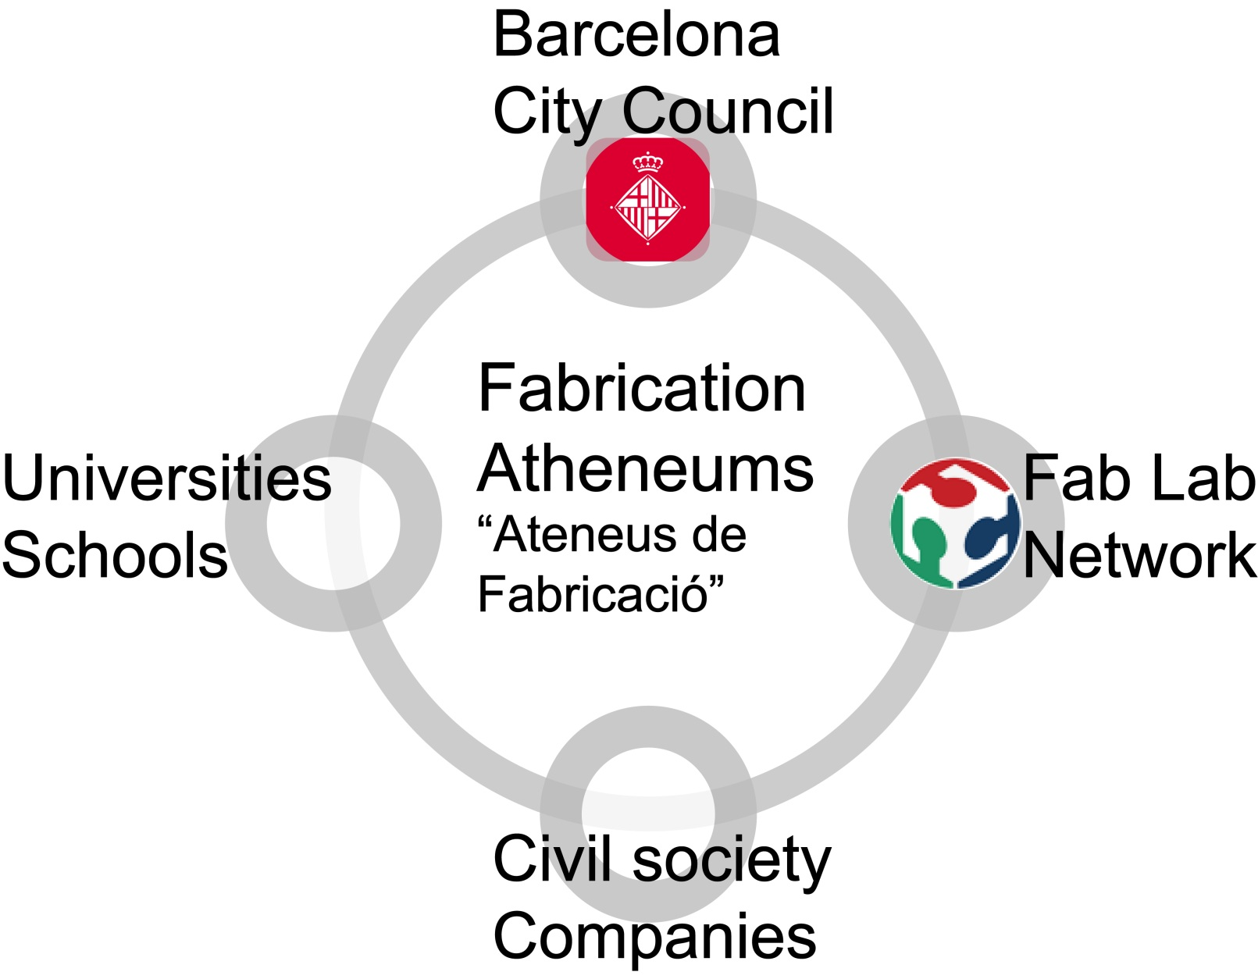
Barcelona’s model for Fab Labs

Slide 28
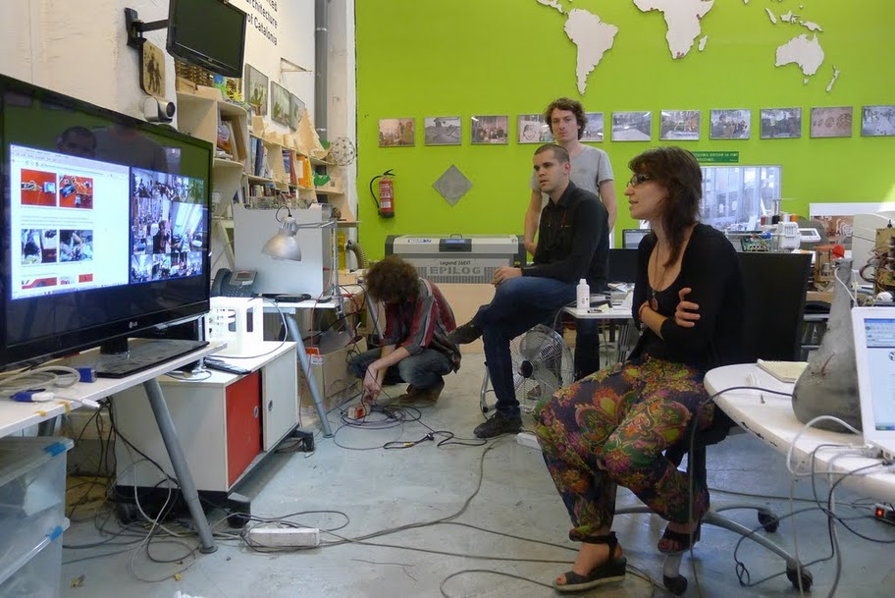
Characteristics of Fab Labs inside the Fab City
All Fab Labs have the same machines
Each Fab Lab has a mission that drives an associated cluster with each district
All Fab Labs will be connected by telepresence
All Fab Labs will share a repository of designs and materials

Slide 29
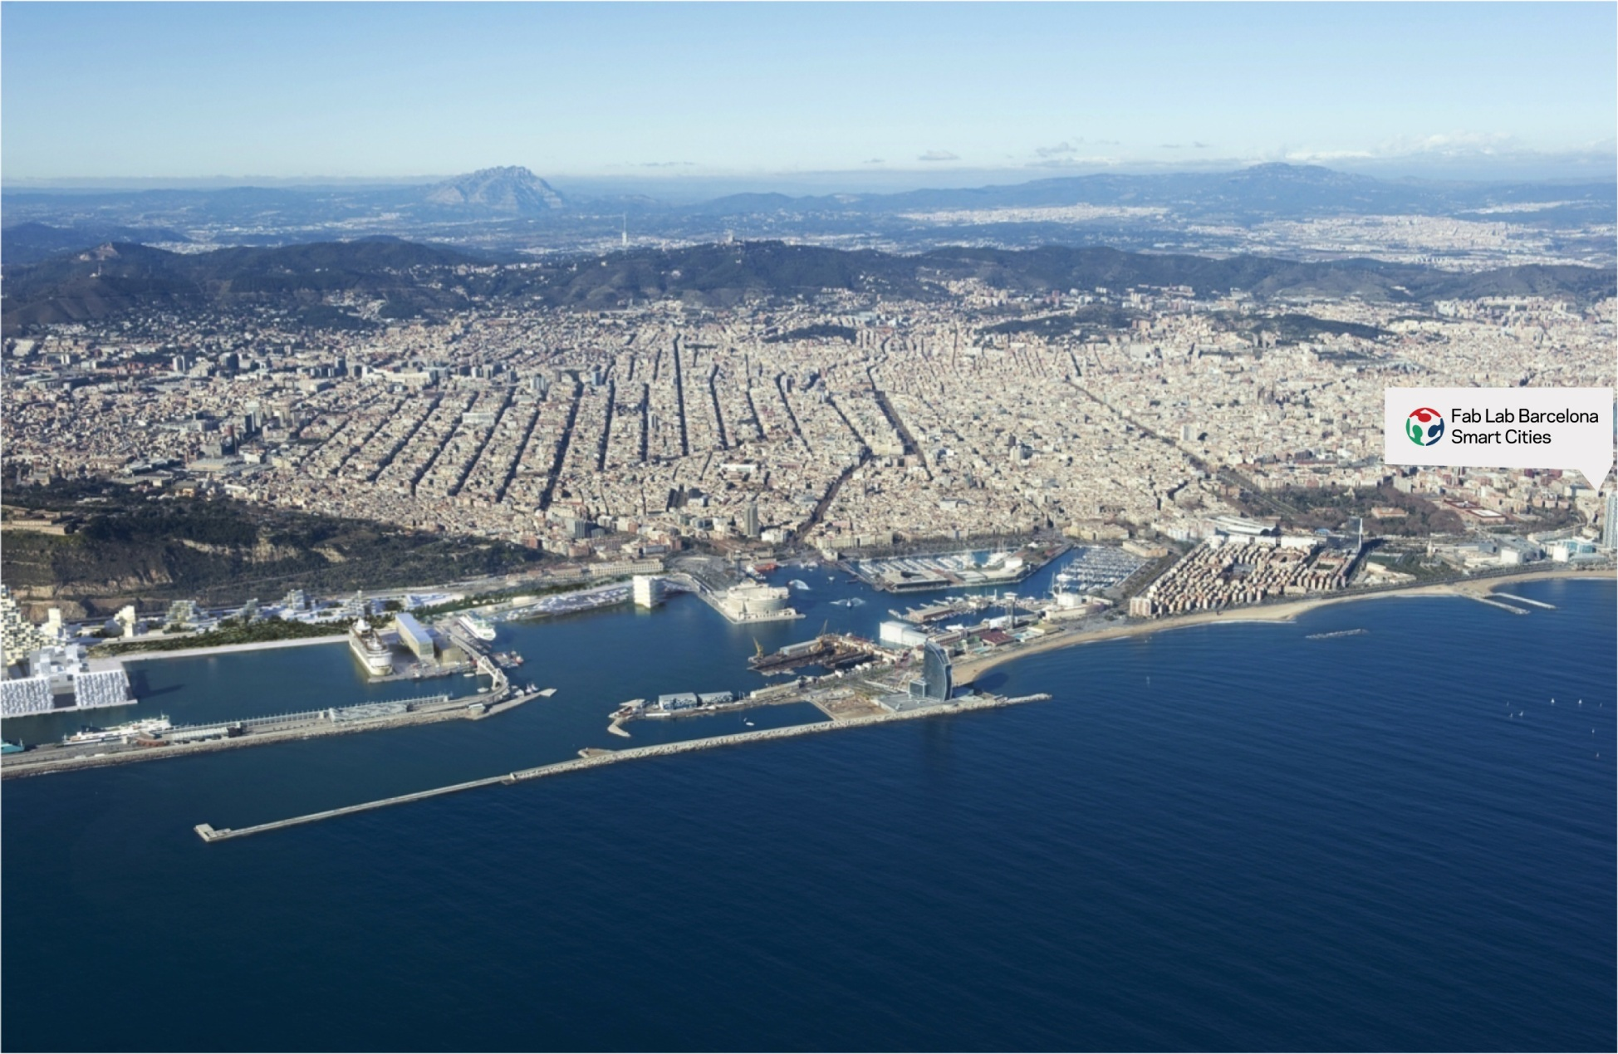
Today: One Fab Lab in Barcelona

Slide 30
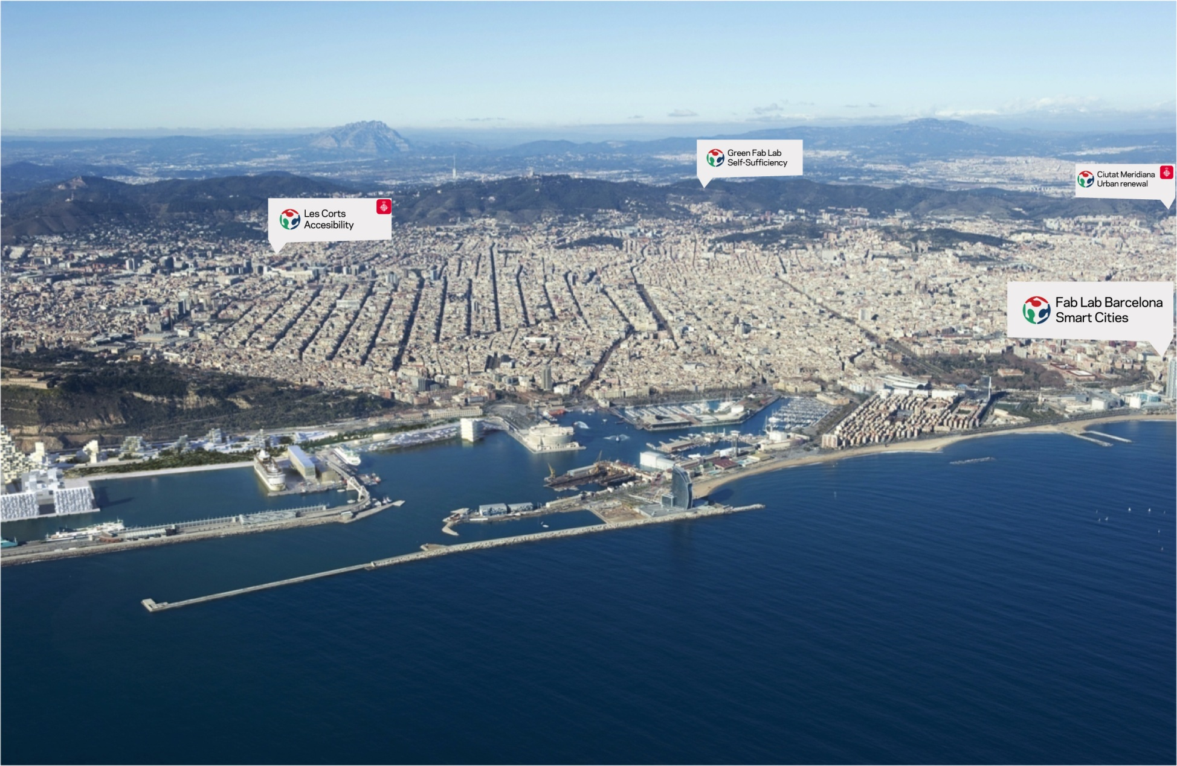
Today: Making three new labs

Slide 31
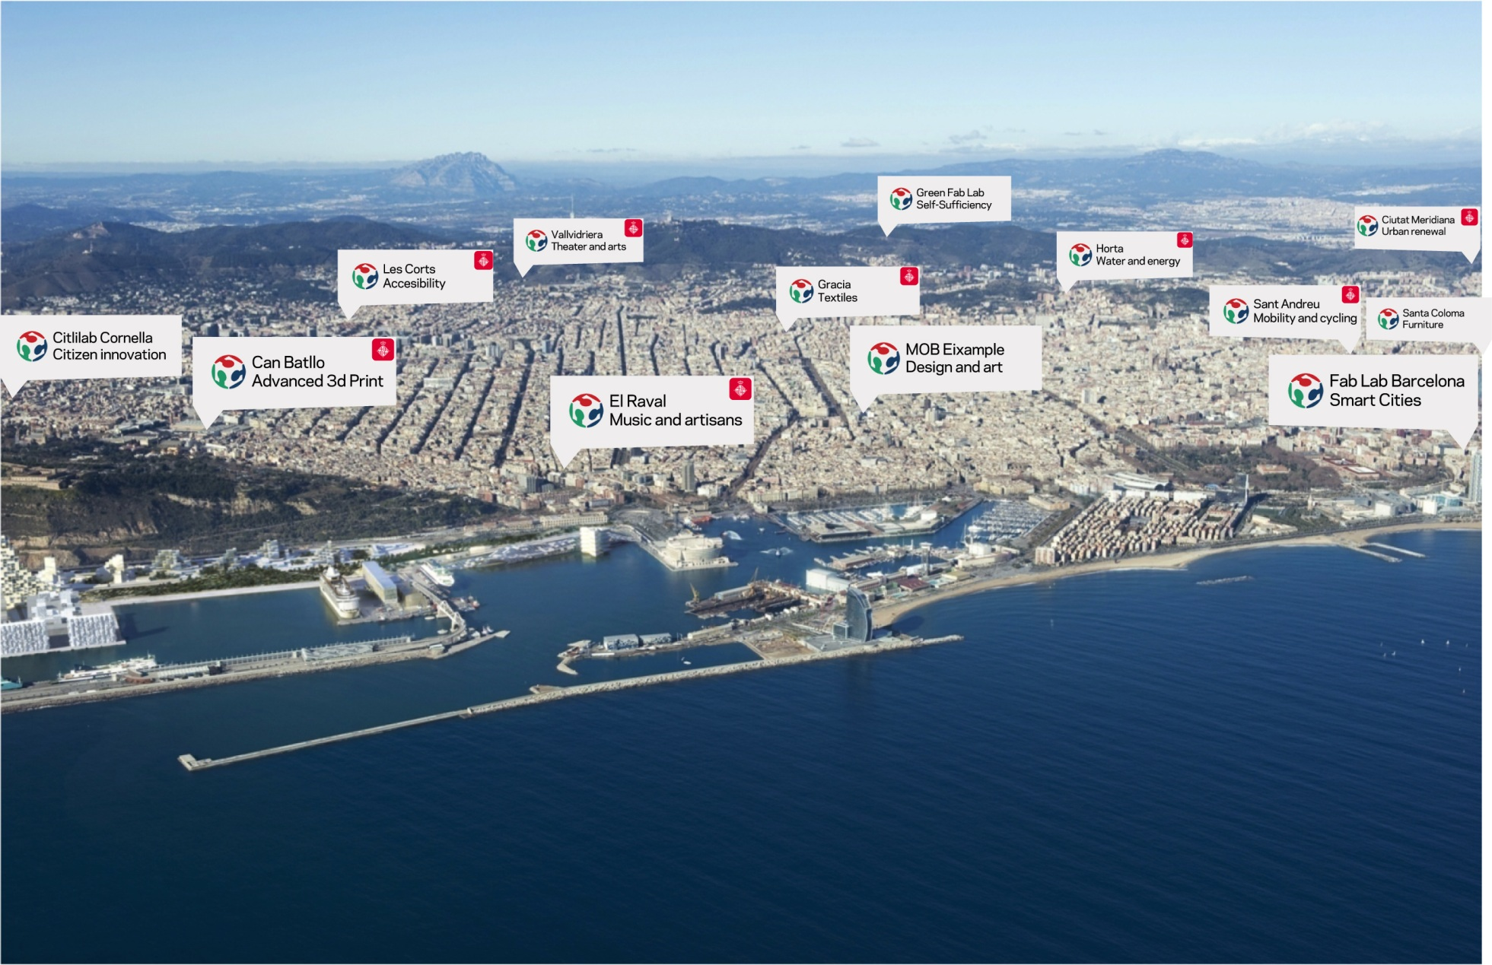
Planning one Lab per District

Slide 32
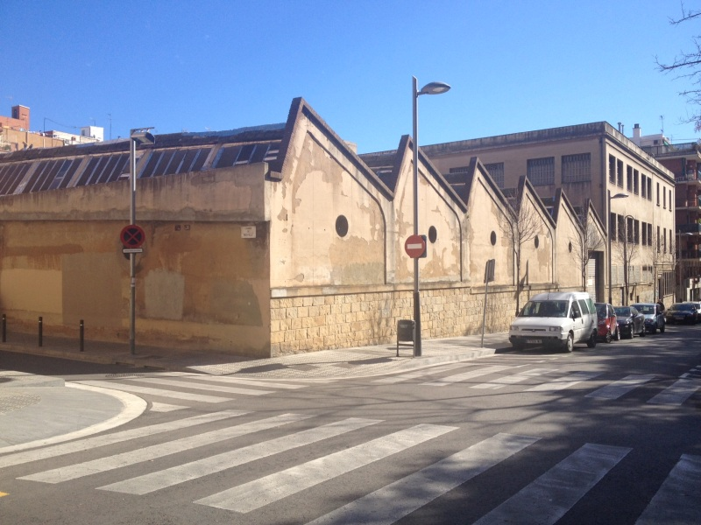
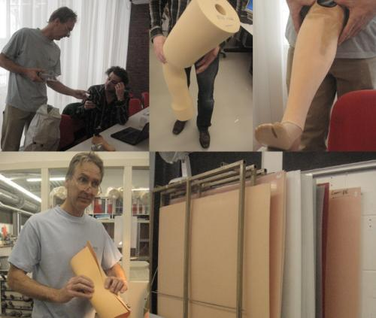
Fab Les Corts. Health
Fab Lab dedicated to medical issues: prosthesis, mobility devices, implants, etc.
Connected to the neighborhood and support to local initiatives
Partners: UPC University, Esclatec, WikiSpeed.
Fabrication of mobility devices: skates, bicycles, electric cars
Opening: February 2013
Manager: Barcelona City Council

Slide 33
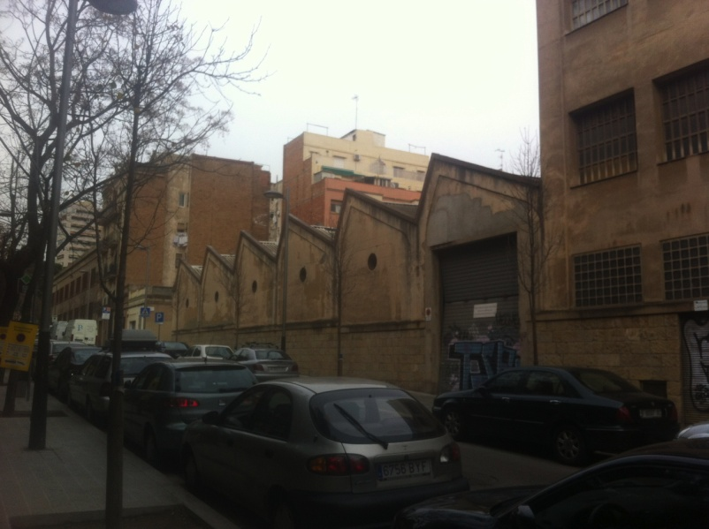
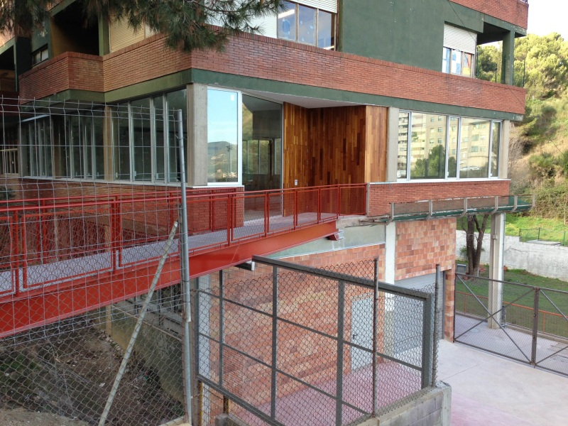
Fab Ciutat Meridiana. Urban Regeneration
Fab Lab dedicated to urban renewal and sustainability
Close relationship with the Collserola Natural Park
Energy production and urban farming projects
Special education programs together with the Sant Joan de la Creu School
Social inclusion Fab Lab
Opening: June 2013
Manager: Barcelona City Council

Slide 34
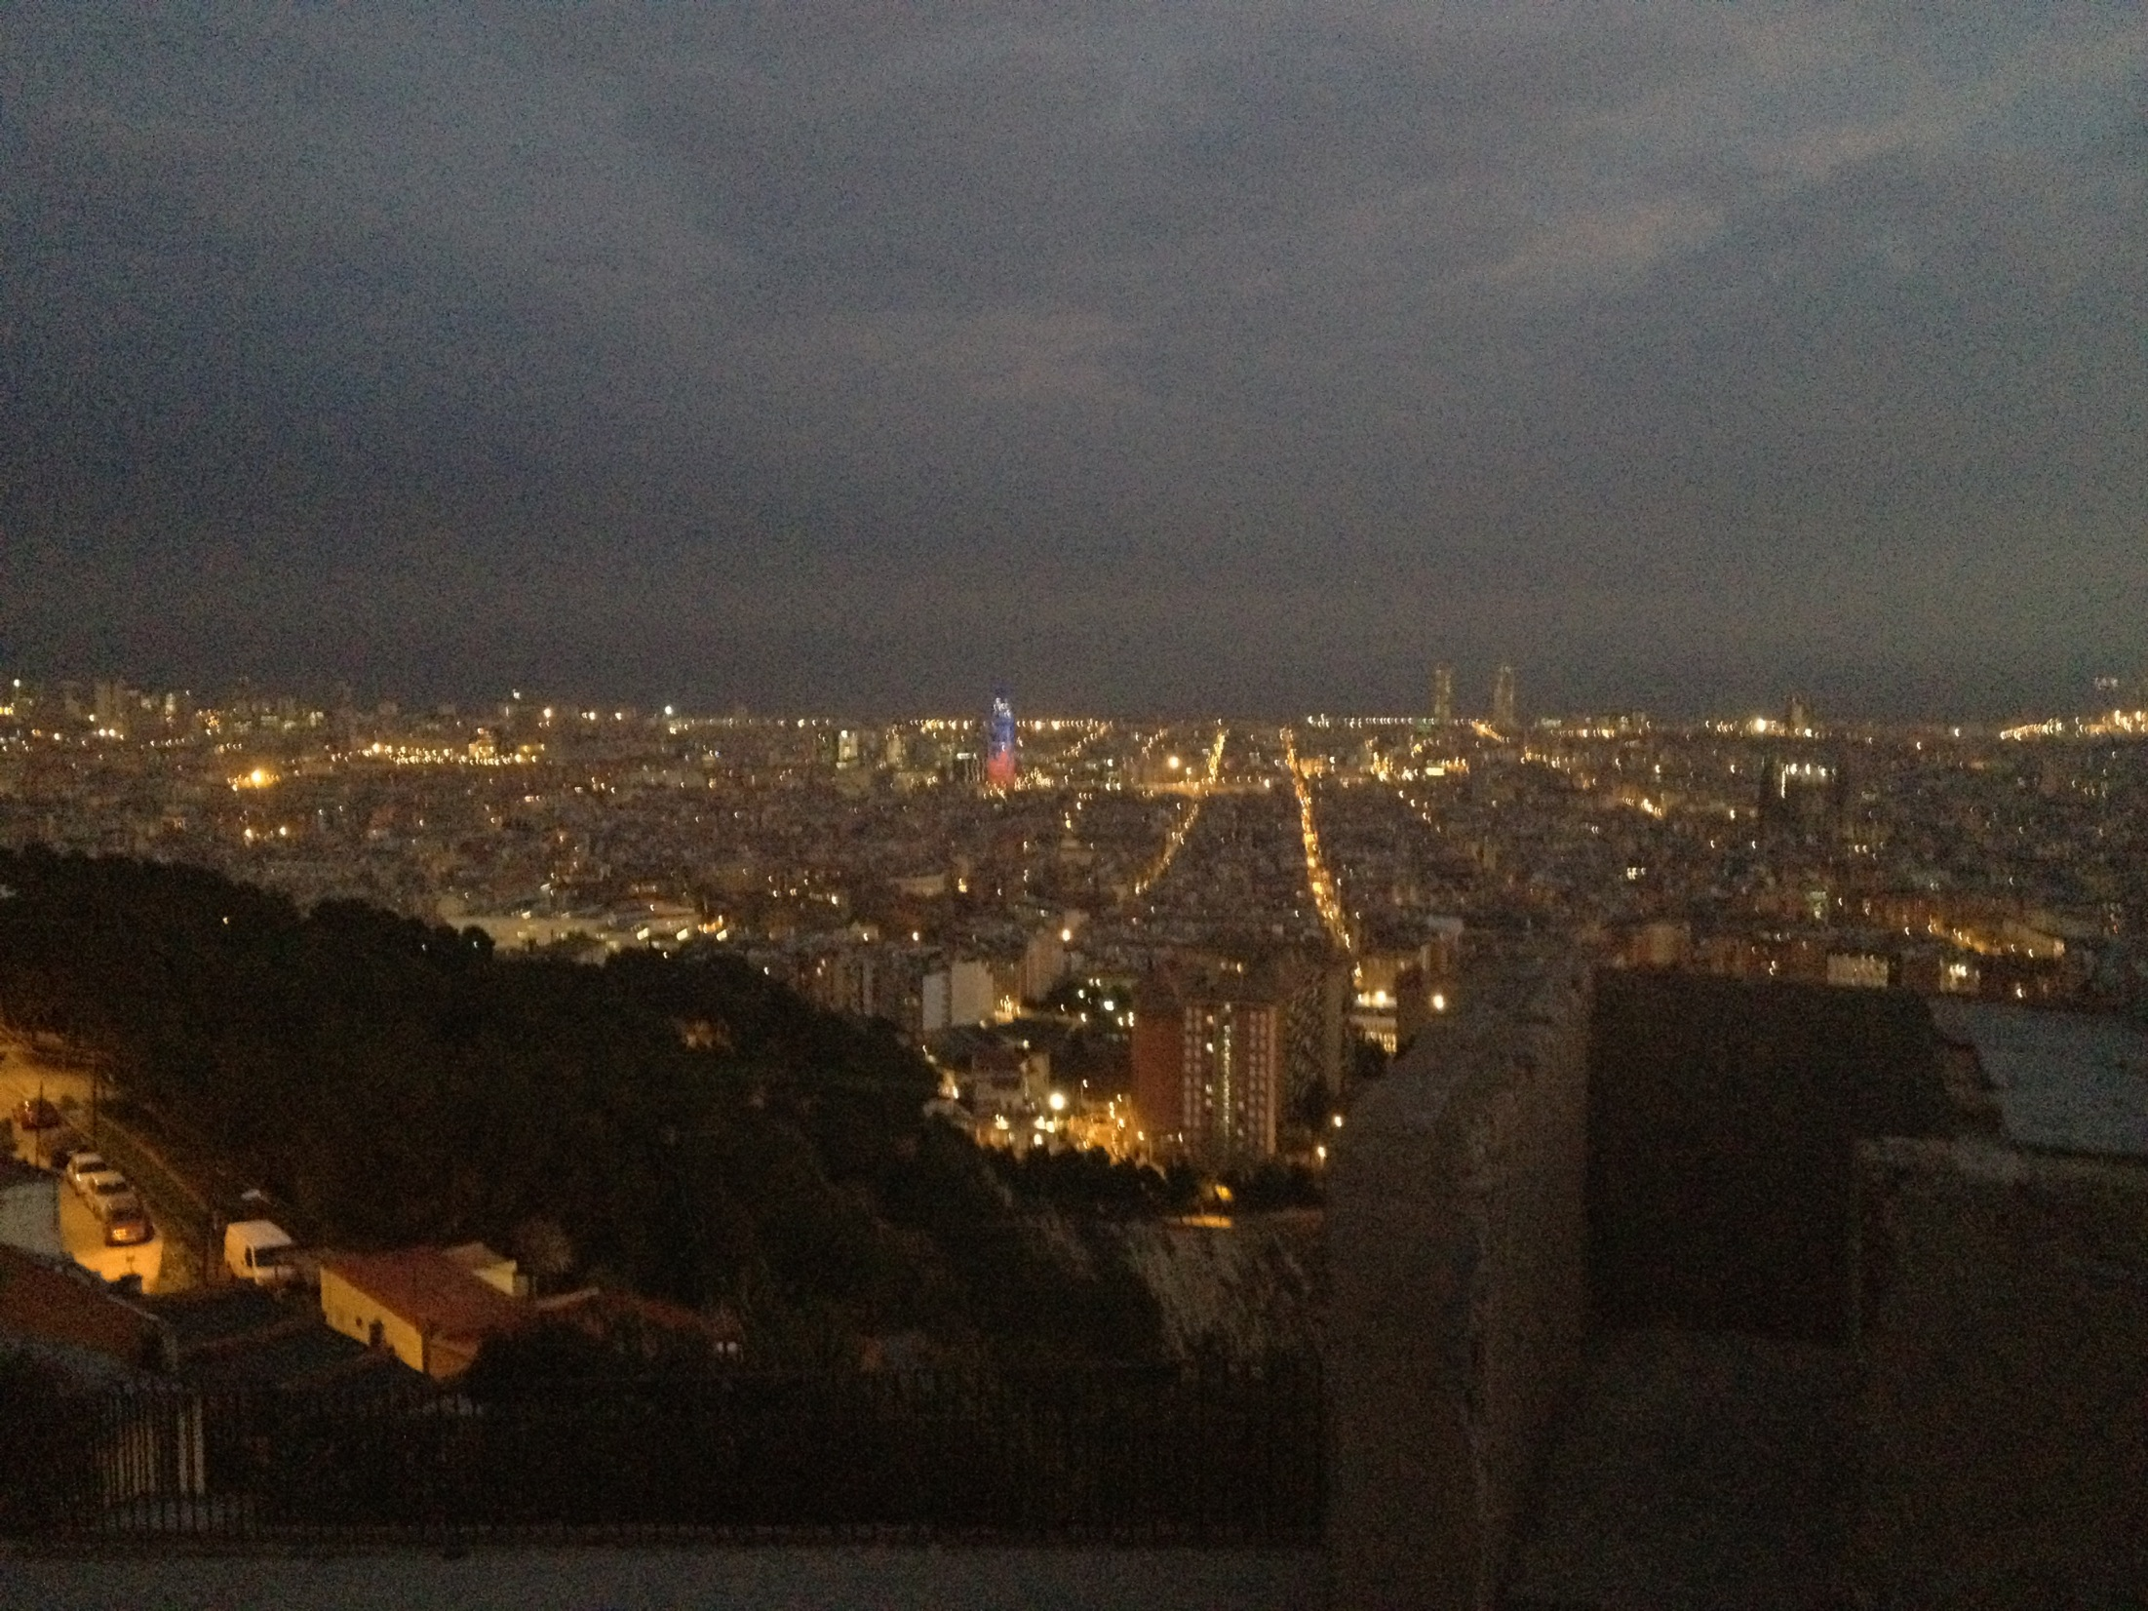
PLEASE COME TO
FAB10
BARCELONA SUMMER 2014
from FAB LAB to FAB CITY

