Slide 1
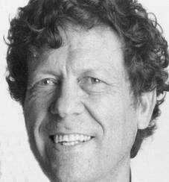
Notes:
Danny was born in Haifa in 1937. Israel at the time was a perfect incubator for "Think Different."
It was mandate times. The people in charge were the British. They were the people who wouldn't let Holocaust refugees or survivors enter the country, who blocked their entry by land and sea. It was settlers against the British, David against Goliath. They made the rules; the settlers figured out how to break them.
The settlers had little in the way of material goods. That situation only got worse after the declaration of the state in 1948 and the ensuing war. People made do with very little and had to improvise. To improvise, you have to figure out how to do it. And then you had to figure out how to do it better.
If people were poor in goods they were rich in each other. Helping was a way of life.
The kids were born in Palestine but the parents came from elsewhere. They spoke a cacophony of languages and spoke Hebrew with accents and often not well. They worked hard; being a worker or a farmer had prestige because these built the country and were forbidden to Jews in Europe. The kids grew up on their own, raised themselves.
Danny's father, David, came to Israel at 15 with his parents, and went immediately to work. He turned out to be good at electricity, and that became his profession. Before '48, he was in the Palmach, the underground movement that fought the British and later became the Israeli Army. He worked with maps, and one of them later was key in one of Danny's more reckless escapades. His mother Dorit came from Hungary also in her teens, to join a sister. The rest of her family perished in the Holocaust. His mother worked as a nurse during the War of Independence and later for the army. They had a one bedroom apartment. Danny shared the bedroom with a renter who helped make ends meet, and his parents slept in the living room in a pull-out bed.

Slide 2
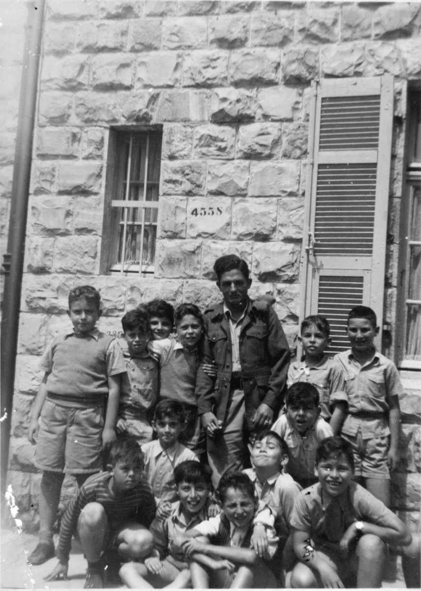
Notes:
1948 Math teacher Yosef Mannheim; Danny clutching him so he wouldn’t leave to the left; Danny’s friend, Amitai, farther left, who also loved math and later went to Litani with Danny.
You will not be surprised to learn that Danny was a lopsided student, brilliant in math, but not very interested in much else. His parents were called to the school on a weekly basis. You will also not be surprised to learn that Danny was a daredevil and, inevitably, there were injuries. Here's one. At 10, he sprained his thumb and had to wear a splint on his right hand. Naturally he couldn't write, so he couldn't do his homework. When he was still wearing the splint at school many weeks later, his teachers called the parents to school to ask if he really still needed the splint. Many of the teachers had European PhDs and were respected scholars, but teaching was the only job open to them. Danny was especially attached to his math teacher. Here you see him clutching that teacher, who had left teaching to fight in the 48 War for Independence and had returned in uniform to visit. Danny is trying to keep him there.

Slide 3
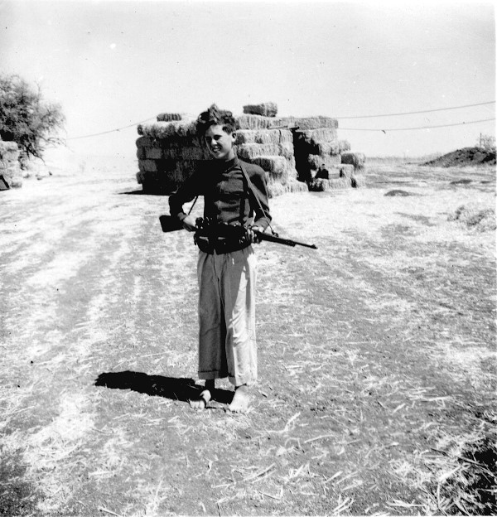
Notes:
The center of life for the kids was the youth movements, of varying flavors of socialism, fiercely argued. The youth movements worked in associated kibbutzim on vacations, and during the school year when needed. The youth movements would later both build new kibbutzim and enter the army as a unit, so those summers and vacations working on the kibbutzim were also pre-military training. Here you see Danny in his second or third year in high school, before his growth spurt, with a prized rifle. He was the envy of all because he'd been chosen to guard the kibbutz at night, and for that, he received a rifle.

Slide 4
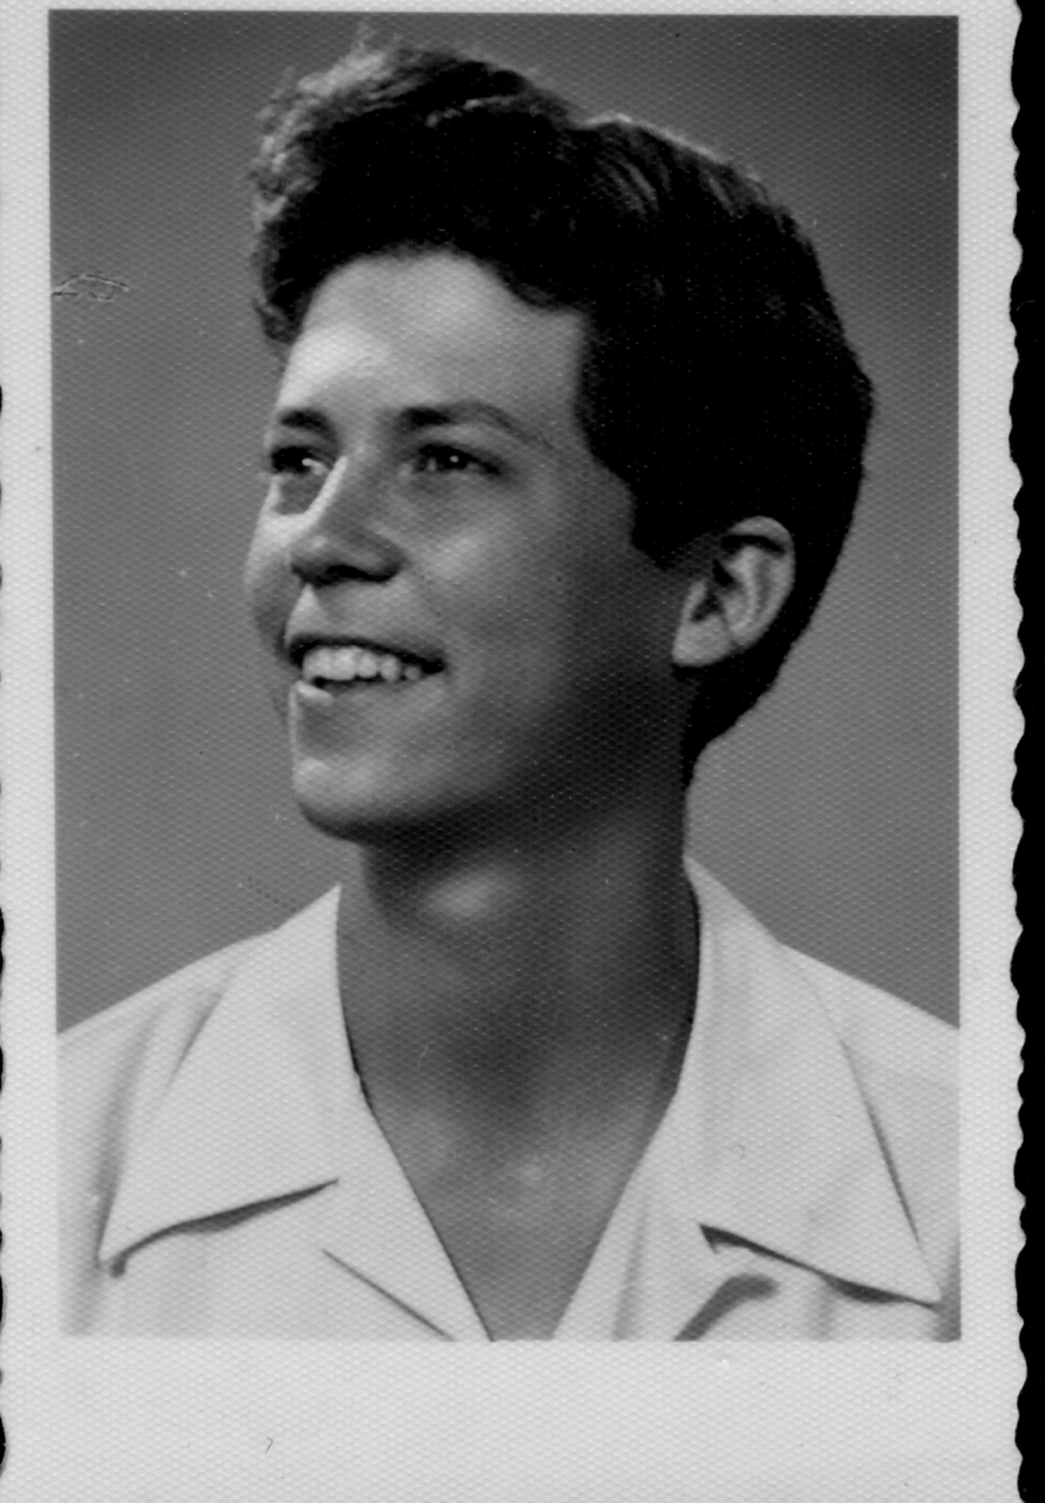
Notes:
Danny was in high school shortly after the War for Independence that founded the state and established borders that were life-threatening to cross. At the same time, the many stories of bravery and bravura that enabled Israel to win the war had become oft-told legends. Israelis were attached to the land, every stone, and legendary places that were now across borders were enticing, especially to young men. One of them was the Litani River, in Lebanon, one of the sources of the Jordan River. Another was Petra, spectacular ruins in Jordan. Both were Mt. Everest to young men, an Everest you thought you could walk to under the cover of darkness in just a few hours. But to get there, you had to cross well-guarded border into enemy territory. No questions asked before shooting. A harvest trip to a kibbutz near the Lebanese border made a trek to the Litani irresistible to Danny and a couple of friends (one of them is next to Danny in the photo with the math teacher), aided by his father's map. Obviously Danny returned. Was it thrill-seeking? Self-delusion? Thoughtlessness? Later, he made a pact with another friend to go to Petra in Jordan. When they were both serving in the army in the Negev, Danny was summoned by that friend. Danny couldn't get there in time, and that friend and his companions were killed on their way to Petra.
In high school, Danny happened to read an article on an electronic brain, and decided that was what he wanted to do.

Slide 5
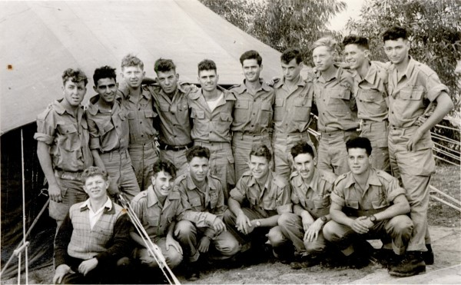
Notes:
The youth movement went to the army as a unit. They did basic training together and together they began building a kibbutz, Chorshim. Agriculture was key to the state's survival, as were kibbutzim of soldier-farmers along the borders.Here are some photos of the construction of Chorshim. It is on the then border with what was Jordan at one of the most vulnerable points in Israel, the narrowest part of the country, 7 miles across.

Slide 6
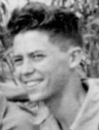
Notes:
Nachal 20

Slide 7
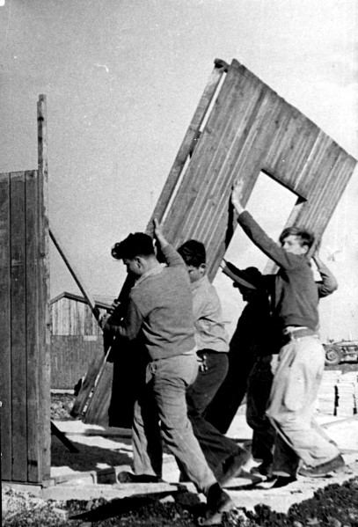
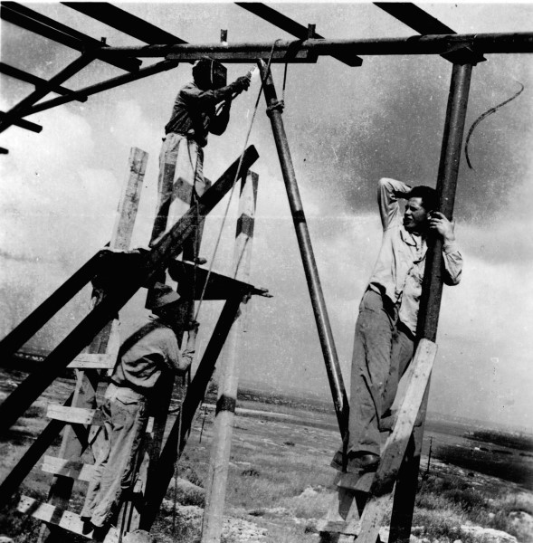
Notes:
Here are some photos of the construction of Chorshim. It is on the then border with Jordan at one of the most vulnerable points in Israel, the narrowest part of the country, 7 miles across.

Slide 9
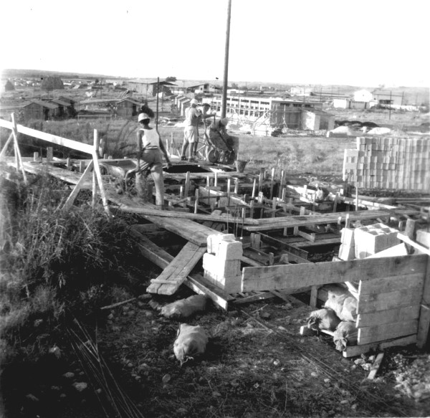

Slide 10
Notes:
Basic training

Slide 11
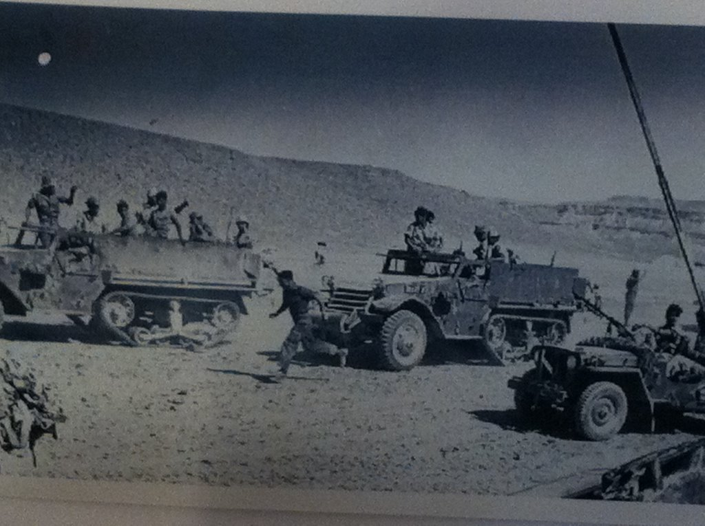
Notes:
In middle of army service was1956 Suez Campaign. Danny was in an elite unit, the paratroopers. He fought in the hardest battle of the war, the bloody incursion of the Mitla Pass, which Ariel Sharon led against the explicit orders of his commander, Moshe Dayan. Remember the photo of Danny with the rifle? For this campaign, he carried a bazooka, to be used against tanks, but never got a chance to use it as the Egyptians had no tanks in Mitla.

Slide 12
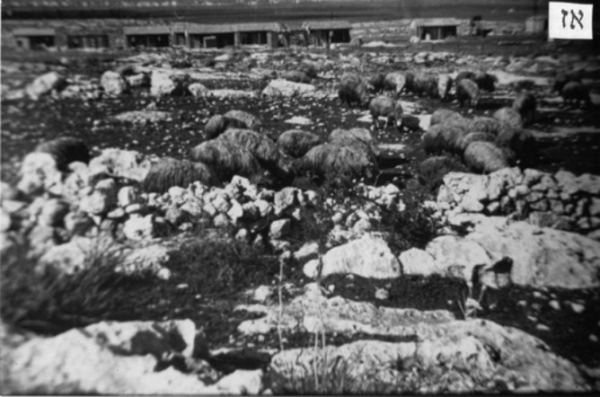
Notes:
After the army, the youth movement returned to the kibbutz they had built. Danny stayed a year or two on the kibbutz, working in the orchards and then keeping accounts, using punch cards on IBM calculating machines in Tel Aviv. When his father had a heart attack, he took a leave to return home. He ended up staying, and enrolling in the nearby Technion to study math. Like much of Danny's life, it wasn't planned or carefully considered; it happened. Eventually most of the other founding members left the kibbutz, but those early ties, the youth movement, the war, the building of the kibbutz, are strong, the deep friendships remain, and they still get together. They are remarkable people, successful scholars, business people, poets, artists, in many cases, more than one of those.

Slide 13
Notes:
As I said, Israelis love the land, and hike it whenever they can. In those years, it meant camping and carrying everything, food and water for the week, with you. Some photos from some of Danny's trips with friends.

Slide 14
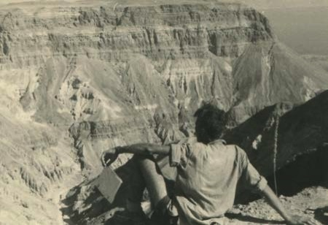
Notes:
Hiking Judean Desert1958, near Masada

Slide 16
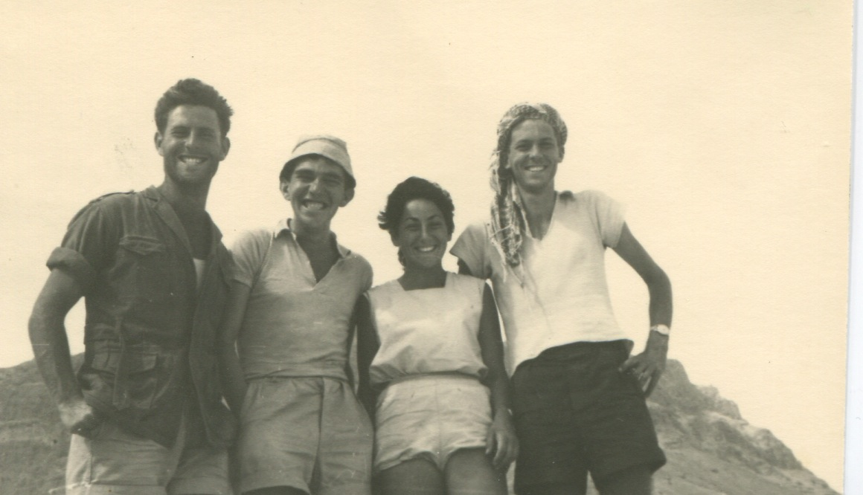

Slide 17
Photos courtesy of Amos Yudan, far right

Slide 18
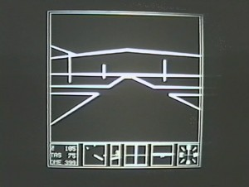
Notes:
After he finished his bachelor’s, the Technion sent him to study applied math at MIT. I will leave you there, because the rest of you became parts of Danny’s story thereafter.

