Slide 1
Danny's Festschrift March 2, 2013
A Hardware View of the Early ARPAnet Days
Bob Parker
and
Randy Cole

Slide 2
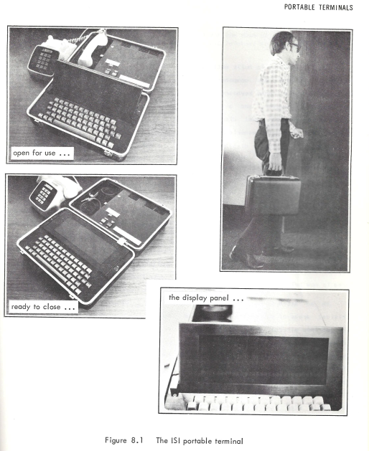
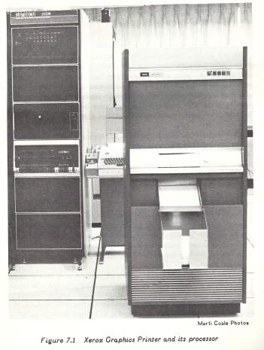
Human Interface Hardware in the Early Years
1973 – Portable terminal, 8 lines of 32 characters, acoustically coupled
1974 – Xerox Graphics Printer connected to ARPAnet
1981 - Rapicom Fax machine interfaced thru “Faxie”
Fax scans managed as documents, stored and delivered in the ARPAnet

Slide 3
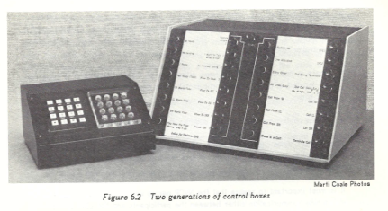
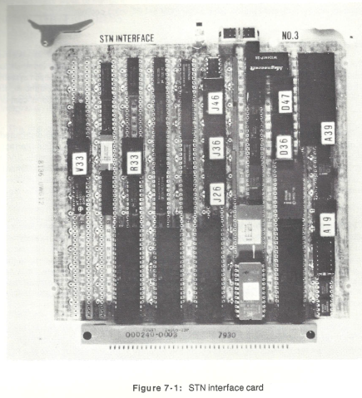
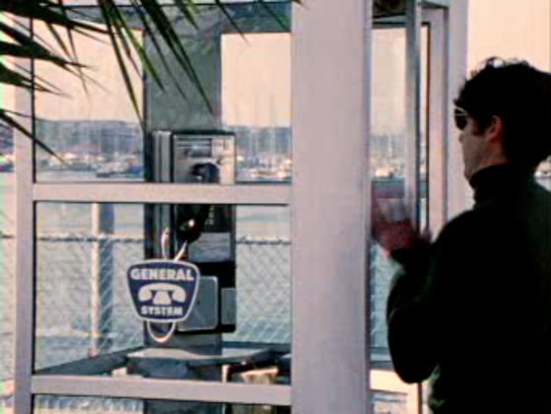
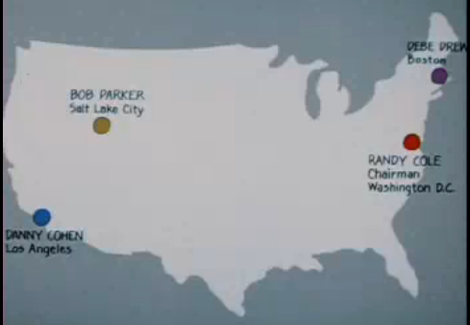
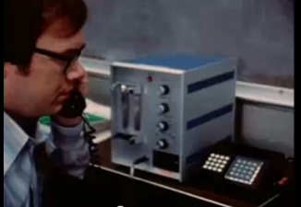
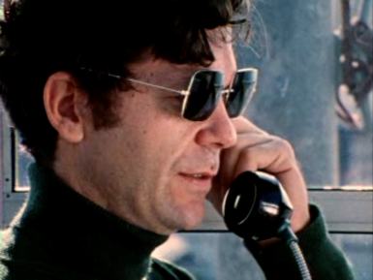
Packet Voice Conference movie Jan. 1978
Network Voice Conferencing
1975- control interfaces
1981 –Switched Telephone Network Interface
http://www.youtube.com/watch?v=MGat1jRQ_SM

Slide 4
Some Lessons We Learned from Danny
When you fly a Cessna below a certain speed with the landing gear up, it's best to tell your passengers that the klaxon they hear doesn't mean they're doomed
The FAA recommends that you verify the oil filler cap is on really tight before takeoff
Remember that when you fly a Cessna at 40,000 feet, the control actuators might freeze

Slide 5
More Lessons
Check to see if gale force Santa Ana winds are in the forecast before you sail your small boat out of the Marina
Being Danny's secretary can be fun, and it's even more fun if you're stoned
Never hang dry cleaning from your handlebars. Flying is best done in an airplane, and a 3-point landing does not mean both hands and your face

Slide 6
More Lessons (2)
You can compress speech as much as you want, if you're not too picky about quality
Do not buy an SPS-41
The speed limit on Lincoln Boulevard is not 80 miles per hour

Slide 7
More Lessons (3)
Sometimes it's better to beg forgiveness than to ask permission
When you really want something, always ask Keith. Tom is only authorized to say "no".
It's a good idea to turn off the shower before you leave for Israel
When the Union 76 station catches fire with your car inside, it's good to know someone like Danny who will lend you his old car, even if it is a Pinto wagon

Slide 8
More Lessons (4)
Most importantly, always look for someone like Danny to work with
If we could live it all over again, Randy and I would not change a thing. Thanks for a wild ride!
Best wishes for your retirement,
Bob and Nancy Parker
Randy and Carolyn (Crew-Cut) Cole

