Slide 1
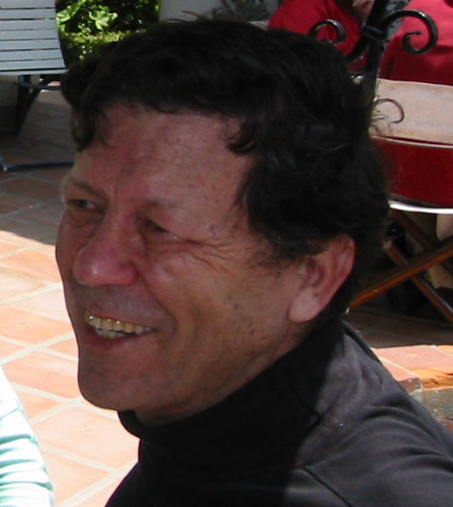

Slide 2
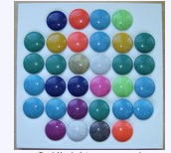
Those Early Days
The game of Mem (Tolly Holt) somewhere in a Venice den of software geeks near the Pacific Ocean

Slide 3
Danny Cohen, the Eclectic
FIELDS OF RESEARCH INTEREST
* High Performance LANs, and Multi-Computing
* Distributed Realtime Simulation
* Realtime Interactive Computer Graphics.
* Network Security
* Information Architecture
* BM/C3 (Battle Management / Command, Control, and Communication)
* Realtime Digital Computer Communication (Computer Networks).
* Application of Digital Computers to Aviation (Cockpit Information Systems).
* Flight Simulation, and Computer Image Generation (CIG).
* Very Large Scale Integration (VLSI).
* Computer Architecture and Parallel Processing.
* Secure Digital Speech and Video Communication over Computer Networks.
* Mathematical Programming and Operations Research.

Slide 4
A Few of Danny’s Contributions
His early work on dynamic perspective showed how to rotate 3D images on a general purpose computer (anticipating virtual reality) and how to do 3D-clipping interactively in realtime.
The MOSIS system that Danny initiated and developed has been operational for over 30 years.
Danny was one of the first to promote separating IP from TCP, which led to the adoption of UDP as a key protocol in the Interenet; UDP supports the vast amount of streaming traffic in the Internet. His groundbreaking work on the Network Voice Protocol (NVP) defined the protocol that was used to develop the first system that proved the applicability of packet switching networks to voice (and later to video).

Slide 5
Real-Time
Traffic
Short response time
High Throughput
Interactive
Traffic
File
Transfer
High Reliability

Slide 6
Endians
This is an attempt to stop a war. I hope it is not too late and that somehow, magically perhaps, peace will prevail again.
The latecomers into the arena believe that the issue is: "What is the proper byte order in messages?".
The root of the conflict lies much deeper than that. It is the question of which bit should travel first, the bit from the little end of the word, or the bit from the big end of the word?
The followers of the former approach are called the Little-Endians, and the followers of the latter are called the Big-Endians
MEMORY ORDER, TRANSMISSION ORDER, ORDER OF NUMBERS, INTEGERS vs. FRACTIONS
“Endian” has over 4,000,000 hits
https://tools.ietf.org/rfcmarkup?url=ftp://ftp.rfc-editor.org/in-notes/ien/ien137.txt

Slide 7
An Internet Pioneer

Slide 8
A Poem by Danny
"In the Beginning, ARPA created the ARPANET.
And the ARPANET was without form and void.
And darkness was upon the deep.
And the spirit of ARPA moved upon the face of the network and ARPA said, 'Let there be a protocol,' and there was a protocol. And ARPA saw that it was good.
And ARPA said, 'Let there be more protocols,' and it was so. And ARPA saw that it was good.
And ARPA said, 'Let there be more networks,' and it was so.”

Slide 9
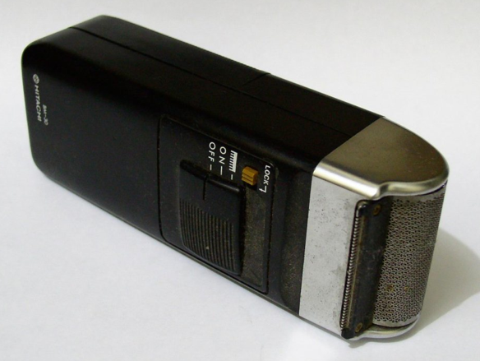
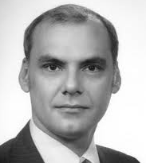
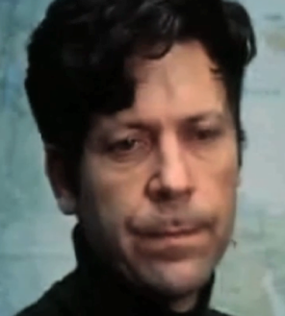
An Accomplice in Crime
September 1973
University of Sussex, Brighton, England
Housed in the dormitories
We jogged the hills of Brighton
The Razor
The Night Owl
The Criminal Courier

Slide 10
Danny at ISI
But where is his phone?

Slide 11
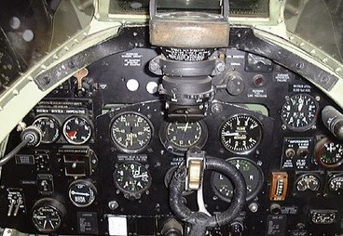
An Aircraft Instrument Panel

Slide 12
Running to Go Sailing, or Flying, or Biking

Slide 13
Early VOIP (with Sunglasses)

Slide 14
Early VOIP (without Sunglasses)

Slide 15
Danny Then in a Turtleneck

Slide 16
Danny now in a Tux!

Slide 17
