Slide 1
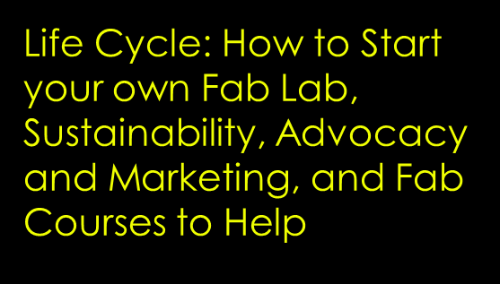

Slide 2
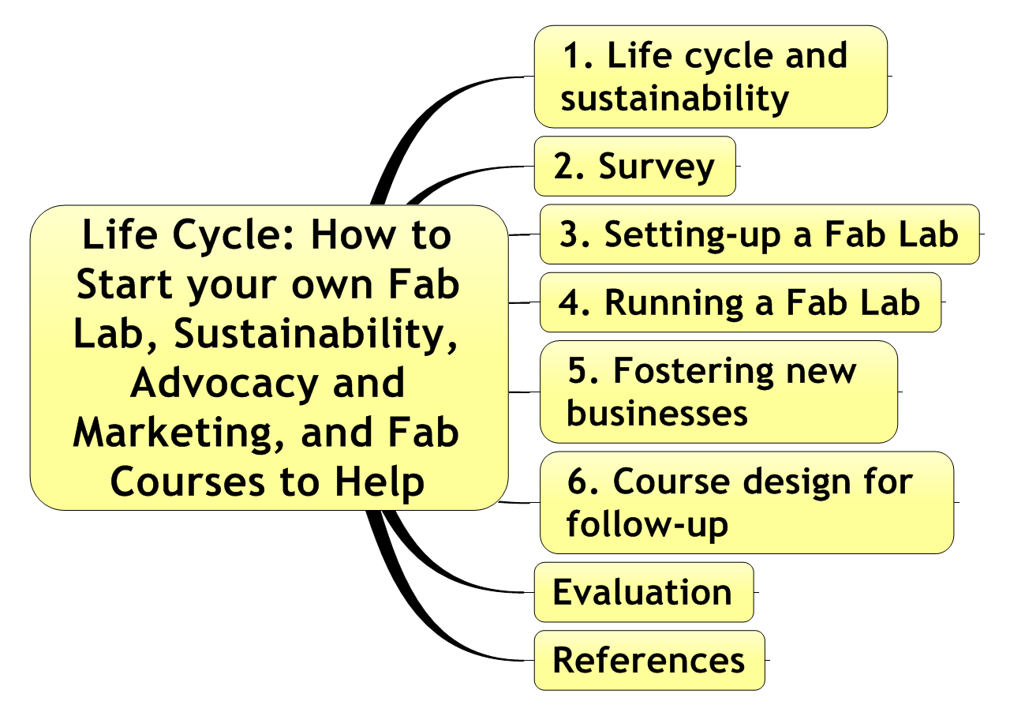
Graphics of contents

Slide 3
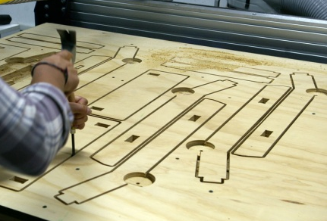
1. Life cycle and sustainability
Business models
Access, production - hourly access, personal production, local production
Education - workshops, training, degree certification
Enabler - Products & services to enable Fab Labs: software, installation and support, supply chain, curriculum
Incubator - Invention / business creation, individual entrepreneurs, joint ventures
Network - Leveraging the power of the Fab Lab network: multi-site invention, production, distribution.
Attraction - The Fab Lab as a "touristic" attraction.
Human resources - The Fab Lab as source of consultants etc.

Slide 4
2. Survey
Stage of the life cycle
Activities (services) and business models
Burning questions

Slide 5
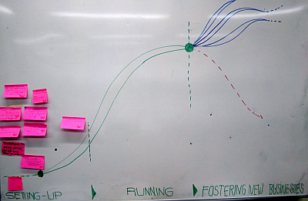
3. Setting-up a Fab Lab

Slide 6
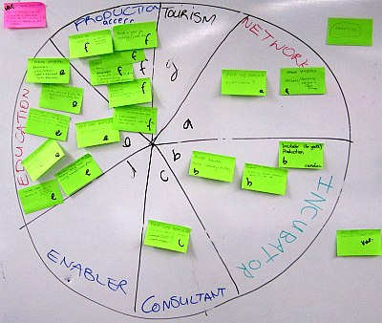
4. Running a Fab Lab

Slide 7
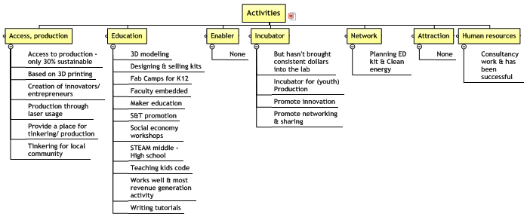
4. Running a Fab Lab

Slide 8
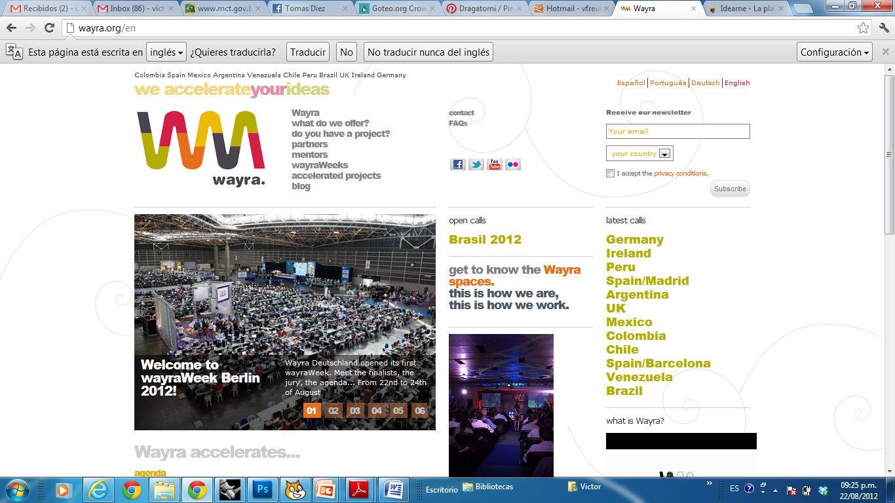
5. Fostering new businesses

Slide 9
5. Fostering new businesses
FaceMe! - design, make, play
Goteo - open projects - http://www.goteo.org
idea-me - http://idea.me
Kickstarter - for financial support - http://www.kickstarter.com
Loftwork
MIT 100k $ - where MENS meets MANUS - http://mit100k.org
Nxtplabs.com - helps starters grow faster - http://www.nextplabs.com
Startup Chile - http://www.startupchili.org
WAYRA - We Accelarate Your Ideas - http://wayra.org

Slide 10
5. Fostering new businesses
concept | advantages | disadvantages
Fab Lab | Social agenda Global Community Loosely standardised Democratise Access No legal brand Global Conference Diversity | Standardization
Maker space
Hacker space

Slide 11
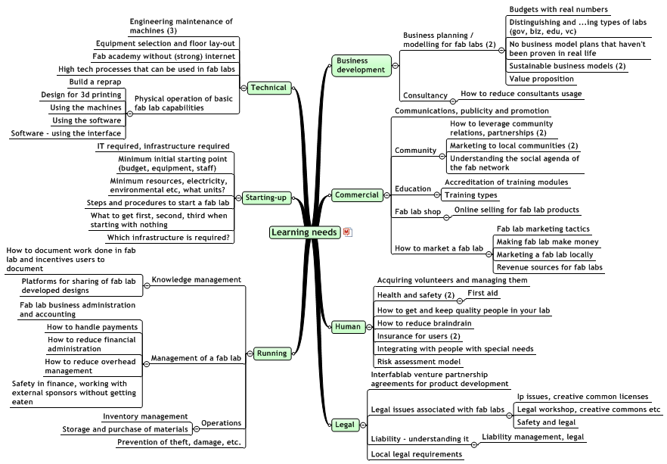
6. Course design for follow-up

Slide 12
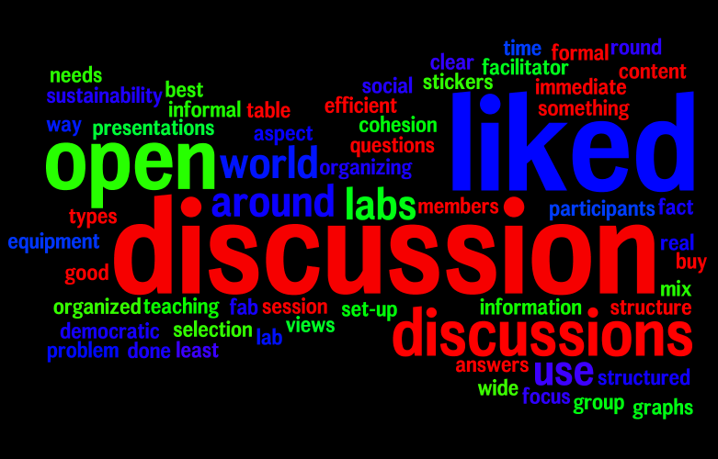
Evaluation

Slide 13
References
Business model generation; Alexander Osterwalder et al.; self published; 2009; available in various languages; www.businessmodelgeneration.com; free preview 72 pages: http://businessmodelgeneration.com/downloads/businessmodelgeneration_preview.pdf.
Digital fabrication Initial Planning Guide, Digital fabrication Introduction Guide, Digital fabrication Instruction Guide; US Fab Lab Network; http://usfln.org.
Fab Academy; Pilot program “How to manage a Fab Lab”; Klaas Hernamdt et al.; Waag Society, Amsterdam, 2012.
FabLabLIMA, www.fablablima.org, REPORTE 22 02 10 (18p)
Fostering new businesses; FabLab, Lima, 2012
Sustainable Fab Labs; presentation at Fab7 International Conference; John Boeck & Peter Troxler; Lima, Peru, 2011.
All materials can be found via http://www.fablabinternational.org, page “Resources”.

Slide 14
Thank you!
Summary of a 3-hour Workshop during Fab8 International Conference; Wellington, New Zealand, 22-28 August 2012; 25 participants.
Beno Juarez (beno@fablablima.org),
Lindi Mophuti (lindi.mphuthi@gmail.com), Victor Freundt (victor@fablablima.org) and ,
Pieter van der Hijden (pvdh@sofos.nl).

