Slide 1
International Fab Lab Association – General Meeting at Fab8
Wellington, New Zealand, 22-28 August 2012

Slide 2
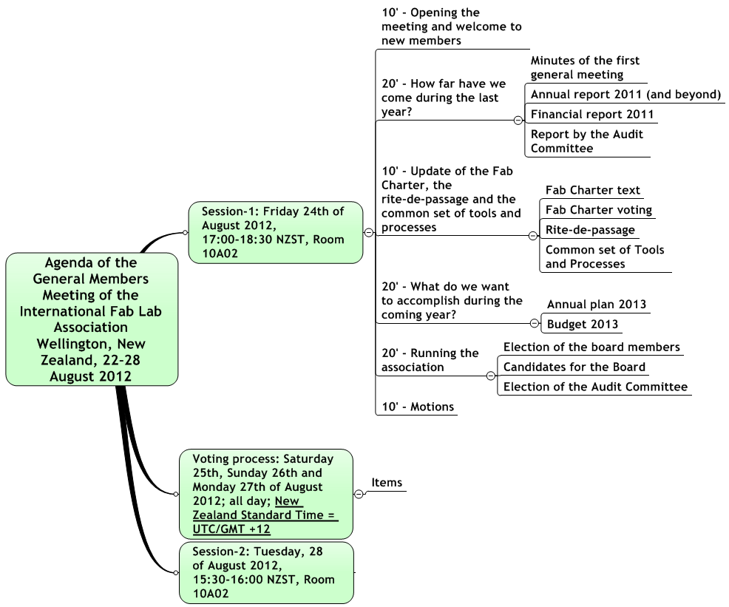
Agenda

Slide 3
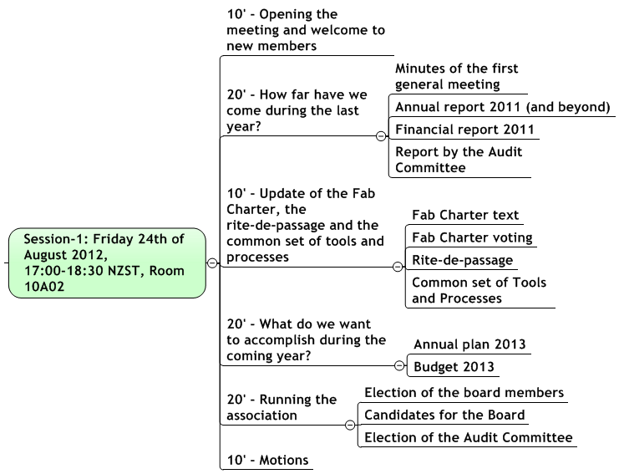
Session-1

Slide 4
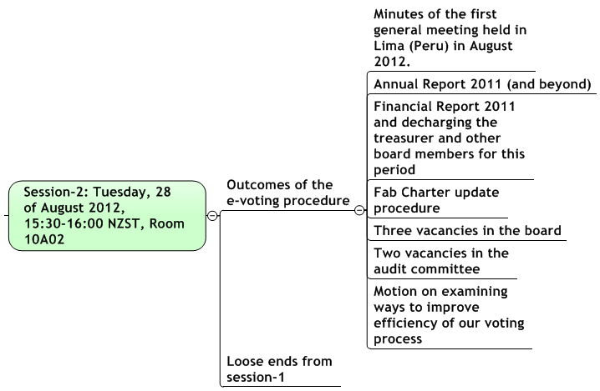
Session-2

Slide 5
Thank you!
International Fab Lab Association
www.fablabinternational.org

