Slide 1
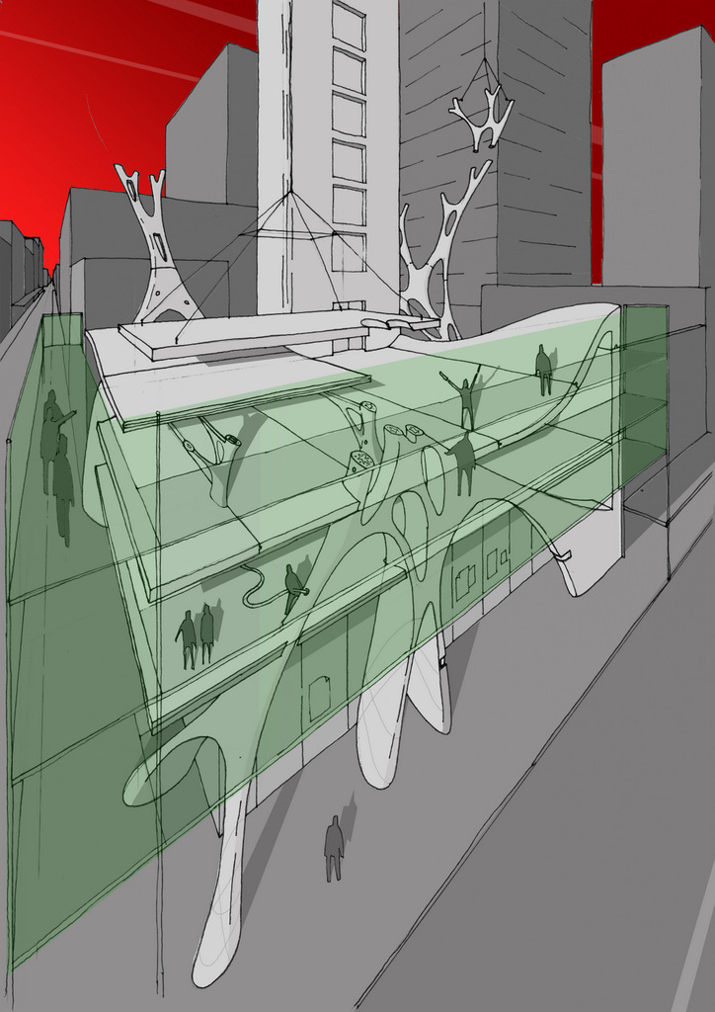
fabrication in construction
Andrew Maher Digital Innovation, Arup
James Gardiner Engineering Excellence Group, Laing O’Rourke

Slide 2
fabrication in construction
scaling up
many tools for different tasks
new techniques, new constraints

Slide 3
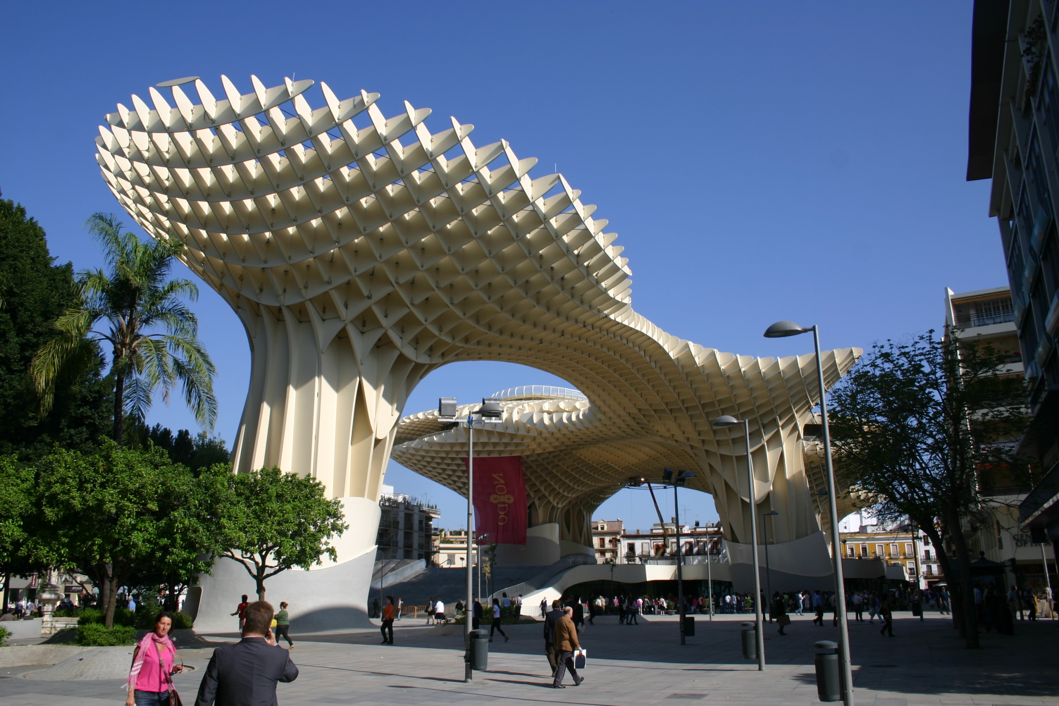
scaling up

Slide 5
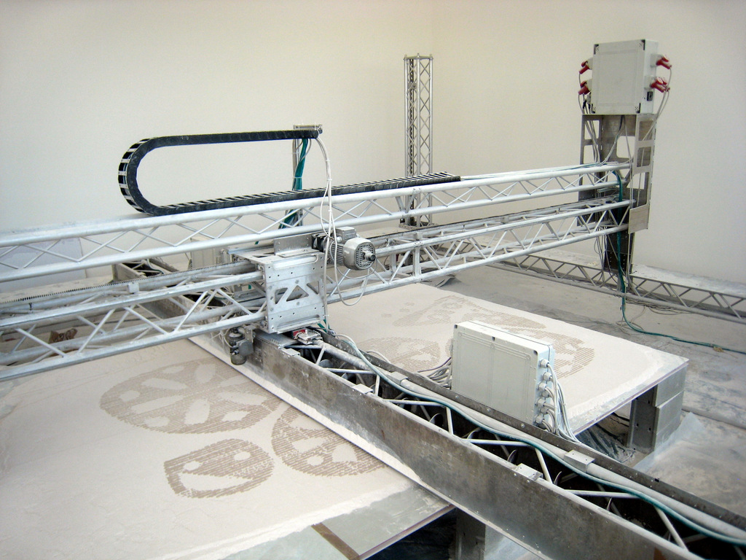
scaling up

Slide 6
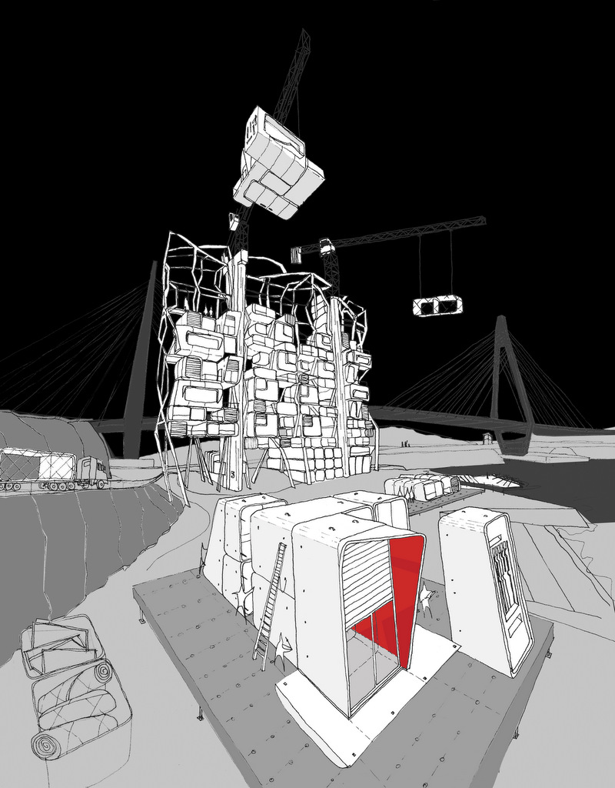
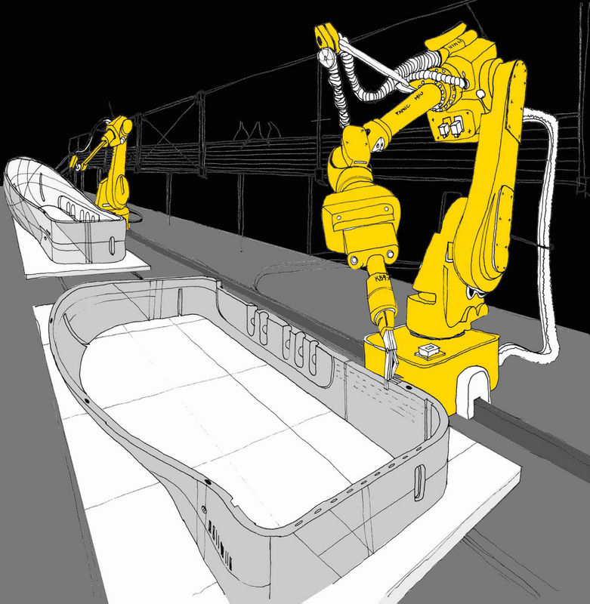
scaling up
adaptation

Slide 7
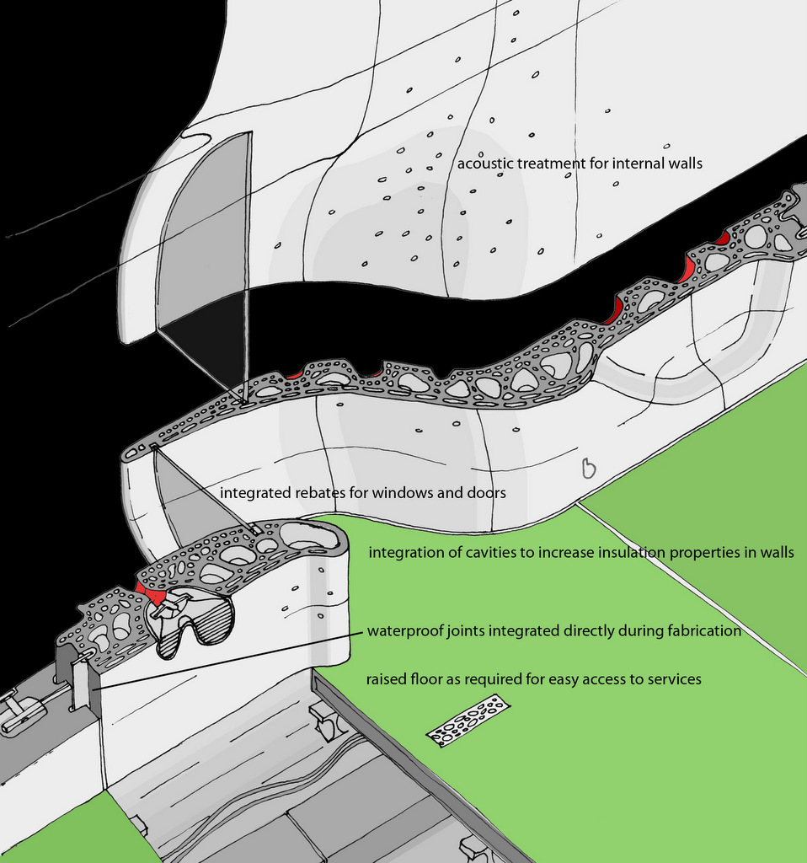
scaling up
one material many functions

Slide 8
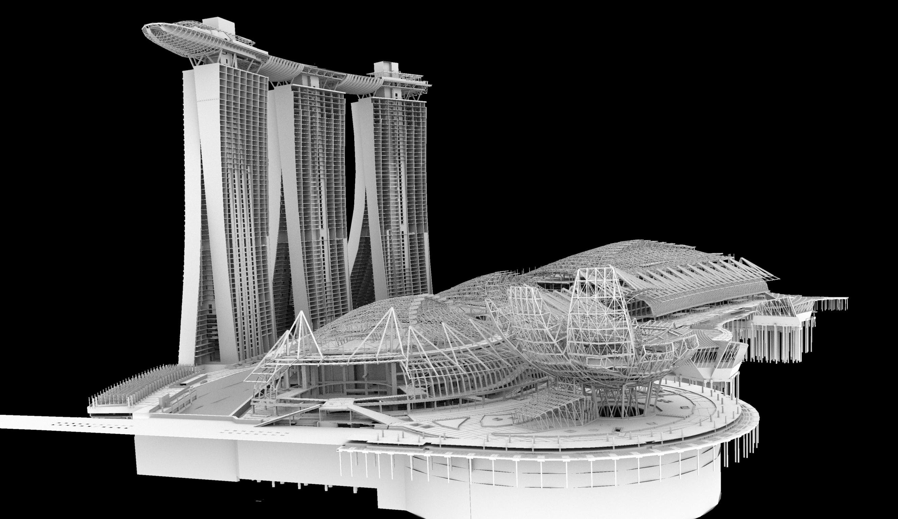
many tools for different tasks

Slide 10
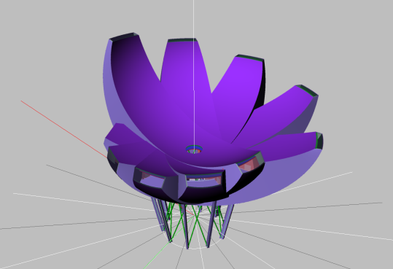
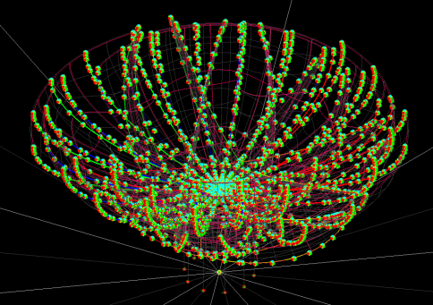
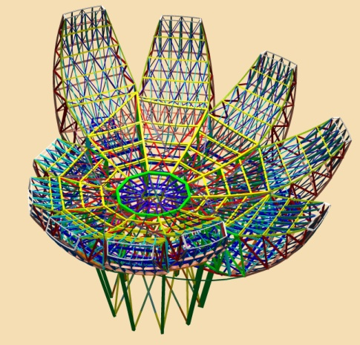
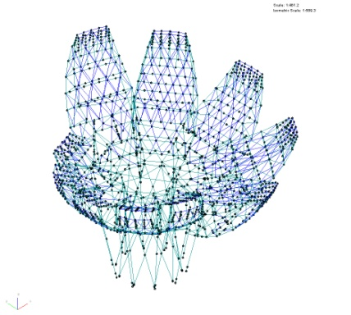
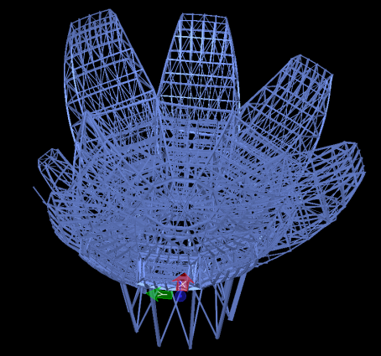
GC
GSA
Analysis
Rhino
Architect
many tools for different tasks
design, analysis and documentation
Bentley STF
Model
XSteel / Prosteel
Fabrication

Slide 11
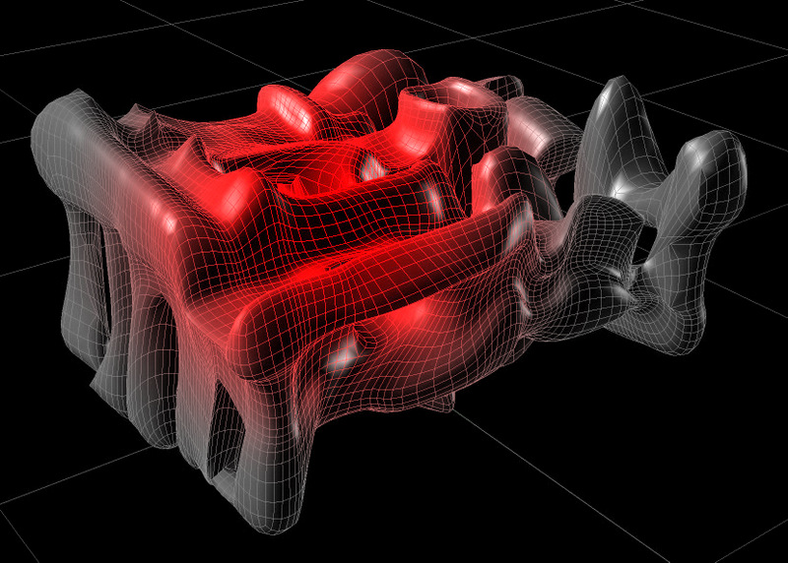
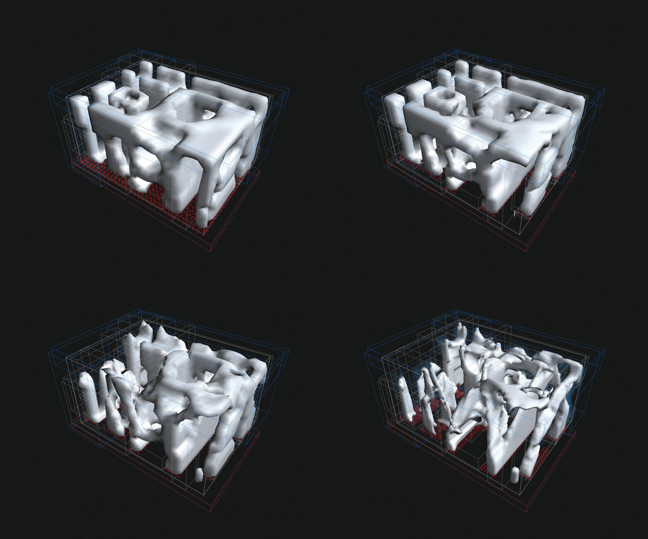
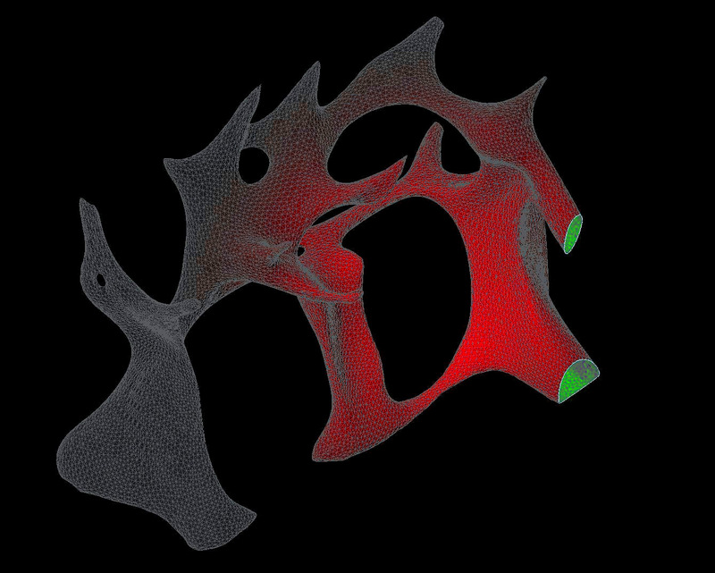
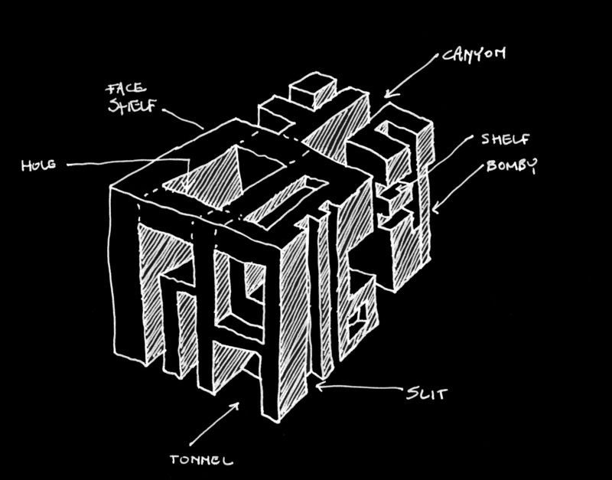
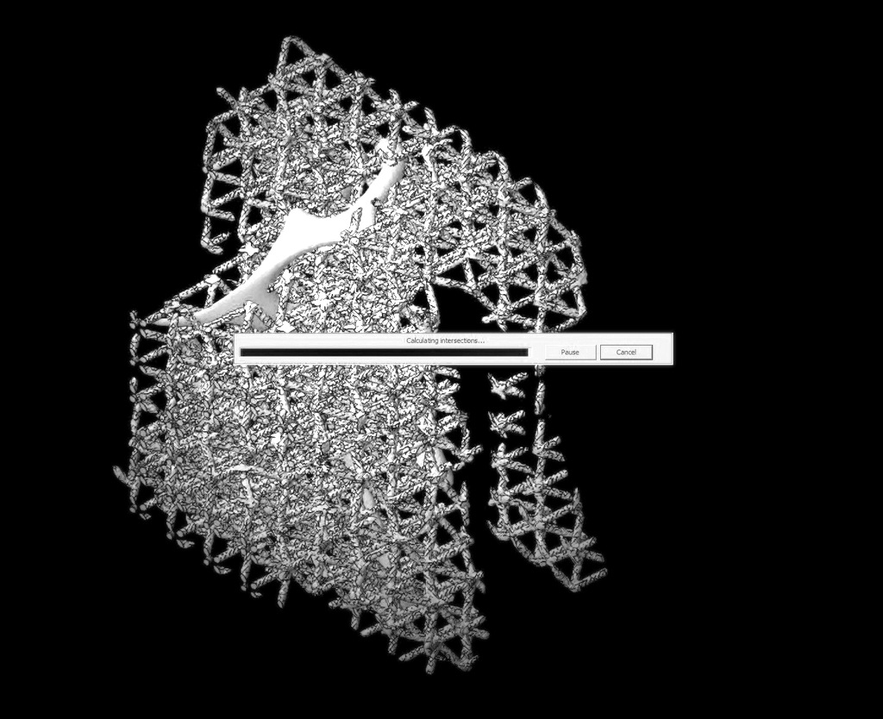
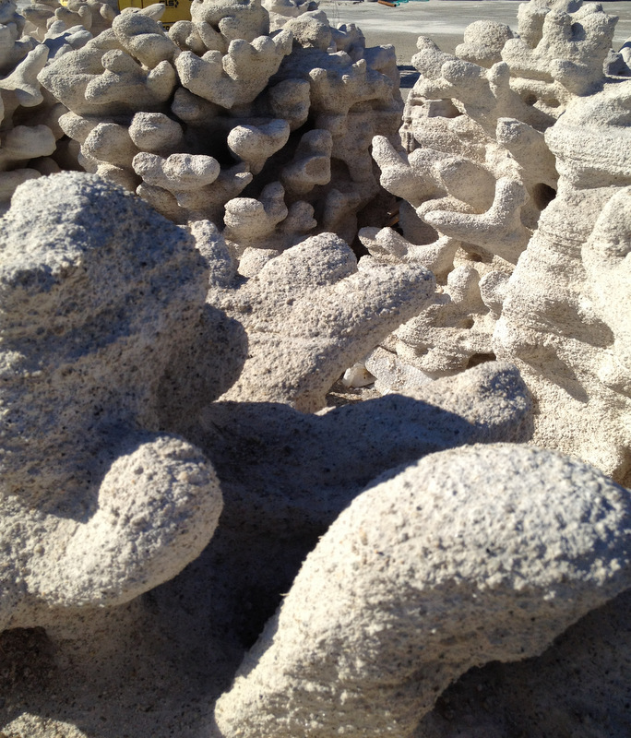
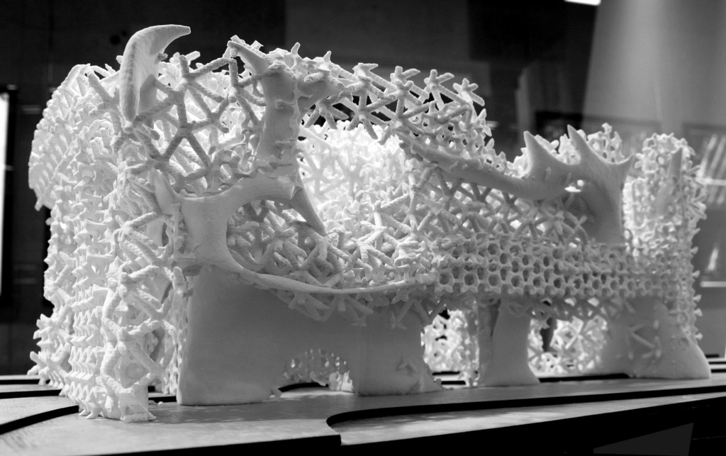
many tools for different tasks
design to fabrication of artificial reef

Slide 13
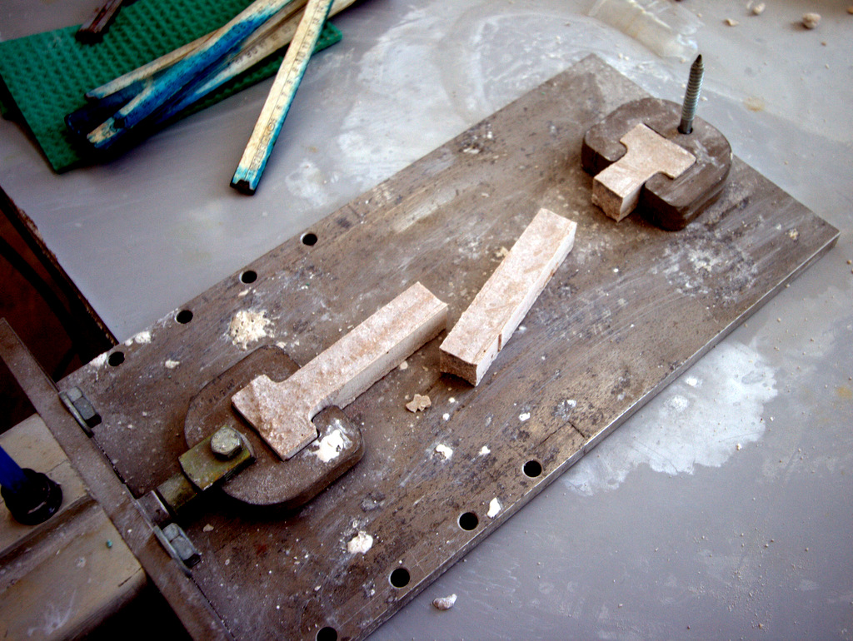
new techniques, new constraints

Slide 14
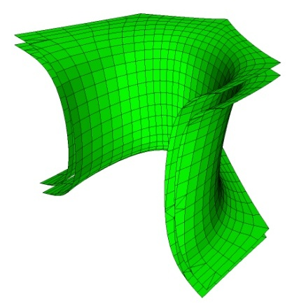
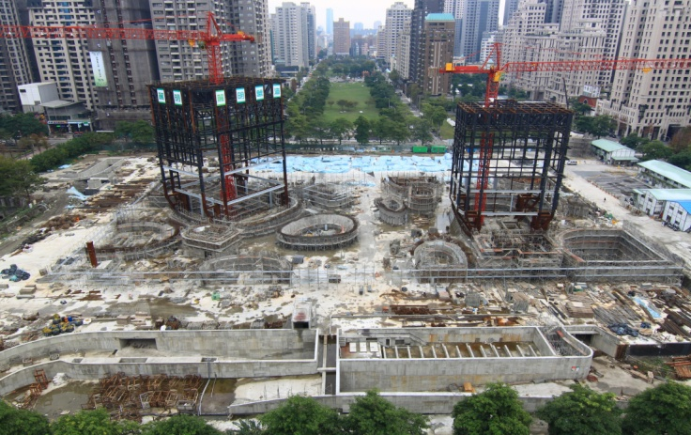
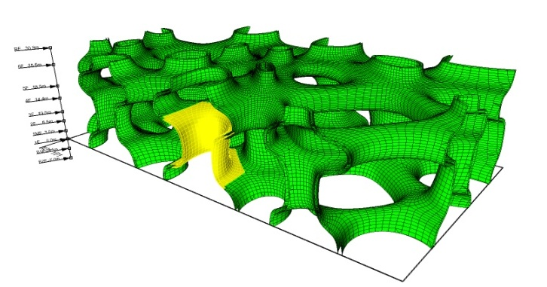
taichung metropolitan opera house
toyo ito and associates
one key piece of information is the location of reinforcement

Slide 15
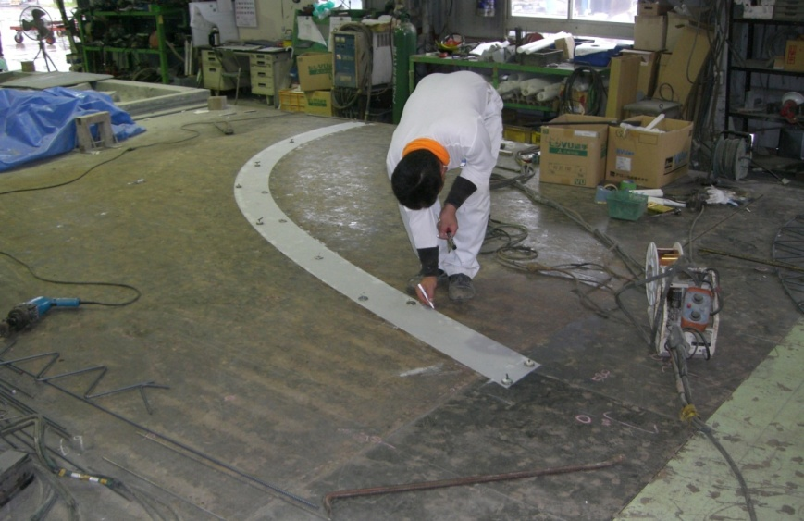
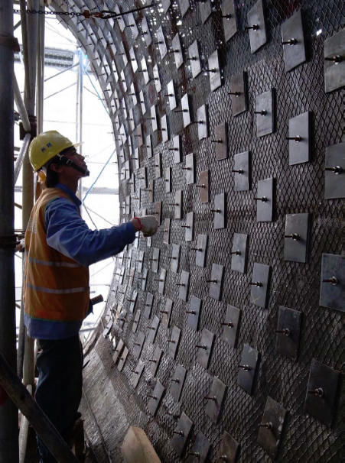
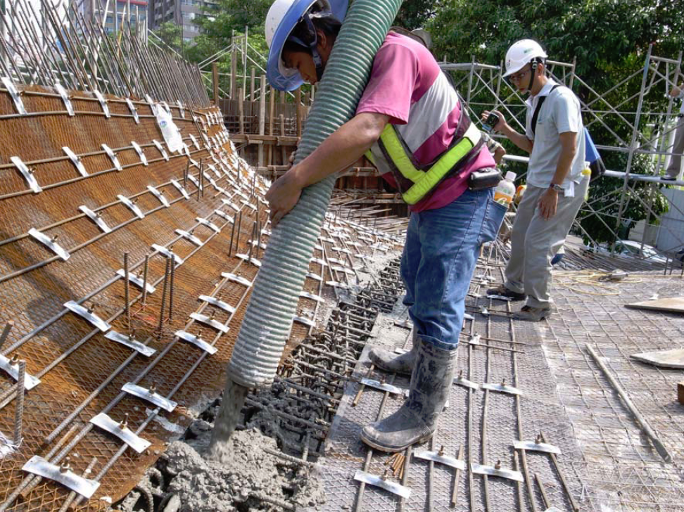
information from the model on site
pouring concrete
in taiwan.
february 2012

Slide 16
new techniques, new constraints

Slide 17
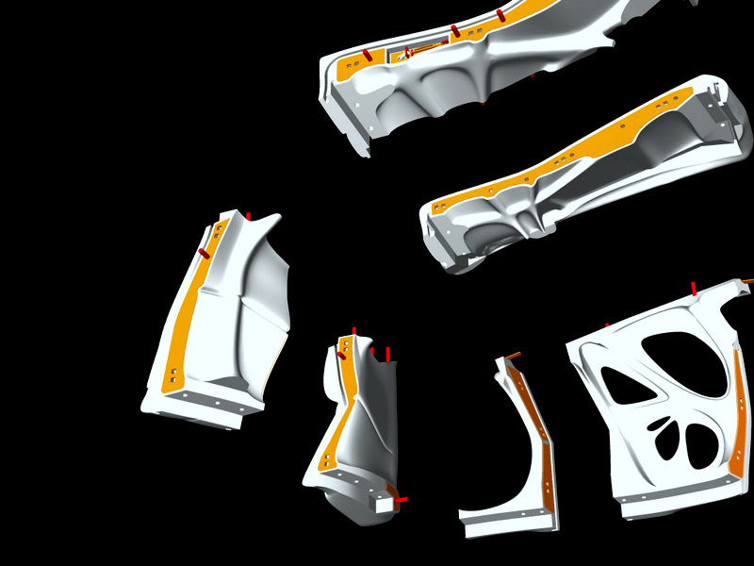
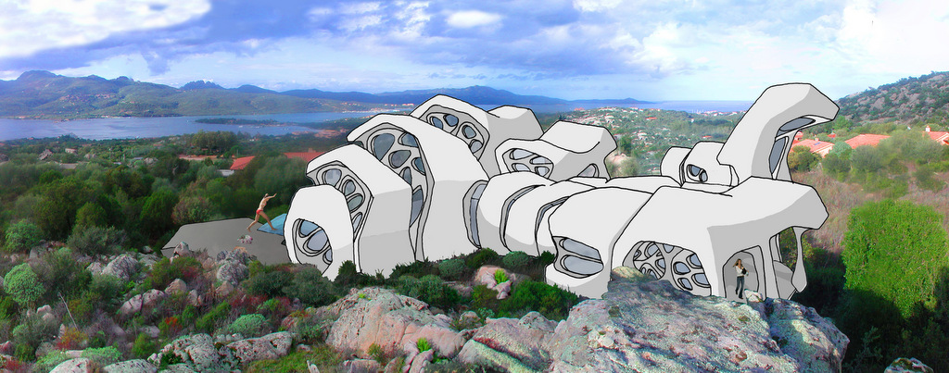
new techniques, new constraints break it down

Slide 18
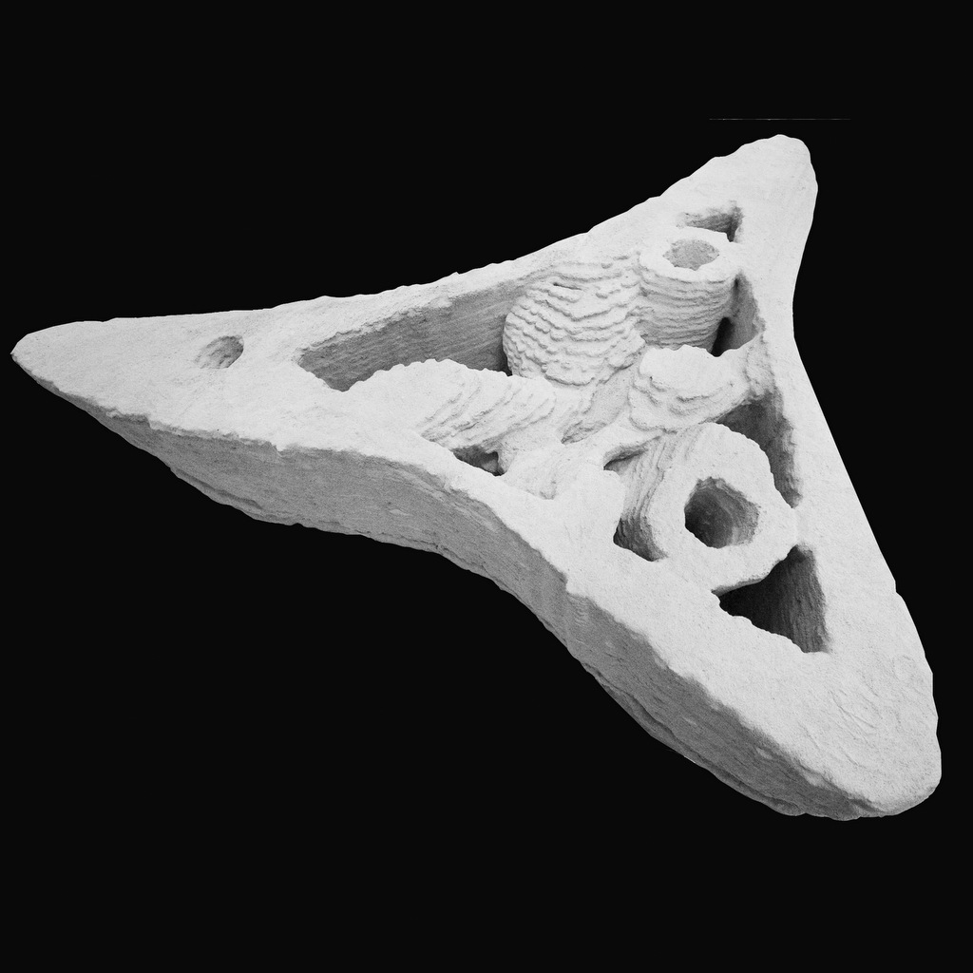
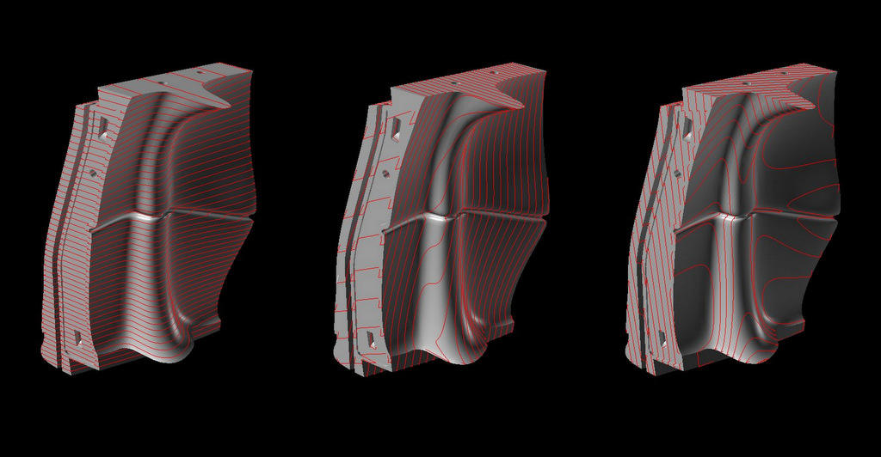
new techniques, new constraints resolution?

Slide 19
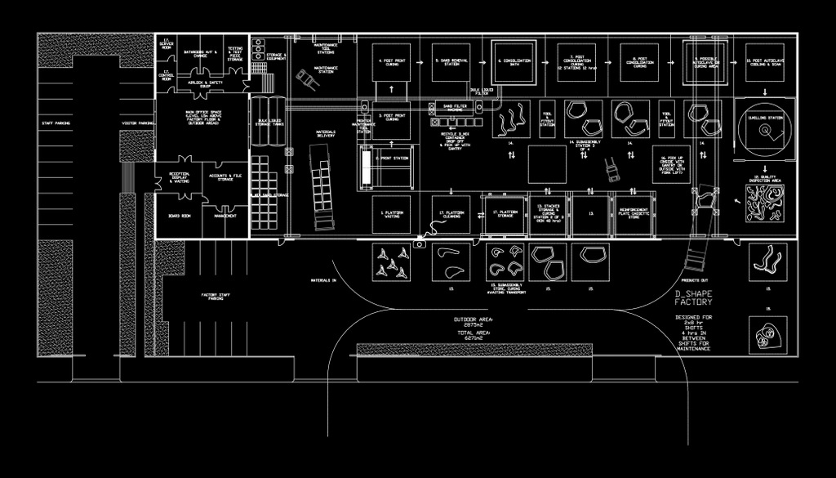
this all means… the future of fabrication for
construction necessitates the
creation of new processes
and new workflows

Slide 20
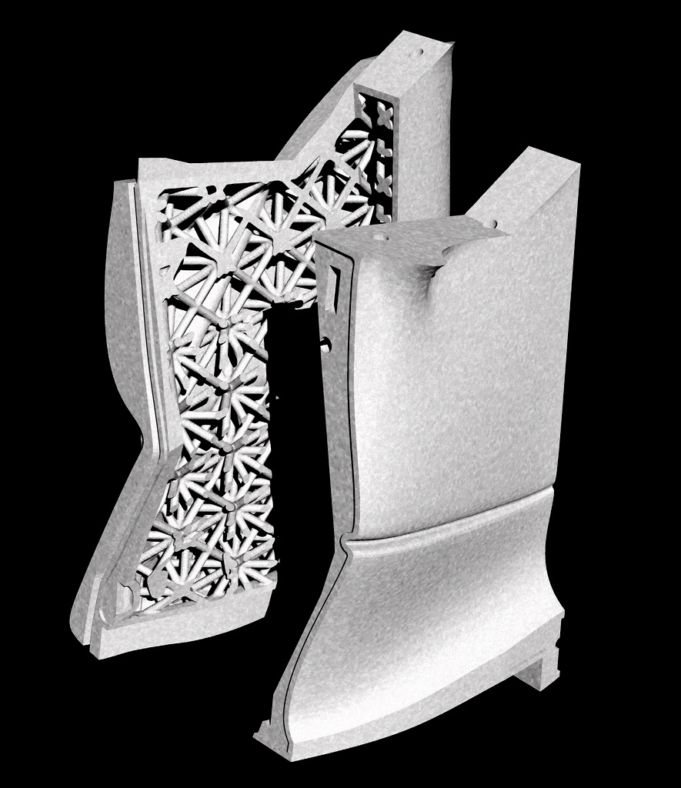
thank you questions?
Andrew Maher Digital Innovation, Arup
James Gardiner Engineering Excellence Group, Laing O’Rourke

