Slide 1
The Innovator’s Hardware Store

Slide 3
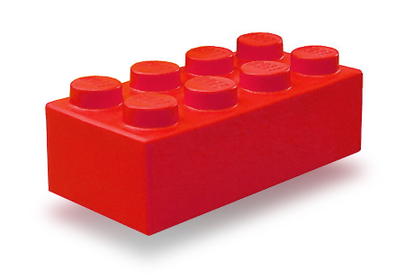

Slide 4
Machine cost over time
$250k
Shopbot
Laser Cutter
Cost
3D printer
PCB Mill
Computer
Vinyl cutter
$200
Year
1991
2011

Slide 5
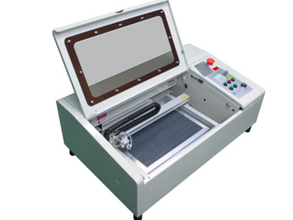
CAD Software
CNC Mill
3D Printer
Laser Cutter
$0
~$500
~$1000
~$2350

Slide 6
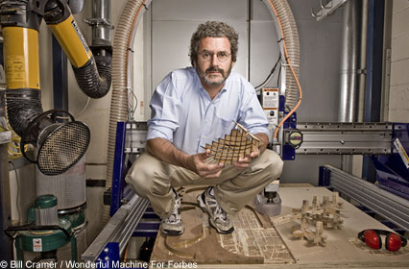

Slide 7
We believe when tools become easy to access, humans create.

Slide 8
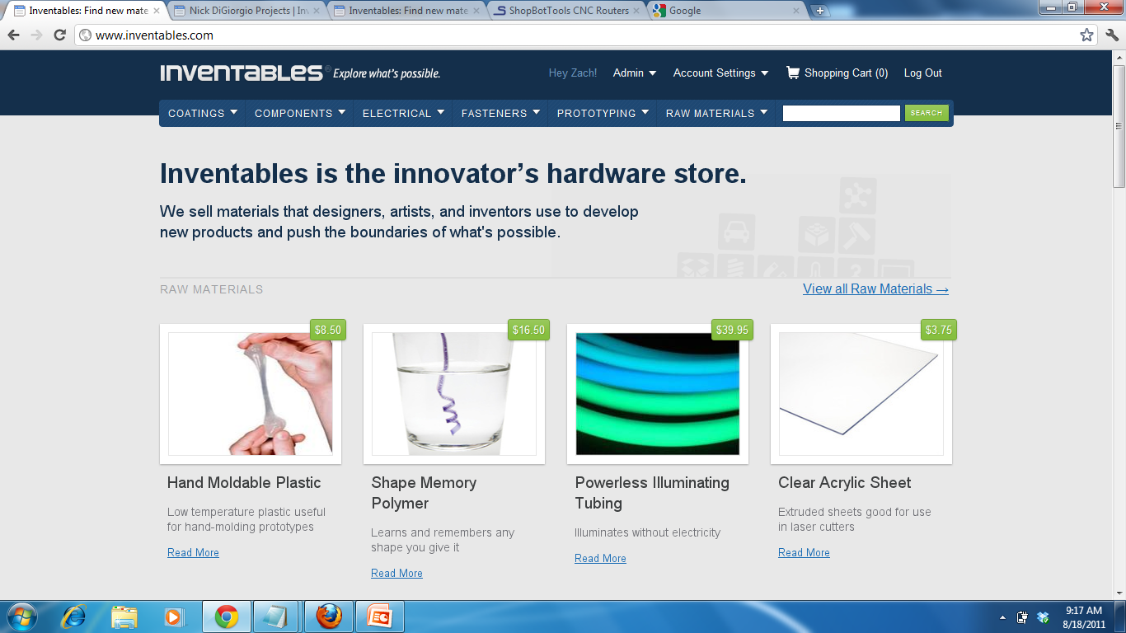

Slide 9
Inspiring and easy to do

Slide 10
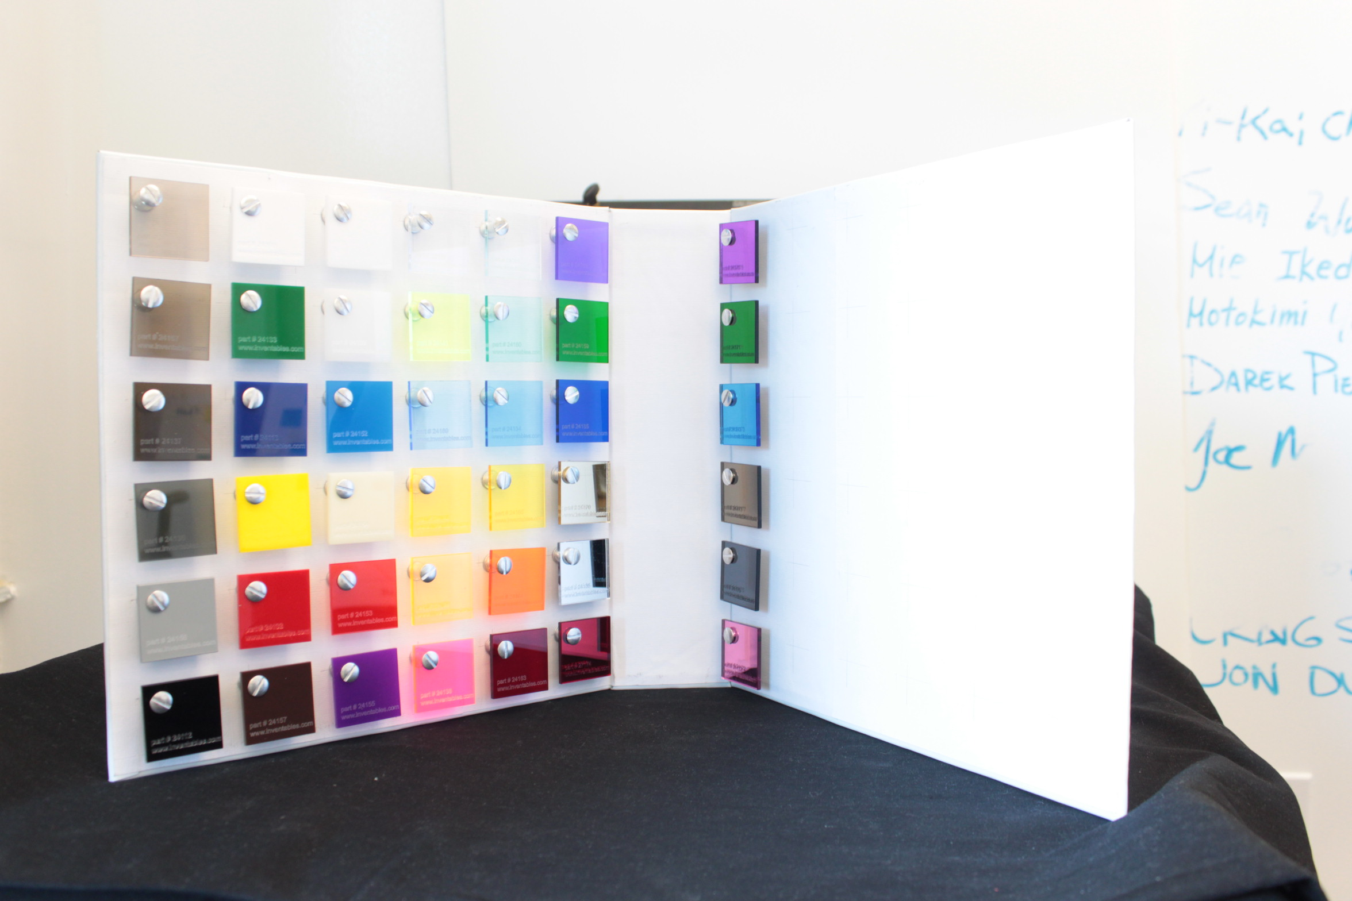

Slide 12
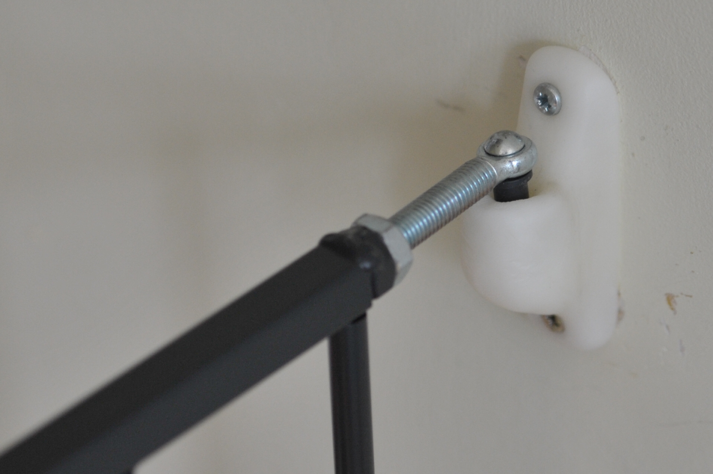

Slide 13
Student Factories

Slide 15
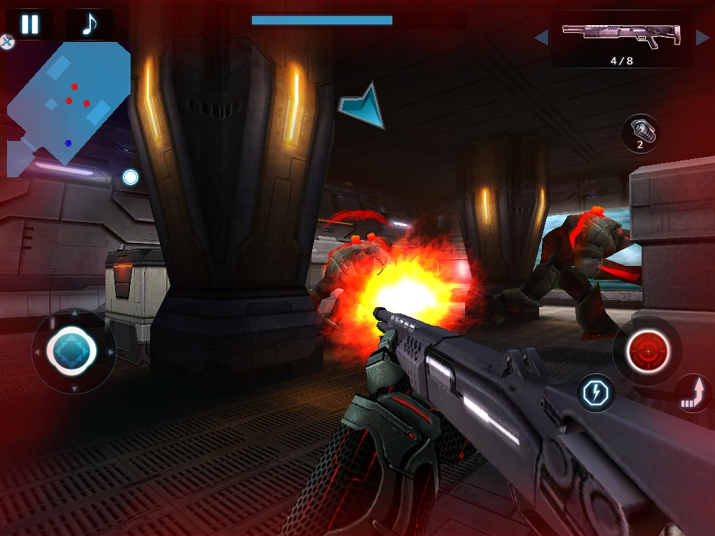

Slide 16
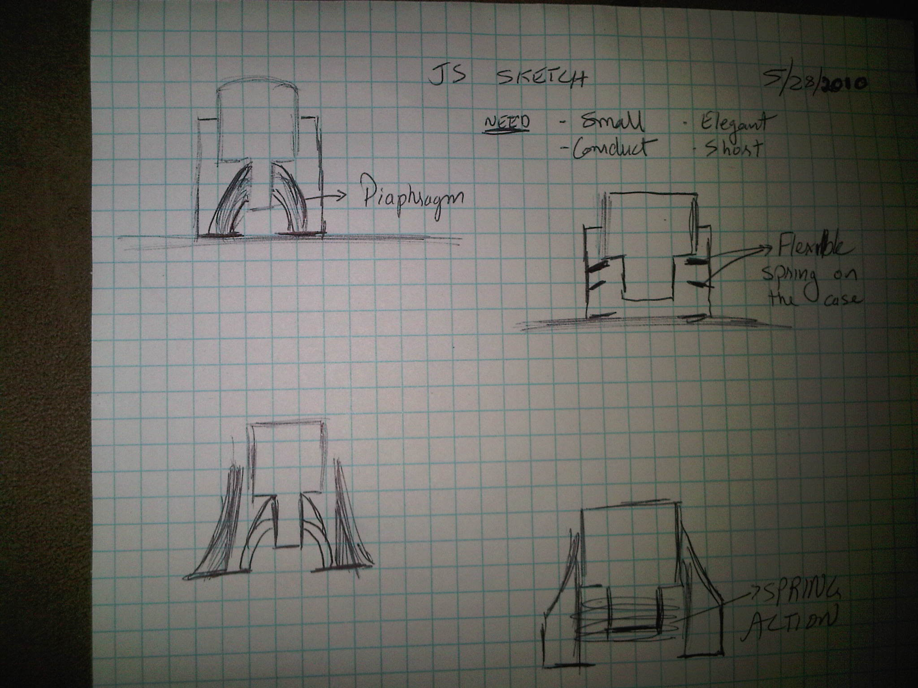

Slide 17
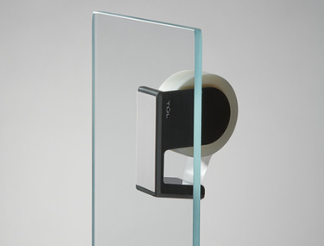
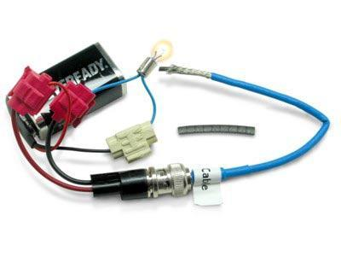
Suction Cup Tape
Conductive Rubber

Slide 18
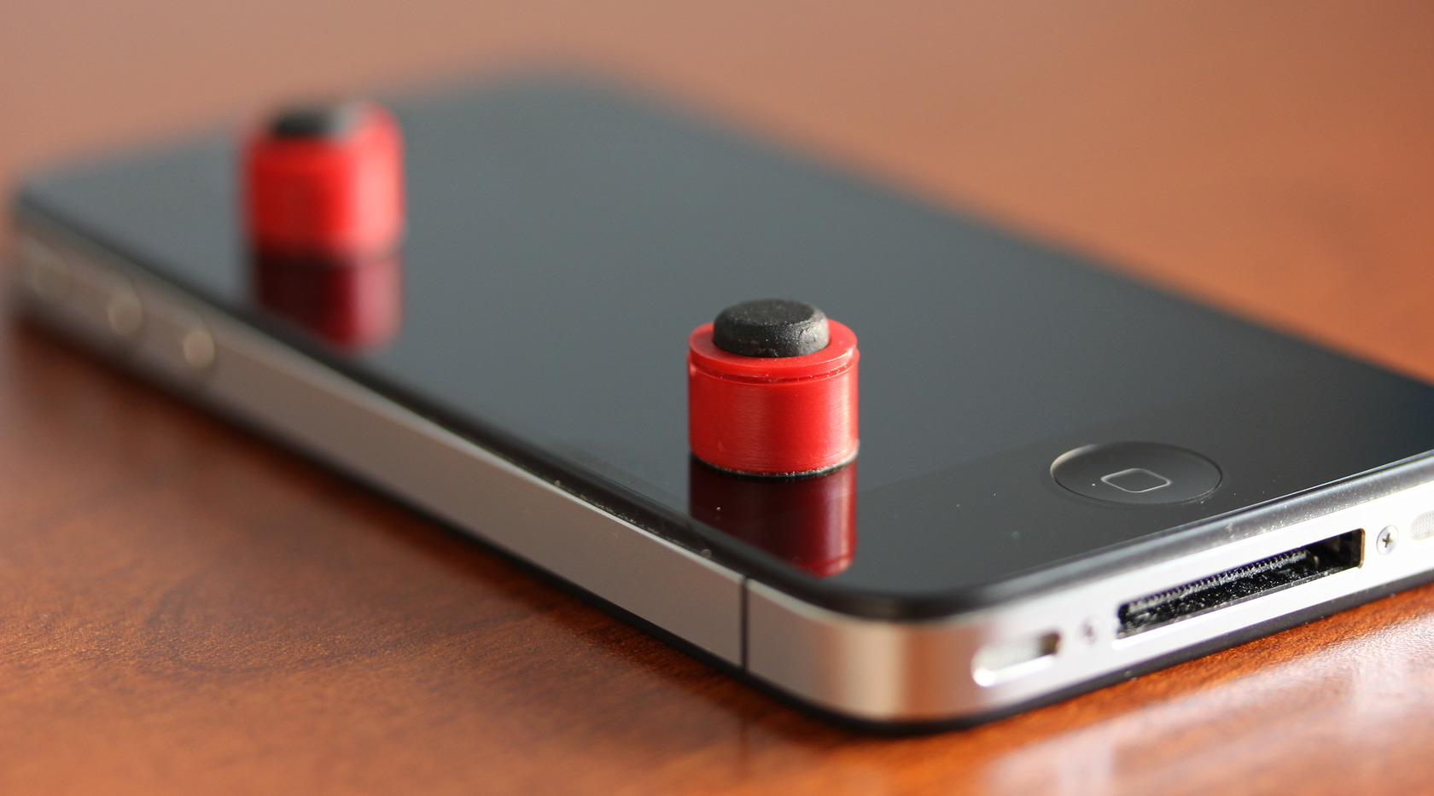

Slide 19
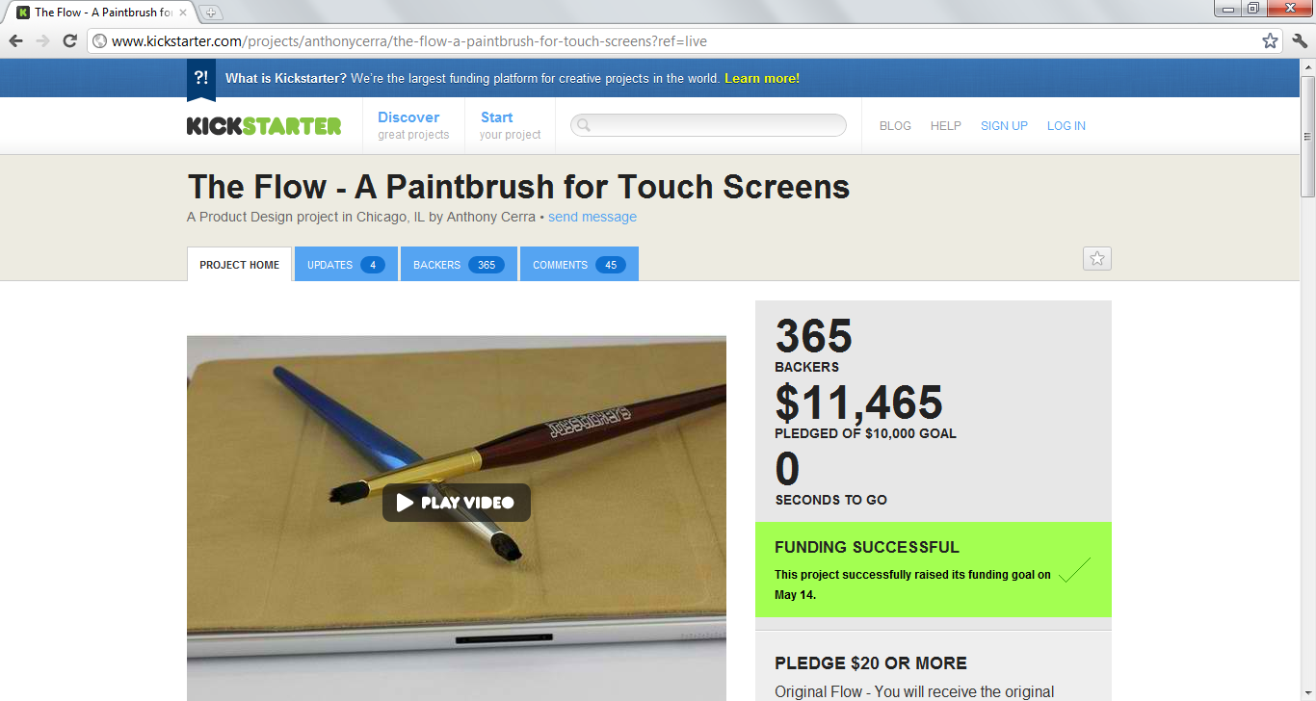

Slide 20
The ETSY Economy

Slide 21
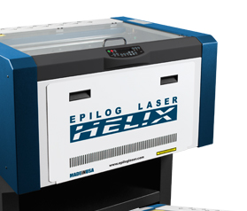

Slide 22
Designed by Kelly Eident made in the AS220 Fab Lab

Slide 23
Created by Cicely Margo cut on laser cutter

Slide 24
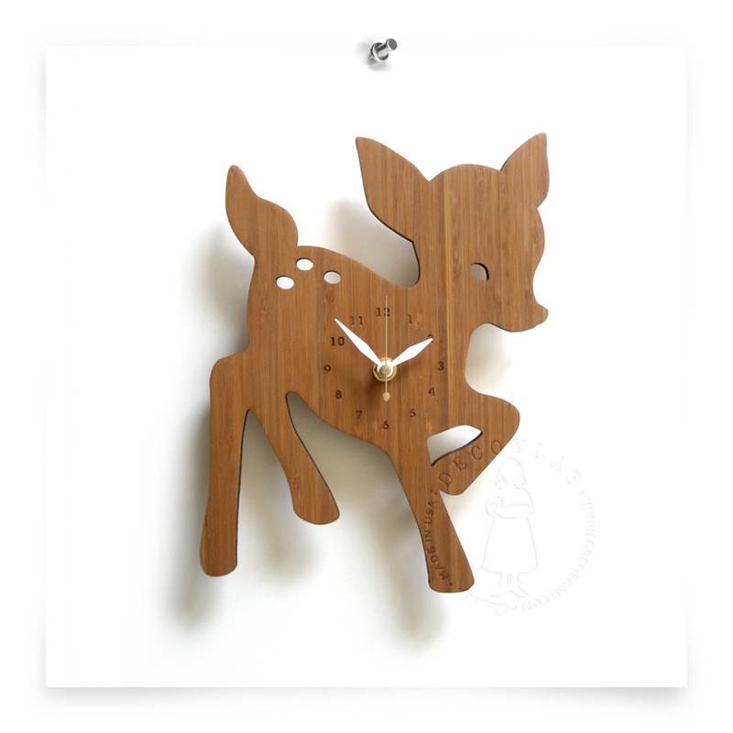
Designed by Maiko Kuzunishi of Decoylab, cut on a laser cutter

Slide 25
Designed by Maiko Kuzunishi of Decoylab, cut on a laser cutter

Slide 26
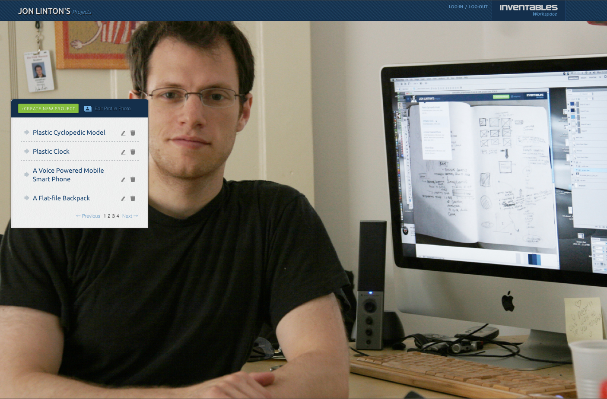

Slide 27
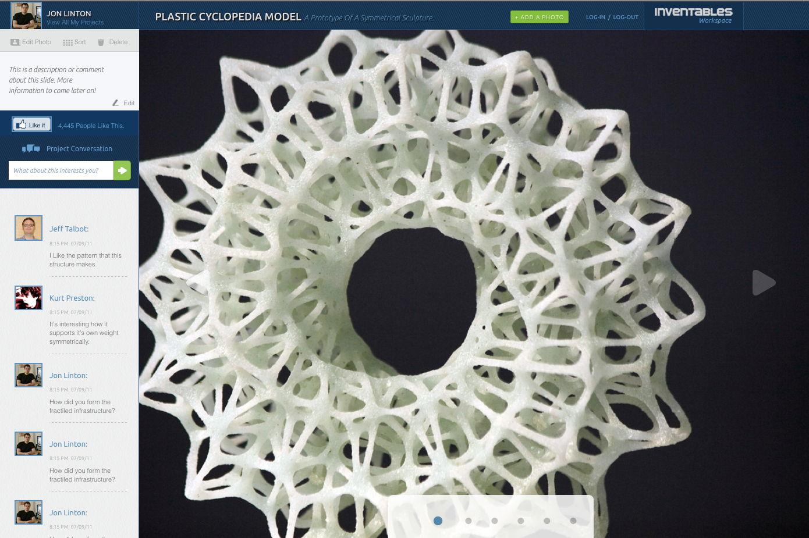

Slide 28
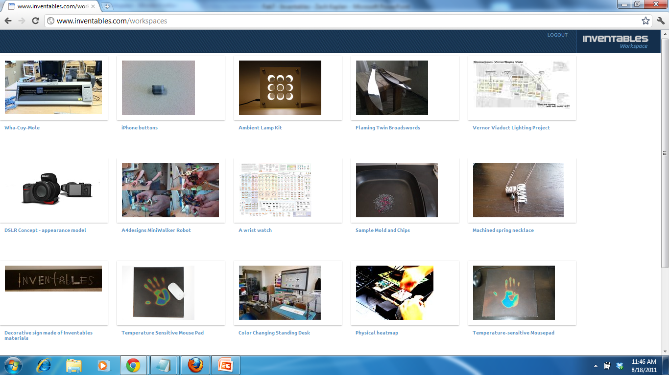

Slide 30
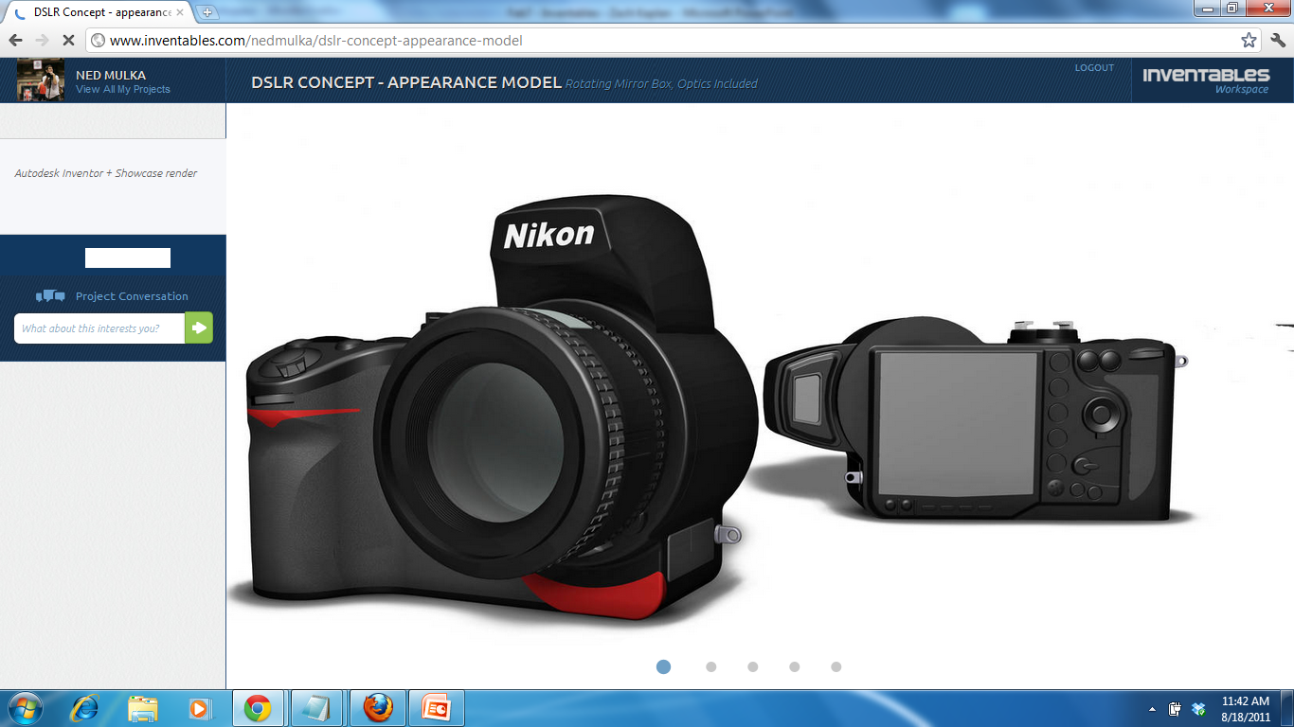

Slide 31
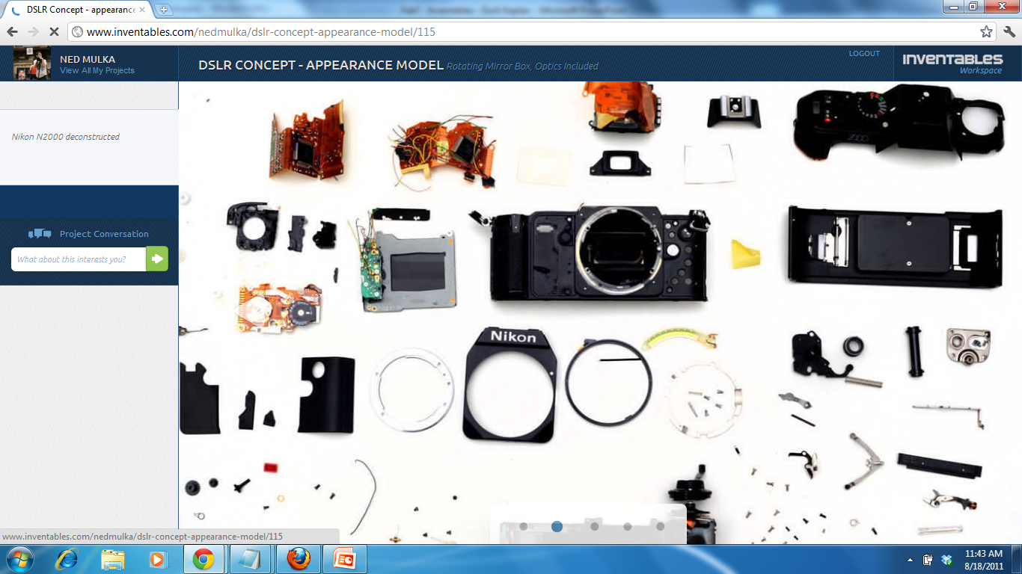

Slide 32
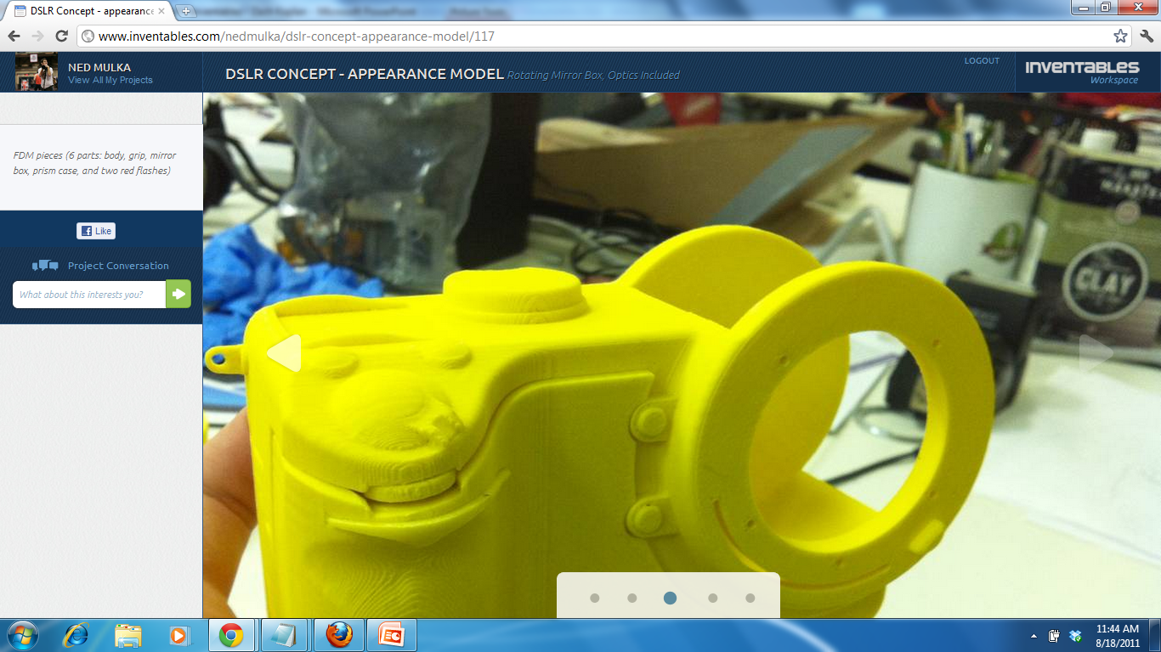

Slide 33
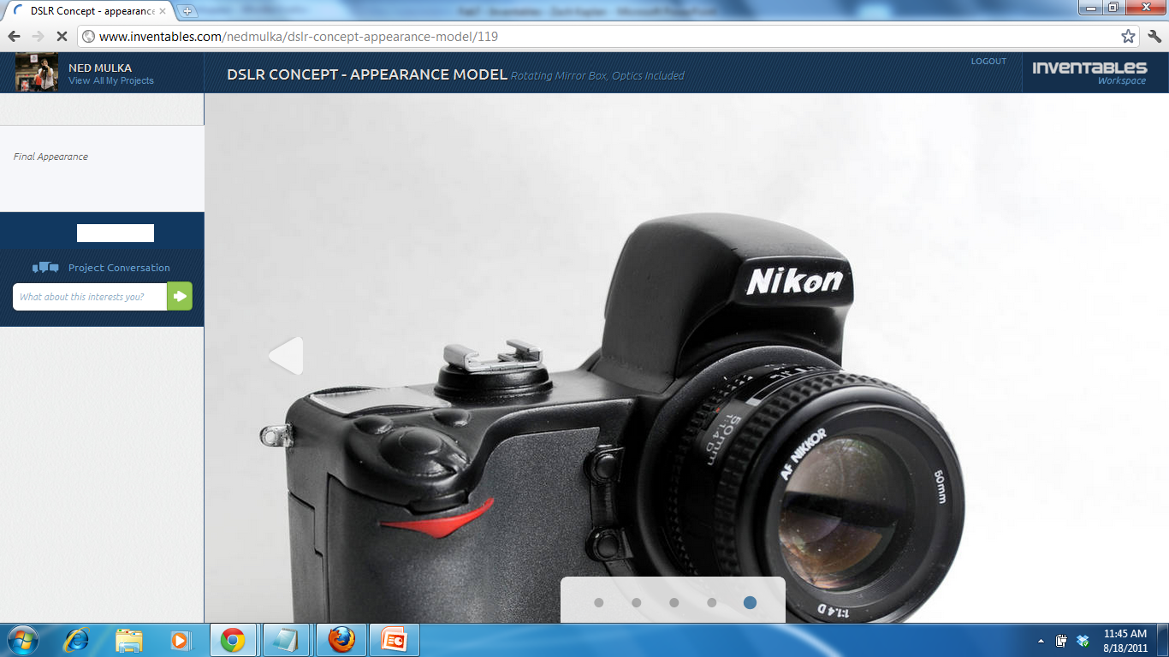

Slide 34
R&D lab on every desktop
www.inventables.com/workspace
help@inventables.com

